Slide 1
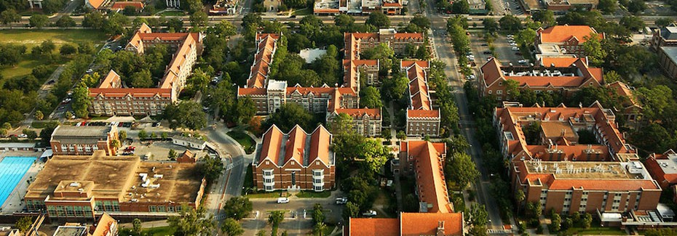
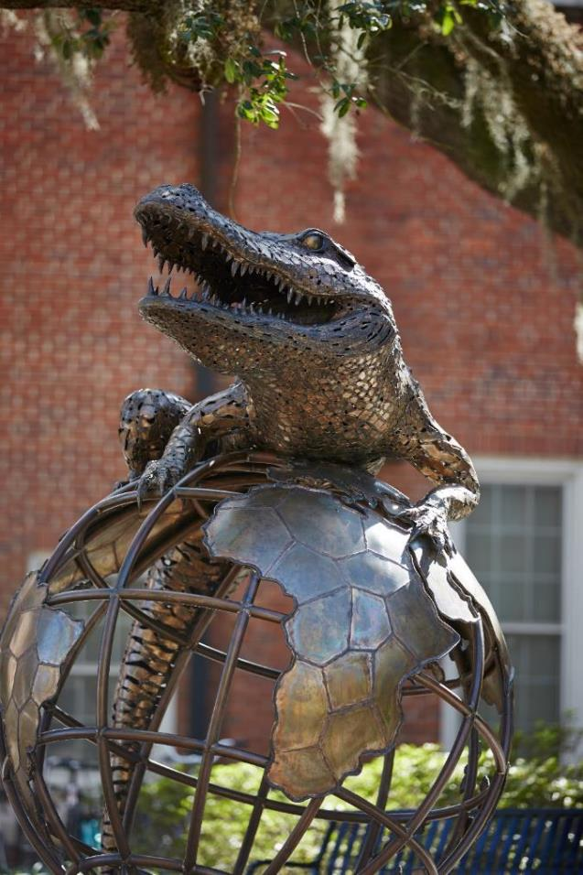

University of Florida
College of Design, Construction and Planning
Bahar Armaghani, LEED Fellow
Director, Sustainability and the Built Environment, and Lecturer
Director, UF Green Building Learning Collaborative
barmagh@ufl.edu
US - Jordanian UCN: Linking Tertiary Education to the Labor Market
November 17, 2020

Slide 2
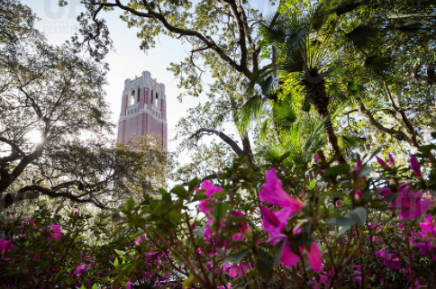
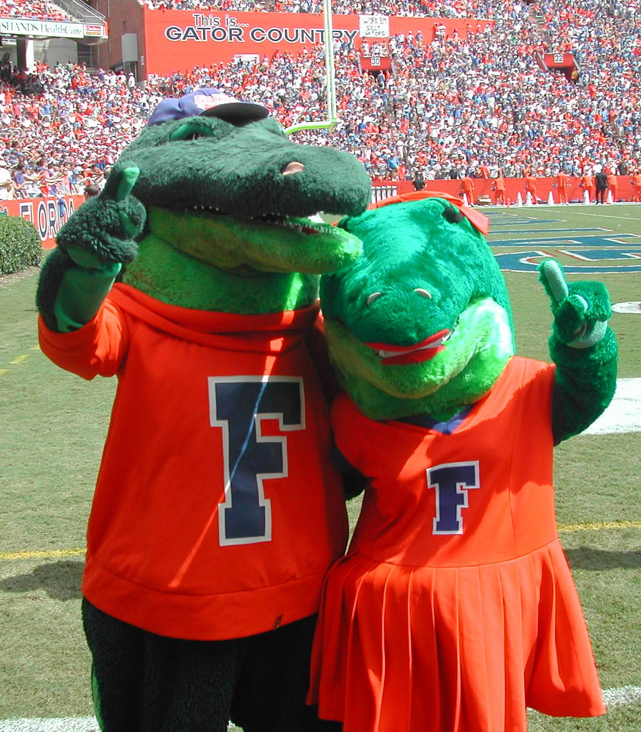
About the University of Florida
Founded in 1853
Florida’s oldest university
Among most academically diverse public universities in the nation
More than 50,000 students, one of the largest universities in the country
More than 38,000 employees, including faculty and staff
The University of Florida is home to 16 academic colleges and more than 150 research centers and institutes
University of Florida offers 103 distinct undergraduate degrees, concentrated into 90 majors within 26 broad fields of study

Slide 3
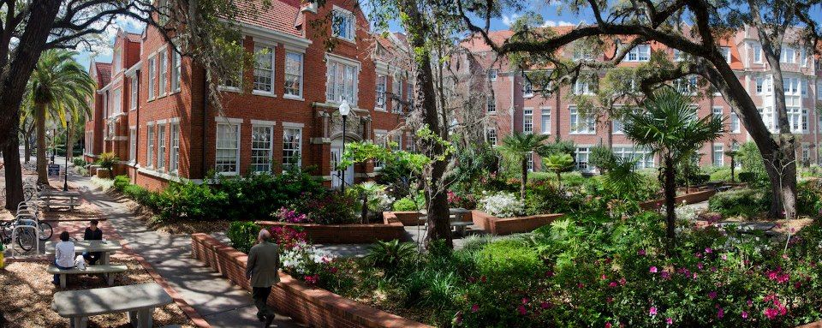

Where We Stand
UF is ranked #6 among public universities, #30 among national universities
UF is ranked #88 in the Academic Ranking of World Universities (Shanghai Ranking)

Slide 4
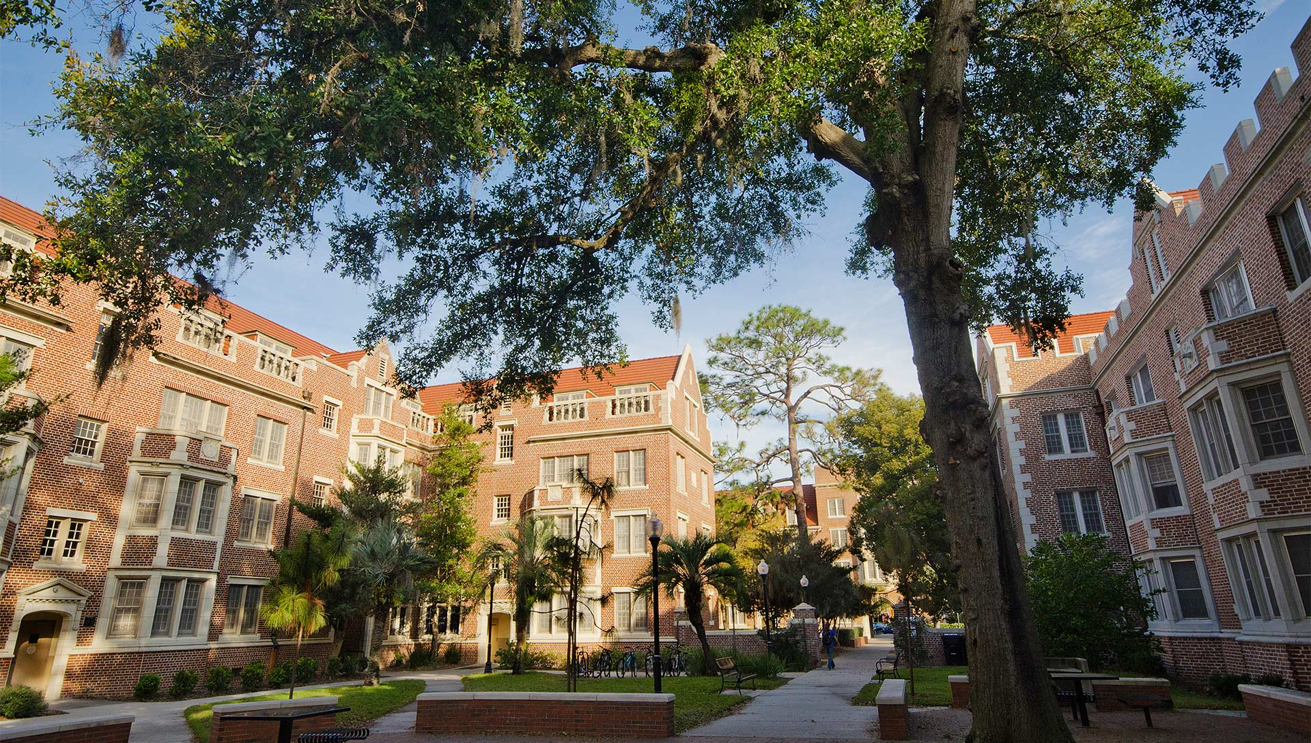
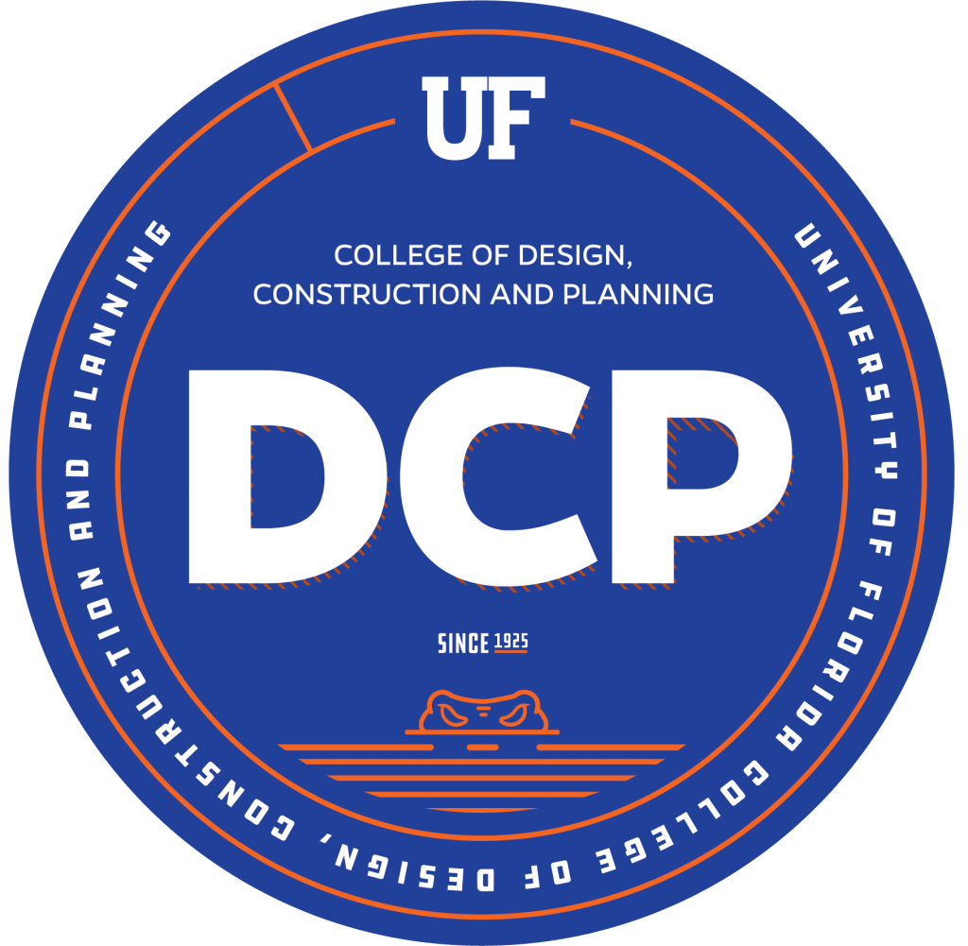
College of Design, Construction and Planning
School of Architecture
School of Construction Management
School of Landscape Architecture and Planning
Department of Interior Design
Degrees Offered:
Bachelor’s Degrees
Master’s Degrees
PhD Degrees
Interdisciplinary programs:
Historic Preservation
Sustainability and the Built Environment

Slide 5
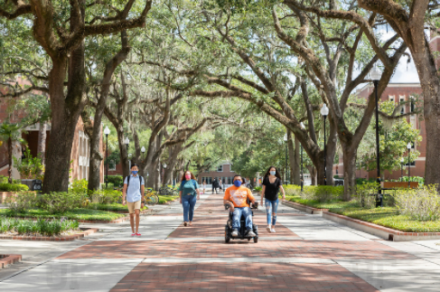
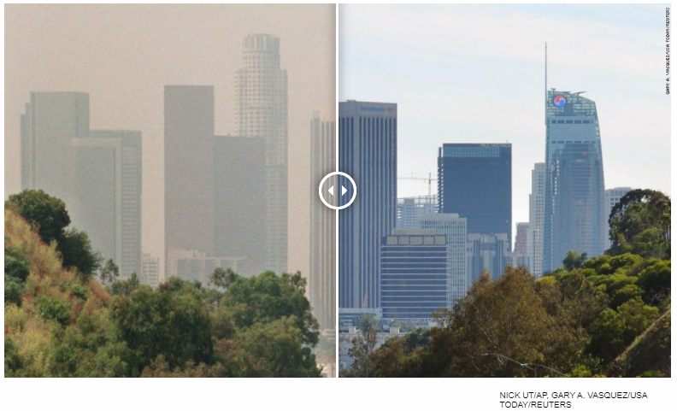
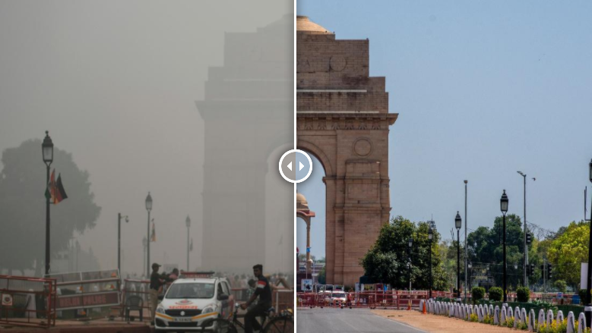
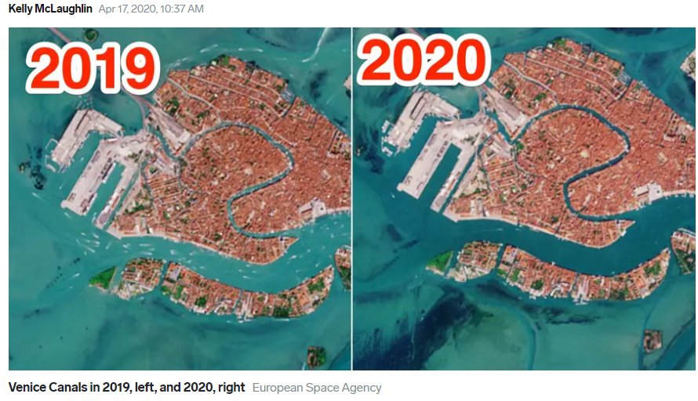
Coronavirus shutdowns have unintended climate benefits
July 1998
March 2020
November 2019
March 2020
China
New Delhi

Slide 6
Sustainability and the Built Environment

Slide 7
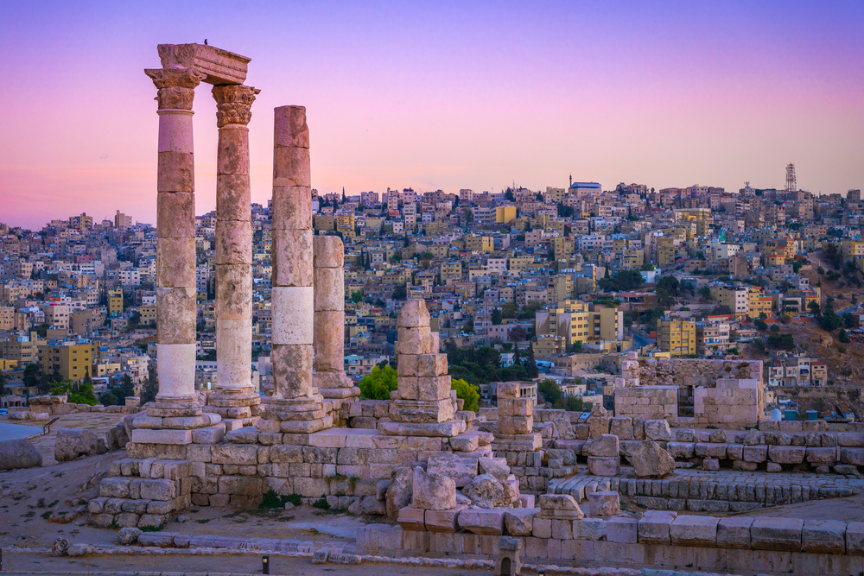


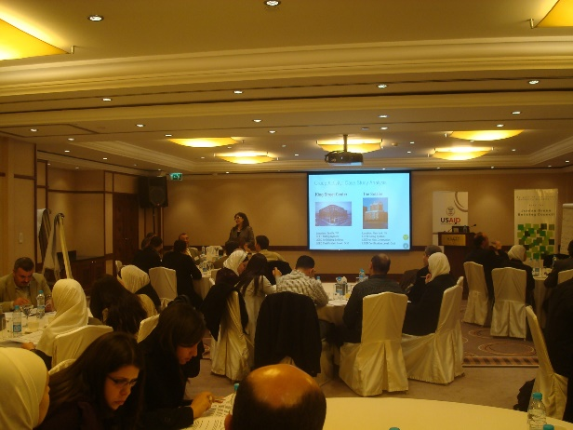
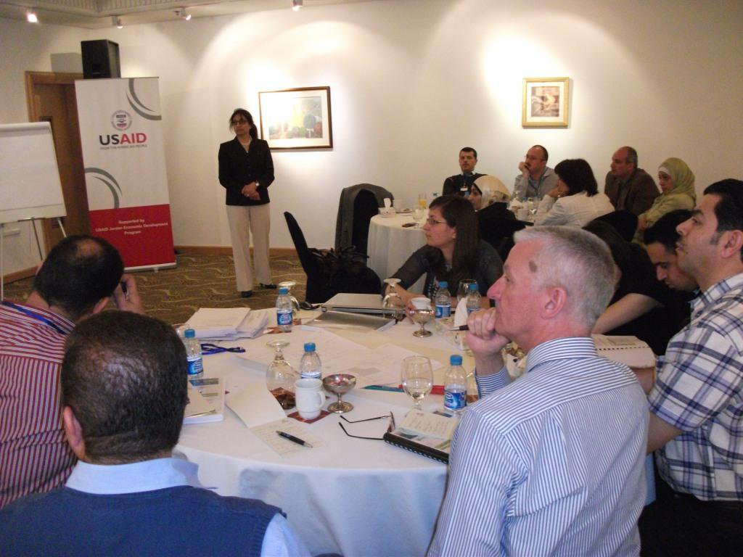
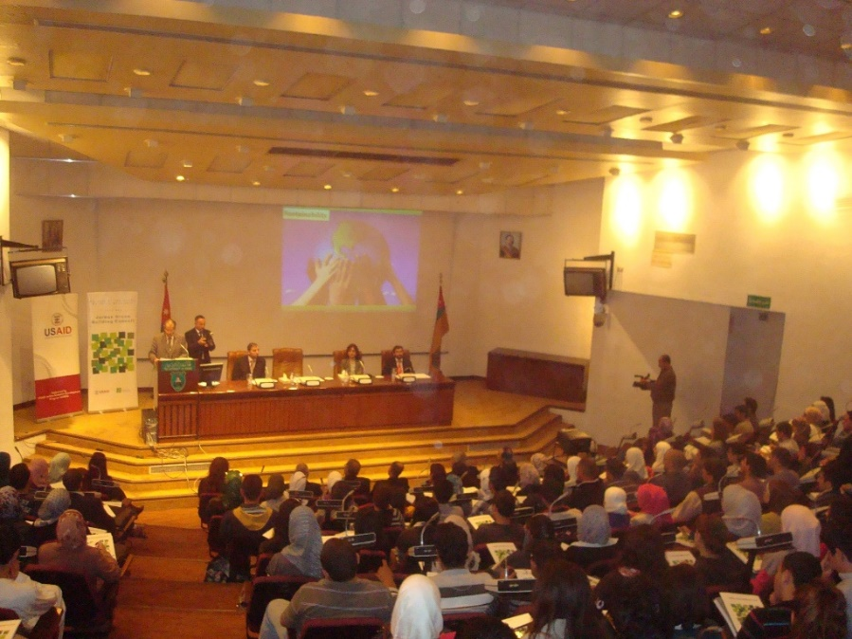
Green Building Codes Assessment & Development in Jordan
2009-2011
University of Jordan
Jordan University of Science and Technology
University of Yarmouk
Al-Hussein Bin Talal University
Public sector; including ministries and municipalities
Private sector; professional organizations and design & construction firms

Slide 8

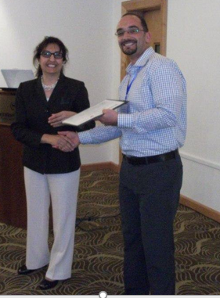
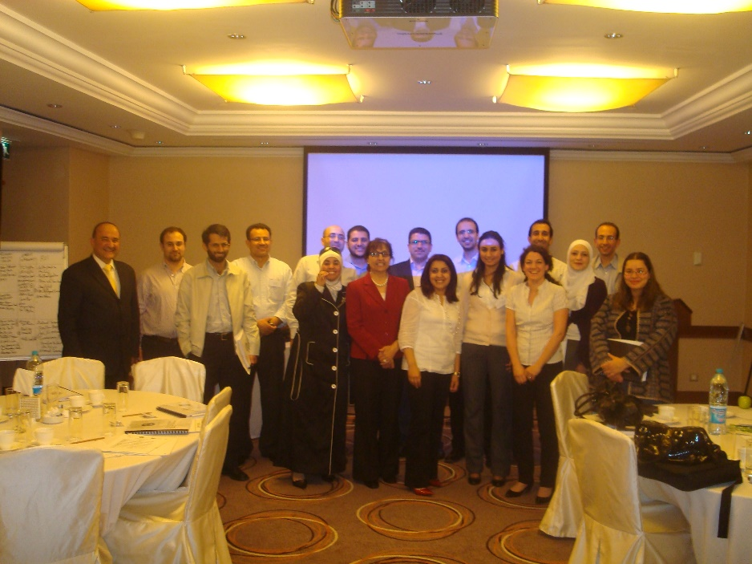
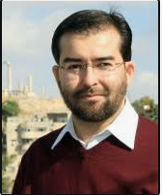
Green Building Codes Assessment & Development in Jordan
2009-2011
LEED Training
LEED Faculty Training

Slide 9
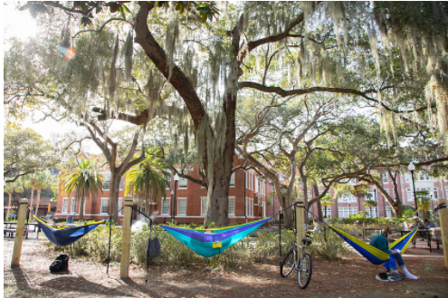
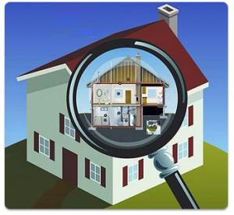
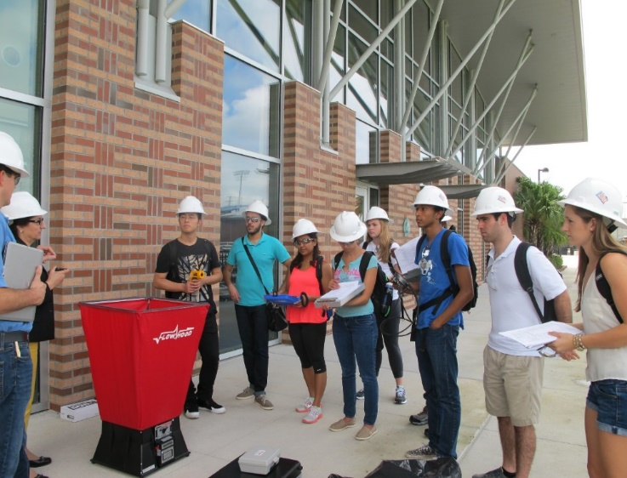
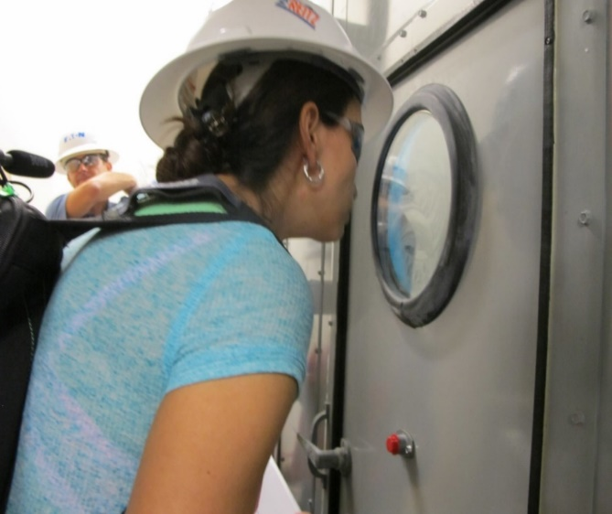
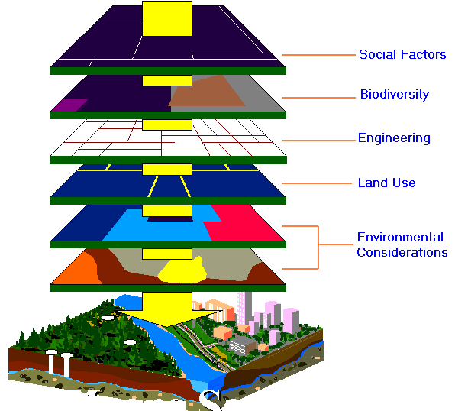
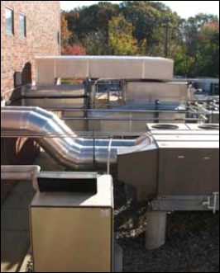
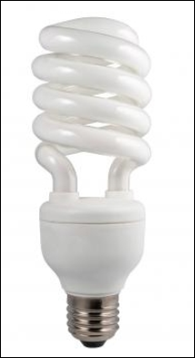
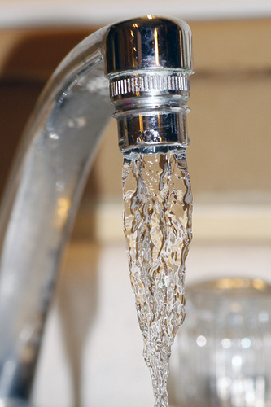
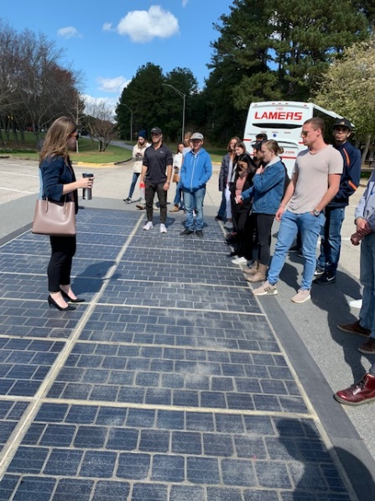
Interdisciplinary & Geodesign Specialization

Slide 10
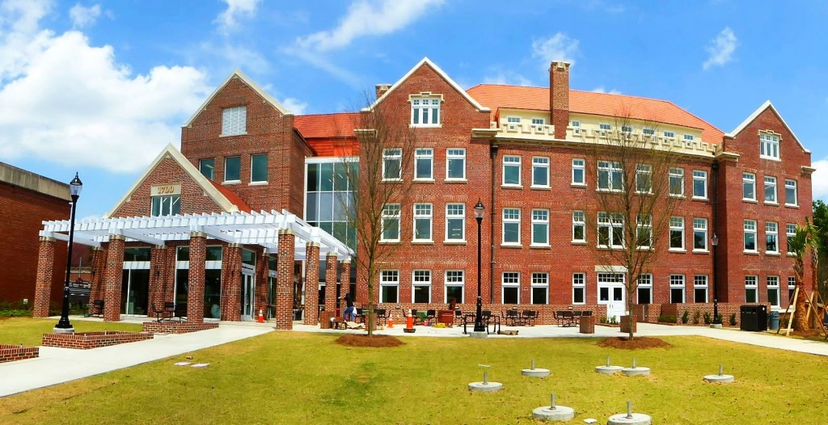
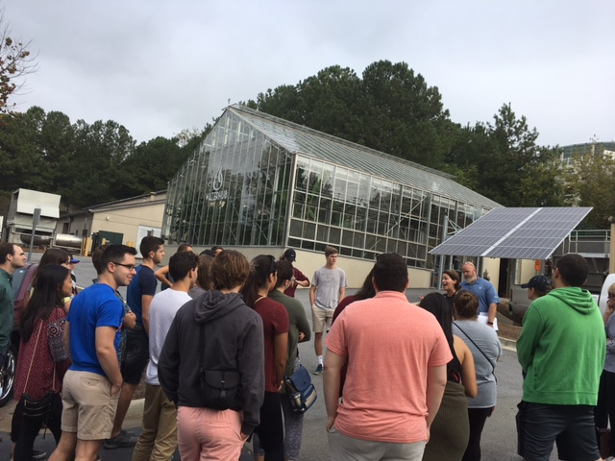
Methods of Learning
- Lecture Courses
- Individual and Group Projects
- Applied Problem Solving
- Field Trips
- Study Abroad
- Studio/Practicum/Field Experience
- Research Methods
- Individual Capstone Project
- Games

Slide 11
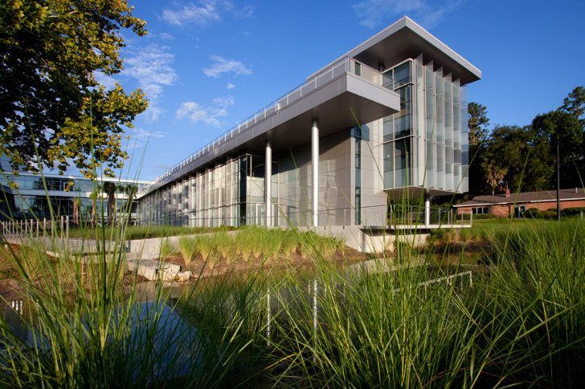
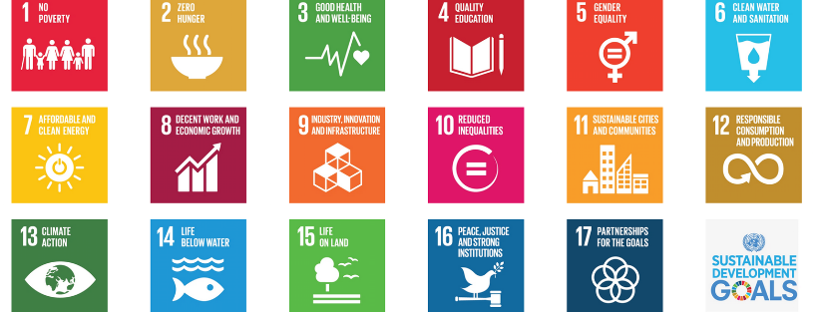
Sustainable Development Goals (SDGs)
Goals to end poverty, protect the planet and ensure prosperity for everyone

Slide 12
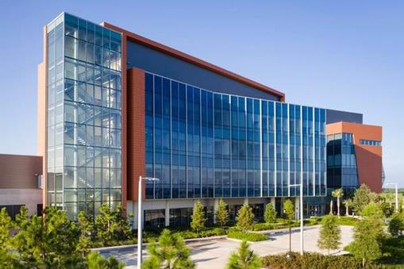
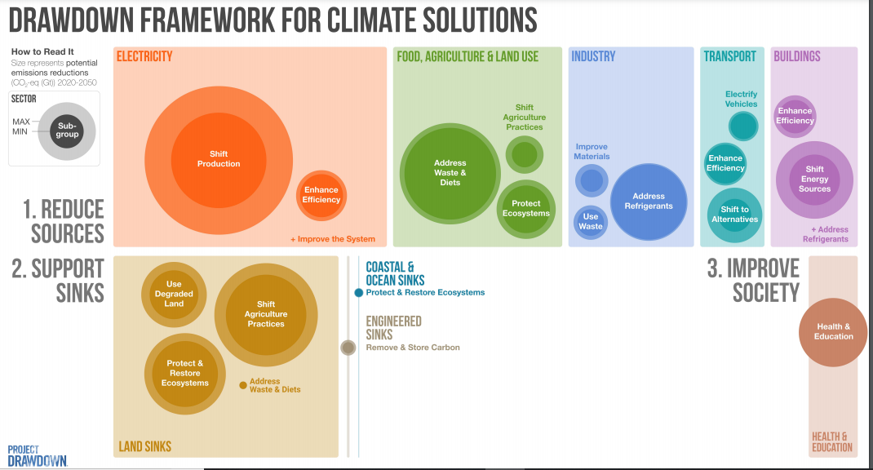


Slide 13
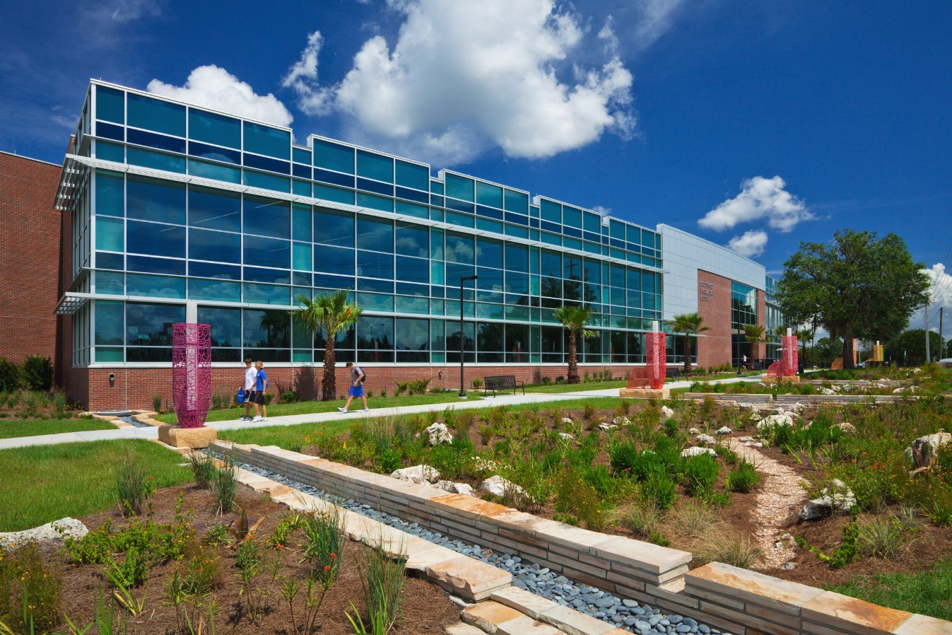
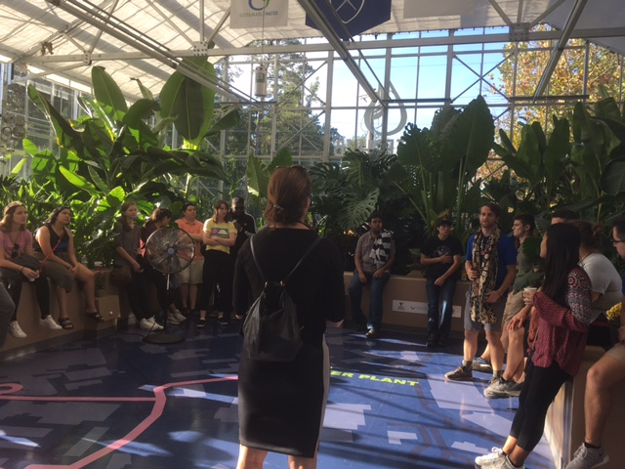
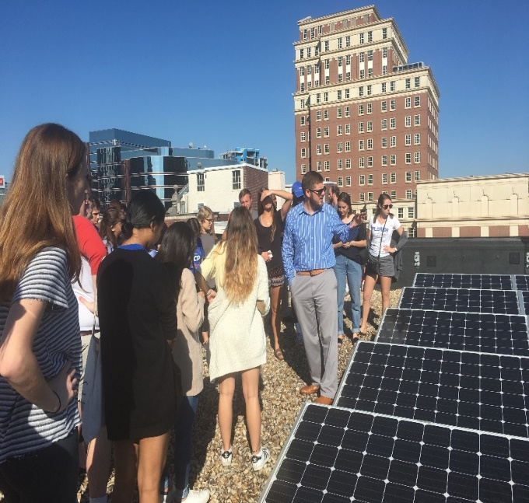
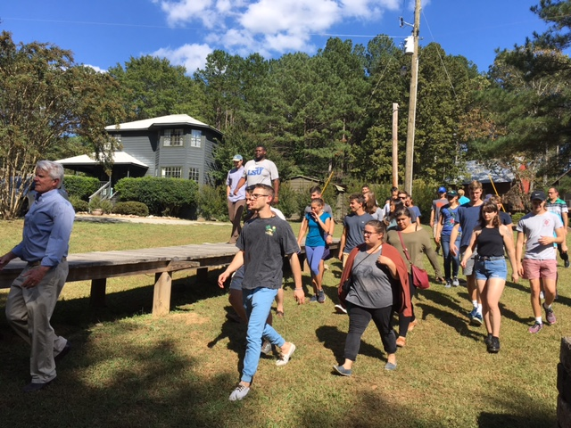
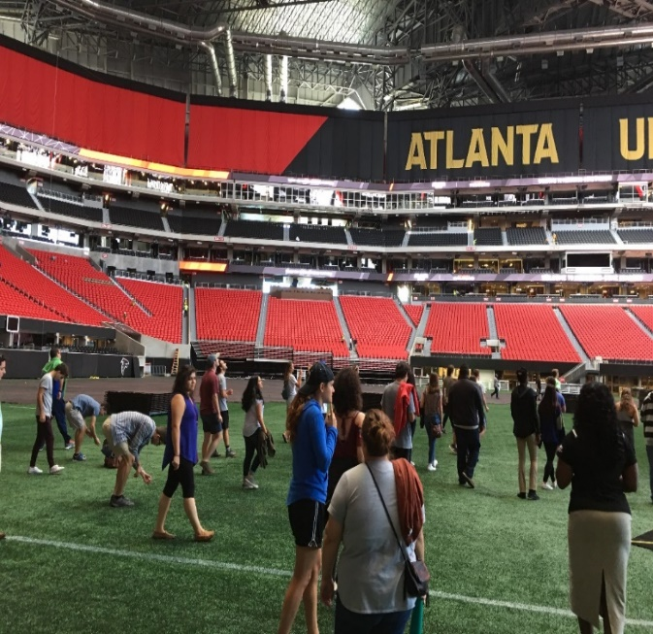
Field Trips

Slide 14
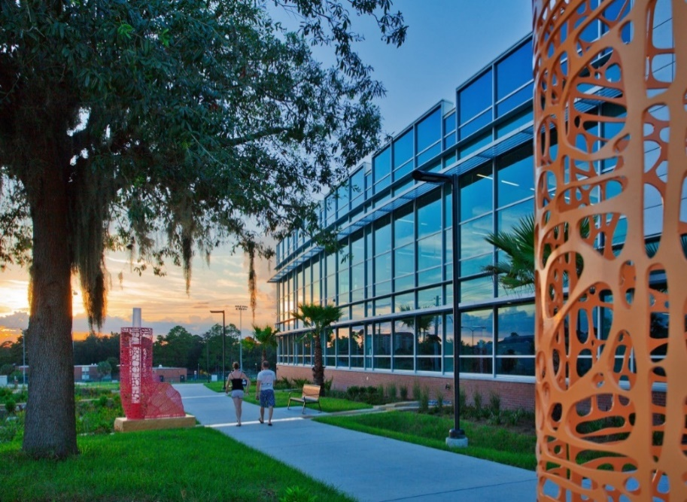

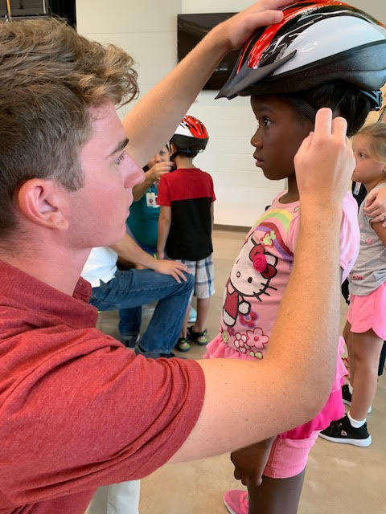
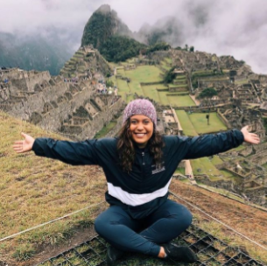
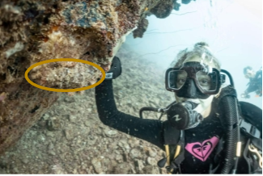
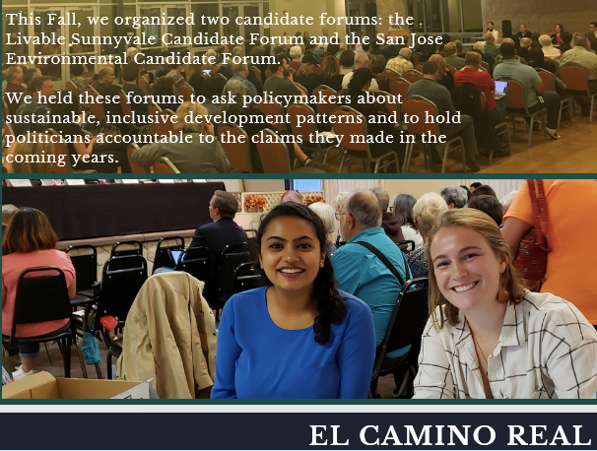
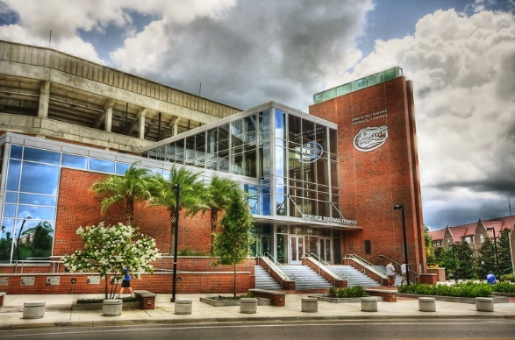
Field Experience, Internships

Slide 15
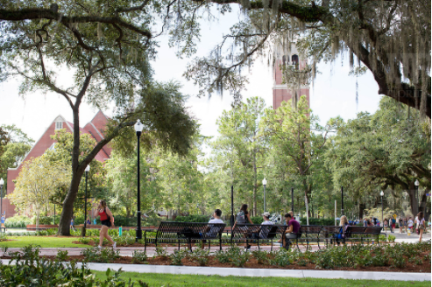
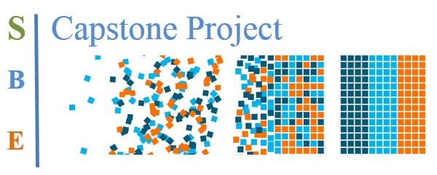



- Exceptional faculty and industry leaders
Developed list of potential mentors

Slide 16
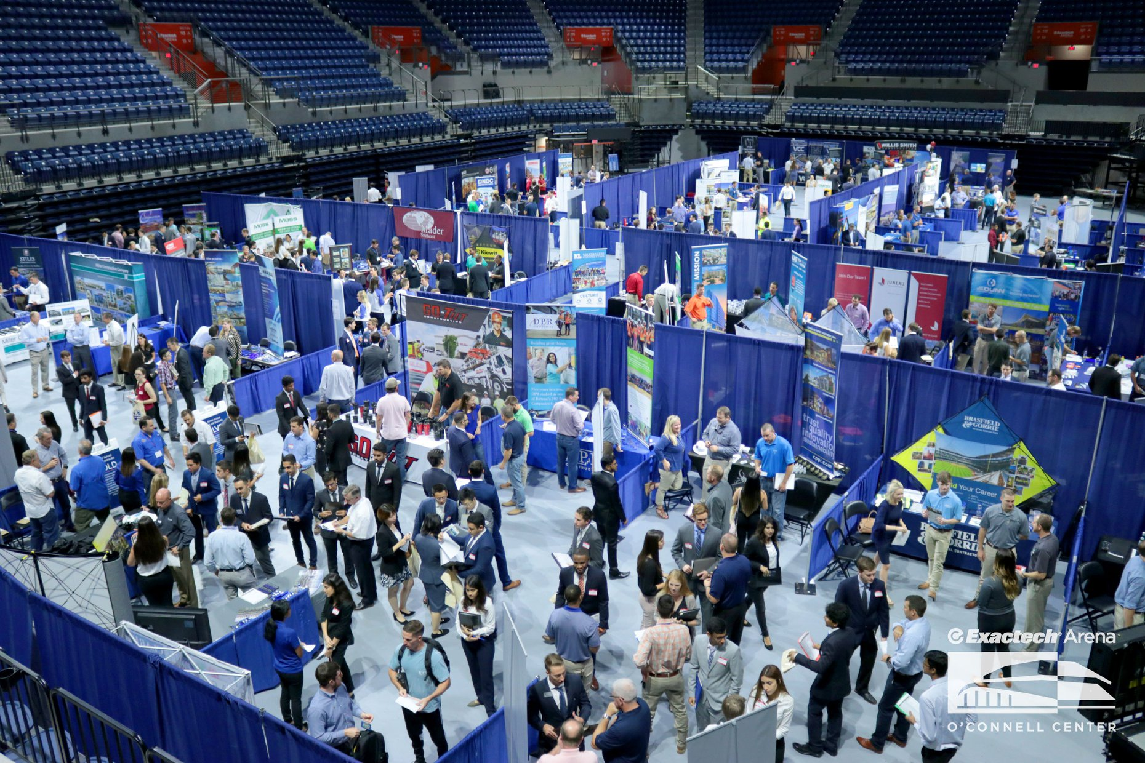
Path to Green Industry Jobs
Skills
Tools
Leadership

Slide 17
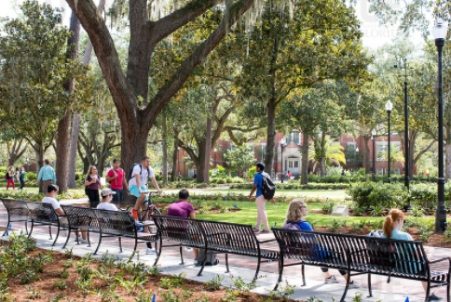
Looking for graduates who have:
Aptitude to learn
Critical Thinking Skills
Problem Solving Ability
Leadership Qualities
Interpersonal Skills
Communication Skills
Demonstrated Competency

Slide 18
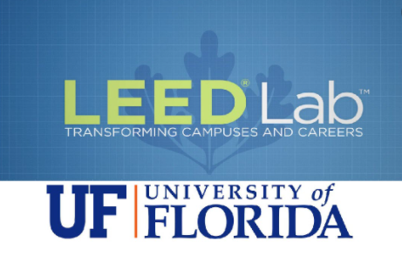
Path to Green Industry Jobs
180 students
68 LEED GA

Slide 19
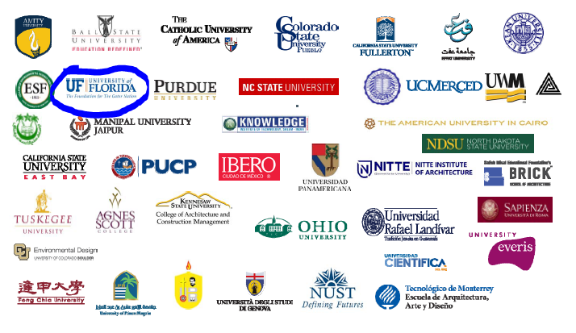

Slide 20







LEED Lab at University of Florida
LEED User
LEED Online
Data Analysis
Excel
Helioscope

Slide 21


First LEED certified building by students in the state of Florida
The 11th LEED certified building by students in the world

Slide 22


UF Green Building Learning Collaborative (GBLC)
Twelve global leaders in sustainability companies
Goals:
1. To provide students the opportunity to participate in applied sustainability projects focused on green buildings.
2. To allow for student mentoring by industry partners.
3. To develop marketable skills through hands on experience for the green job market.
4. To promote leadership in sustainability and the built environment.

Slide 23









UF Green Building Learning Collaborative (GBLC)
epstengroup
TLCENGINEERING

Slide 24

Partnership; Geodesign Specialization & Geoplan Center

Slide 25

Internship:
Siemens
TLC Engineering for Architecture
Skanska
Gilbane Construction
Moss, Renewable Energy Division
Eco Built Strategies
Philip Habib and Associates
Walker Architects
Little John Engineering Inc.
Community weatherization Coalition
Seed Biotech, Inc.
School Board of Alachua County
Power Production Management INC.
Ever Green Construction
Waste Management, Seattle Washington
City of Gainesville
Shands Hospital
Regional Transit System, City of Gainesville
Sarasota County's Planning &Services department
City of Newberry
Florida Crystals, sugar mill
Pinellas County
Employment:
Siemens
Holder Construction
Whiting Turner
Moss, Renewable Energy Division
Clark Construction
Skanska
Stellar Construction
Eco Built Strategies
Pirtle
Cosentini Associates
Kittelson & Associates, Inc.
Epsten Group, Inc.
CBRE, CB Richard Ellis
Power Production Management, INC.
Atlantic Design & Construction
ecoPreserve
Modernized Mobile LLC
Accenture
Toro Engineering & Construction Corp.
Legacy Vacation Club
Tindale Oliver
CTS Engineering, Inc.

Slide 26


UF Professional Development and Training
https://pd.dce.ufl.edu/programs--courses/sustainability-programs/

Slide 27



Slide 28

Thank you

