Slide 1
GRE® English Prep Program
An Online Resource for Preparing for the GRE® English Test
Mwaffaq Otoom
Yarmouk University, Jordan
US - Jordanian UCN Webinar Series
Nov. 12, 2020

Slide 2
Jordan’s Context
As of 2019/2020, there are more than 40,000 Jordanian students studying abroad in more than 50 countries, including 2000 on exchange programs
Less than10% of them are in the U.S.
This percentage is considered low because the quality of the U.S. higher education ranks first in the world – making it appealing to individuals and institutions in Jordan
For instance, most Jordanian institutions (including universities) prefer to hire U.S. graduates
Jordanian universities’ bylaws require at least 1% of their annual budgets be spent on scholarships for graduate study abroad as a faculty development tool
Due to the urgent need for faculty members in emerging research areas, some universities may spend more
Jordanian Universities prefer to offer these scholarships to students admitted to highly ranked U.S. universities
US - Jordanian UCN Webinar Series
Nov. 12, 2020

Slide 3
One Reason for Relatively Low Enrolment in the U.S. Universities
One barrier that prevents students from obtaining admission to a U.S. university is the English language requirement
Students may also lose scholarship opportunities even though they are academically qualified students
U.S. universities, especially highly ranked universities, require high scores on English language and entrance exams
One exam that students struggle in obtaining high scores is the GRE-General Test, particularly the Analytical Writing and Verbal Reasoning measures
US - Jordanian UCN Webinar Series
Nov. 12, 2020

Slide 4
GRE® English Prep Program www.BeEnglishReady.net
This free online resource was developed for native Arabic-speaking students considering graduate study in the U.S.
Material Preparation was conducted by an English Language Specialist from the U.S. and two professors of TESOL at Yarmouk University
A focus group discussion with students who experienced the GRE exam or preparing for it was conducted at the beginning of the project
The pilot was beta tested for feedback by approximately 40 students from Yarmouk University
The pilot was then shared with other UCN members for feedback, as well
It is intended to be a tool to supplement student preparation for the Analytical Writing and Verbal Reasoning measures of the GRE®
US - Jordanian UCN Webinar Series
Nov. 12, 2020

Slide 5
Overall Objective
By enhancing foundational English skills and providing opportunities for practice, native Arabic-speaking students will approach English portions of the GRE exam with elevated confidence and ultimately raise their scores to be competitive candidates in U.S. graduate schools
US - Jordanian UCN Webinar Series
Nov. 12, 2020

Slide 6
Inside the Prep Program
(1) Introduction (English)
(2) GRE® English Prep Program and Graduate Study in the United States (English)
Types of Graduate Degrees
Financial Planning for Graduate Study
10 Steps to Successful Admission
Statement of Purpose
For Further Information about Studying in the U.S.
Introduction to the GRE® General Test
The computer-delivered GRE® General Test format
A closer look at the Analytical Writing and Verbal Reasoning measures
A closer look at the Quantitative Reasoning measure
Registration tips
Tools to help you prepare
GRE® Resources for prospective test takers
(3) The GRE® General Test (Arabic)
(4) Introduction to the GRE® English Prep Program Modules (English)
US - Jordanian UCN Webinar Series
Nov. 12, 2020

Slide 7
Inside the Prep Program
(6) GRE® English Prep Program Modules (English)
Introduction
Essay Structure
Improving Academic Writing: Clauses & Sentence Types Part 1
Improving Academic Writing: Clauses & Sentence Types Part 2
Transition Words
Essay Scoring and Analysis: Analytic Writing Task 1
Analysis of Task 2: Analyzing an Argument
An Exercise in Critical Thinking
Tips for a Successful Response: Writing Task 2, Analyze an Argument
Essay Scoring: Task 2
Reading Comprehension: Overview
General Tips: Reading Comprehension
Vocabulary: Roots, Prefixes & Suffixes
Text Completion Questions: Overview
Using Signal Words to Your Advantage: Text Completion and Sentence Equivalence
Sentence Equivalence Questions
(7) Closing (English)
US - Jordanian UCN Webinar Series
Nov. 12, 2020

Slide 8
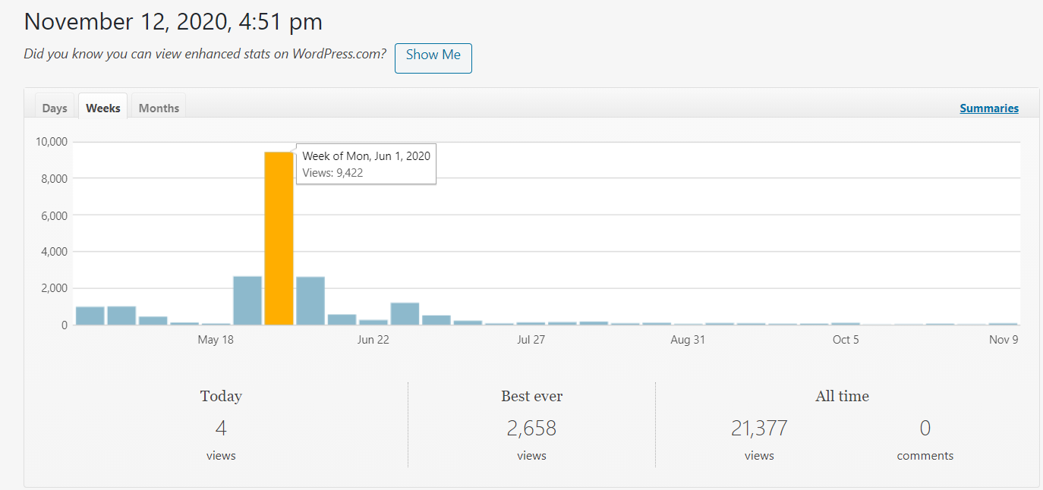
Stats.
US - Jordanian UCN Webinar Series
Nov. 12, 2020

Slide 9
Thank you!
U.S. Embassy in Jordan
John Hishmeh, Assistant Cultural Affairs Officer
Heather Dioguardi, Education and Outreach Officer
Rita Khanoian, Education USA Adviser
Regional English Language Office
Jake Jacobs, English Language Specialist
Yarmouk University
Mohammad A. Alzubaidi, PhD, Deputy Director of International Relations and Projects
Ruba F. Bataineh, PhD, Professor of TESOL, Department of Curriculum and Instruction
Lamia K. Hammad, PhD, Professor of English, Department of English
ETS Global – MENA Region
Ishraq Al-Zu’bi, Academic Relations and Marketing Manager (TOEFL iBT & GRE)
US - Jordanian UCN Webinar Series
Nov. 12, 2020

Slide 10
Inside the Prep Program
US - Jordanian UCN Webinar Series
Nov. 12, 2020

Slide 11
US - Jordanian UCN Webinar Series
Nov. 12, 2020

