Slide 1

US - Jordanian UCN Webinar Series: Virtual Exchange Programming
December 8th, 2020
Sarah Martin
Special Program Manager, Global Ties KC
smartin@globaltieskc.org
+1 (816) 421-4242

Slide 2
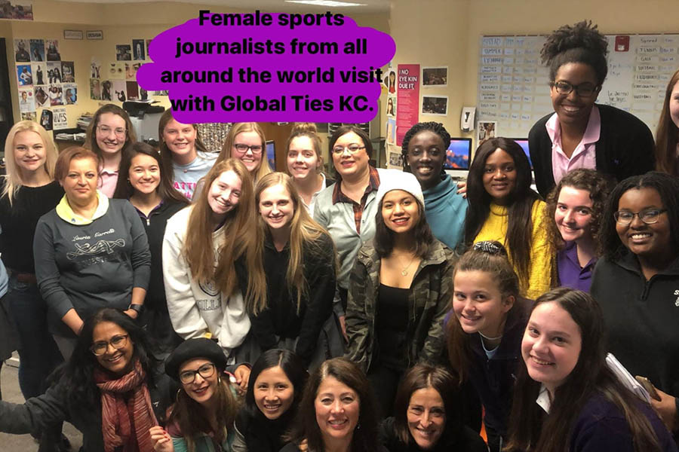
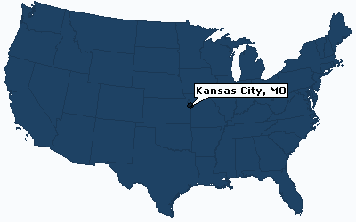
Global Ties KC facilitates government sponsored professional and youth exchange programs for Western Missouri and the state of Kansas.
65+ years ⬝ 35+ program/year ⬝ 350+ visitors/year

Slide 3
Case Study for Procuring and Managing a Virtual Exchange Program
MOR-USA Virtual Exchange Program
August 2020

Slide 4
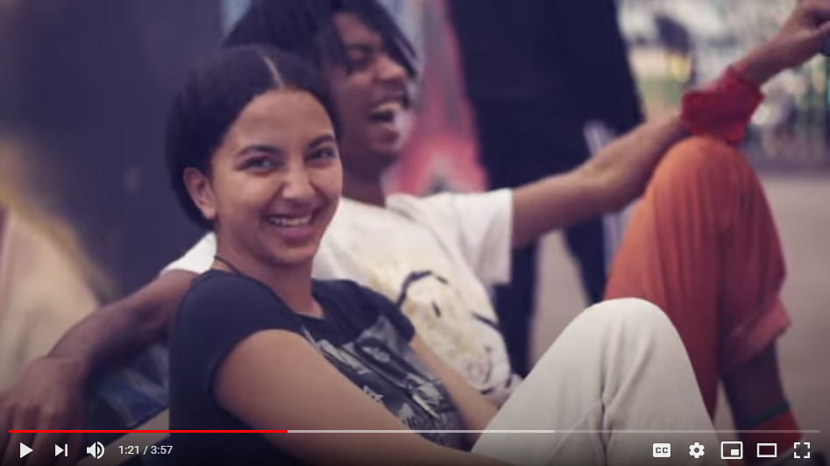
MOR-USA Program Overview
10 Kansas City participants + 10 Casablanca participants
  Two recruitment partners
  All participants were artists, primarily hip hop dancers/singers
Synchronous and Asynchronous activities
  Technologies: Zoom and FlipGrid
Project-based curriculum - Collaborative art video
3 weeks ⬝ 800+ hours of engagement ⬝ No attrition
Amazing Partnerships

Slide 5

MOR-USA Grant Distribution and Recipients
U.S. Department of State
Funder
Stevens Initiative
Prime Recipient
Global Ties KC
Subrecipient
* 18 subrecipients granted in total
MOR-USA
Program
Team
ArtsTech KC
Kansas City, Missouri, USA
Contractual USA Partner
Positive School of Hip Hop
Casablanca, Morocco
Contractual USA Partner

Slide 6
MOR-USA Grant Procurement
Stevens Initiative was looking for:
Priority topics: Language, global learning, STEAM education, training educators on virtual learning practices
Clear partnerships
  Defined tasks
  Recruitment access
Facilitation plan and training
Adequate staffing
Evaluation and monitoring practices

Slide 7
MOR-USA Planning Steps
Ideation and curriculum design
  Program objectives and key activities
  Technology
Program documentation
  Recruitment one-pager
  Curriculum sheet
  Timeline and schedule
Partner confirmation
Curriculum re-design (to account for cultural differences and partner feedback)
Proposal submission

Slide 8
Thank you!
Sarah Martin, Special Program Manager
smartin@globaltieskc.org
+1 (816) 421-4242
Questions or experience discussions
Potential partnering on future exchanges
Meeting with Youth Diplomats in Kansas City

