Slide 1
Adaptive approaches to conducting international research on water resources and food security assessments during COVID-19 times
Venkataramana Sridhar
Ph.D., P.E., D. WRE., M. ASCE
Biological Systems Engineering
Virginia Polytechnic Institute and State University
Blacksburg, Virginia, USA
vsri@vt.edu; 1-540-231-1797
Twitter: @SriVRao; Facebook: Venkat Sridhar

Slide 2
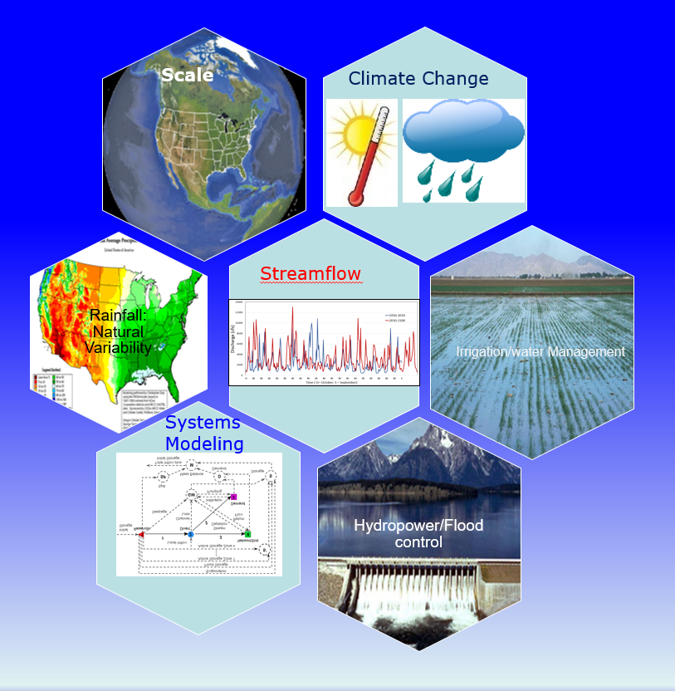
Interdisciplinary Research
Water is life
Modeling water is central to many disciplines or fields of research
Ex. Climate, energy, agriculture, atmospheric science etc
Drought and water management
Water, Sanitation and Public Health
Urban pollution, water and wastewater treatment

Slide 3
FEWS Nexus
Q1:
How much water is available?
Q2:
What is the irrigation water demand?
WATER
Q4:
Climate change
Population increase
What is integrated modeling?
FOOD
SUSTAINABILITY
Food, Water, Energy Nexus Security
ENERGY
Q3:
What is the energy potential?

Slide 4
COVID Impact
Mostly modeling of water resources systems and somewhat affected due to COVID.
A workshop related USAID PEER project scheduled in April in collaboration with Tamil Nadu Agricultural university India is canceled.
A stakeholder meeting in Cambodia related to the NASA Mekong project in June is canceled.
Two Ph.d. visiting scholars funded by Government of India to visit Virginia Tech this summer to develop computational model for flood forecasting is also on hold.

Slide 5
Being Adaptive
Open to online collaborations
Scheduling meetings on a weekly and monthly basis
Participating/giving key note address through online platforms
Advise students and postdoc regularly
Teach online classes

Slide 6
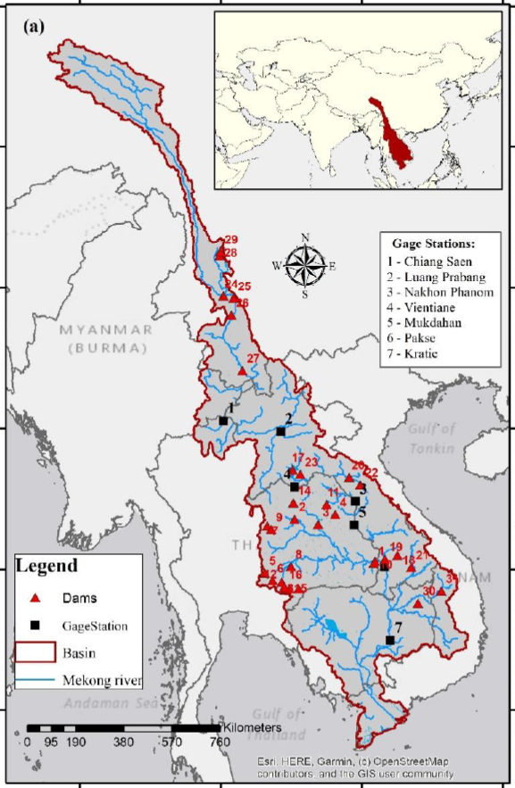
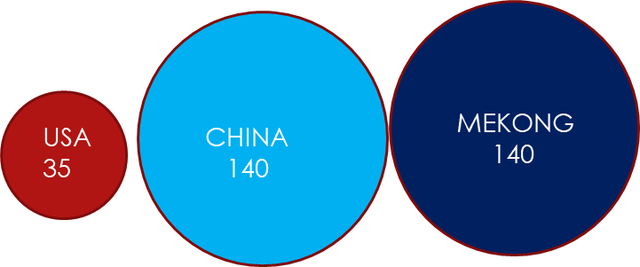
Mekong River Basin
12th largest in world & 7th largest in Asia
6 nations in southeast Asia
Drainage area: ~765,000 sq.km.
Annual mean flow: ~15,000 cu.km./yr
Length: UMRB:~2200 km+LMRB:~2600 km
Biggest cities: Bangkok (9.3 Million); Ho Chi Minh City (7.4 Million)
Mekong river is lifeline:
The Mekong River basin support various different ecosystems and host large number of population (60 million people).
60% food security by rice production. (15 million ha)
Fish is estimated to supply 75% of people’s protein in some areas. (4.4 million tons in 2015)
Population density

Slide 7
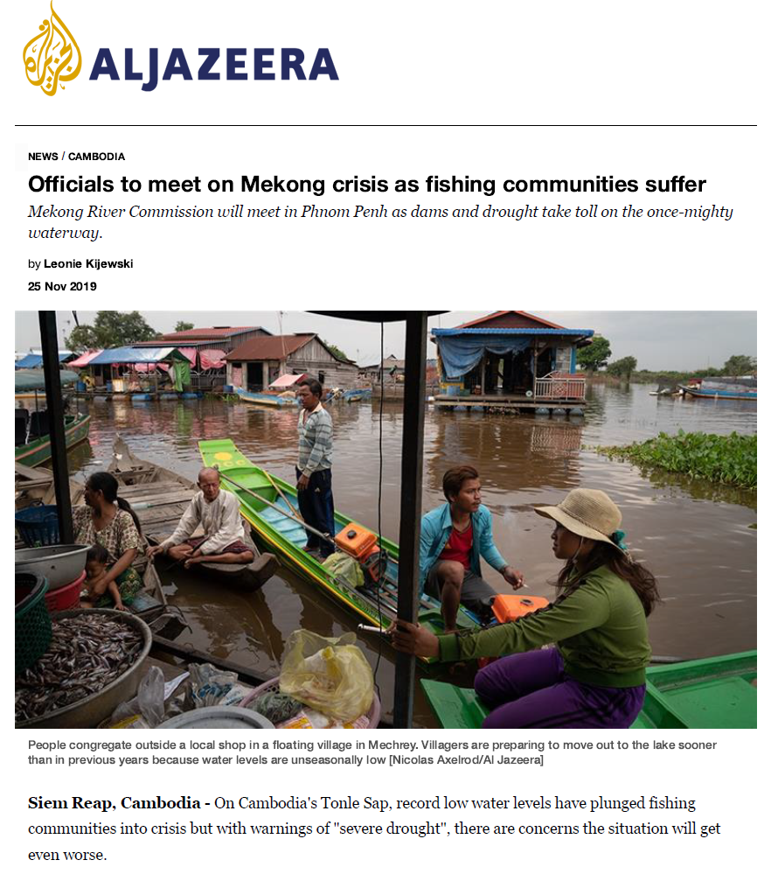
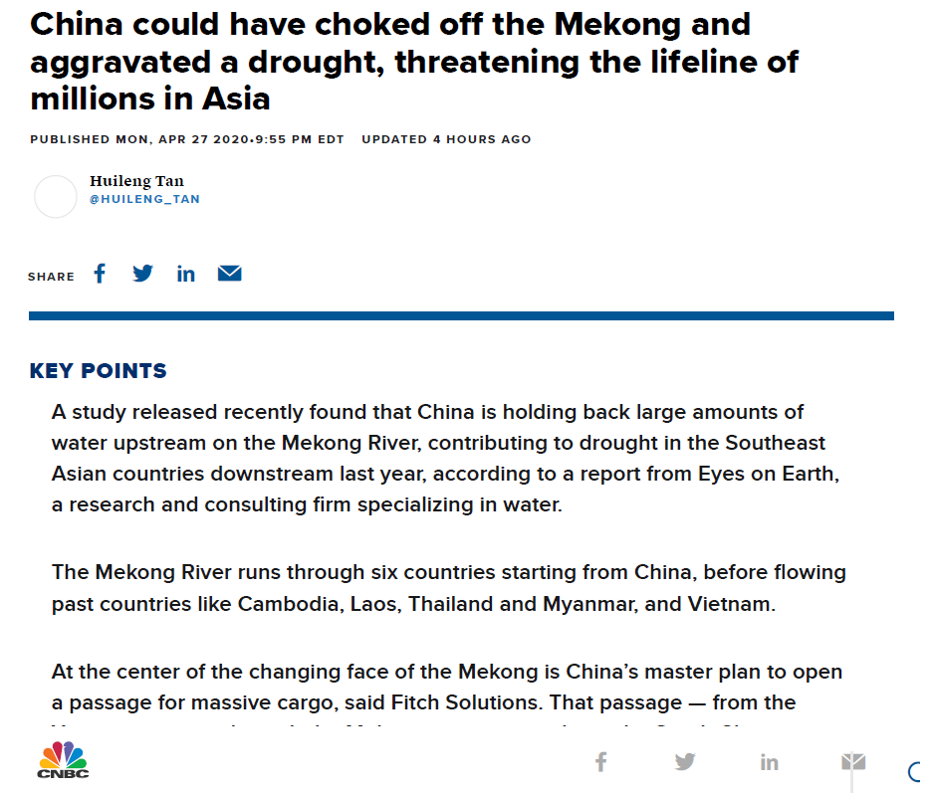
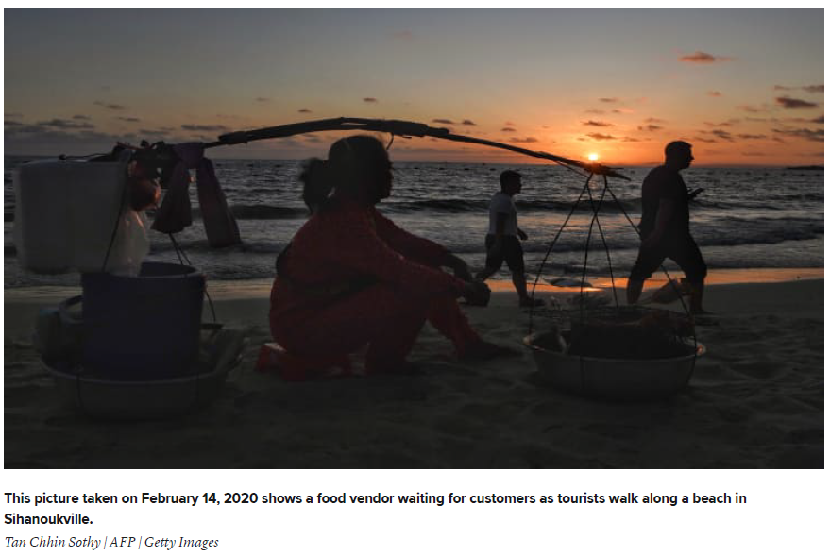
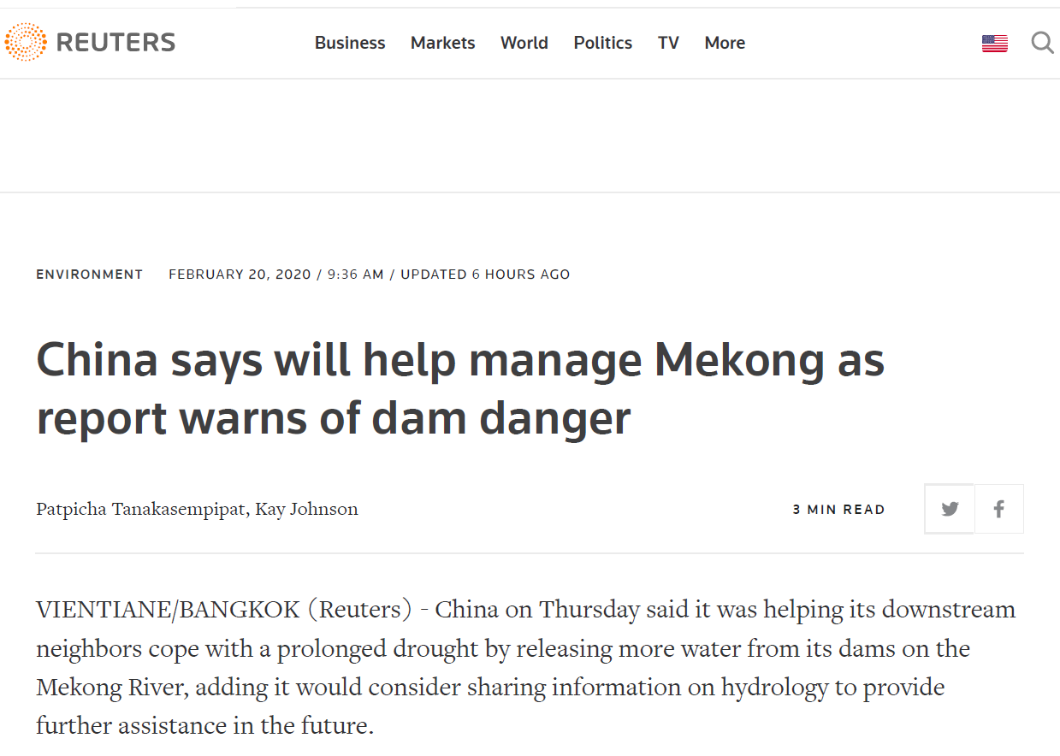
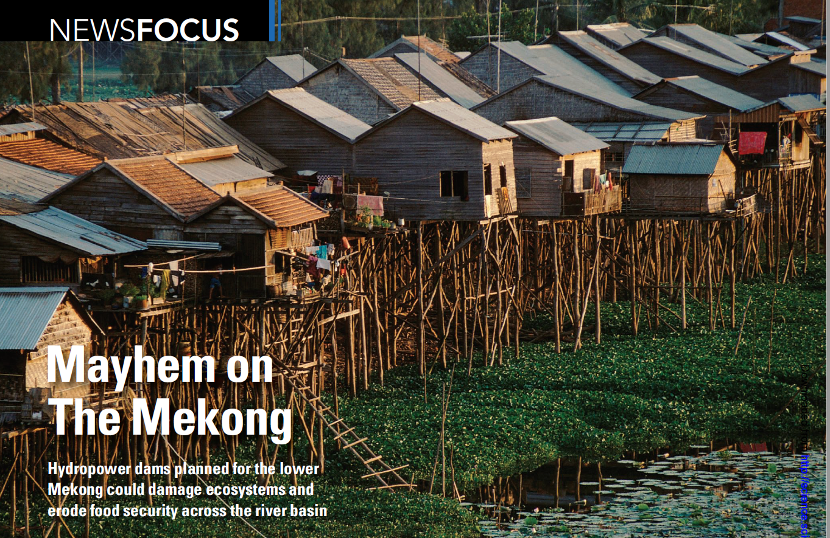
Mekong in the Media

Slide 8
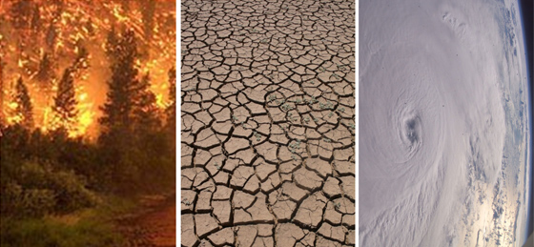
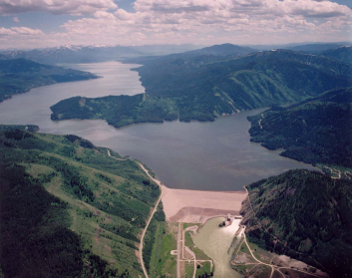
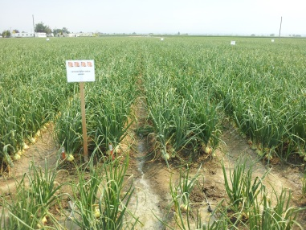
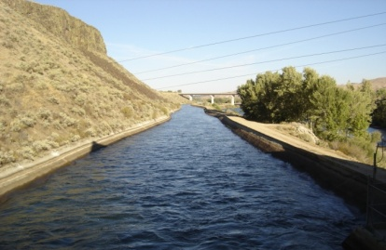
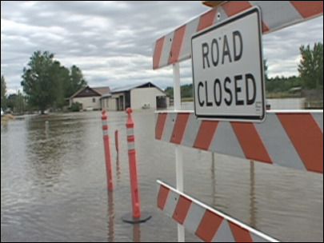
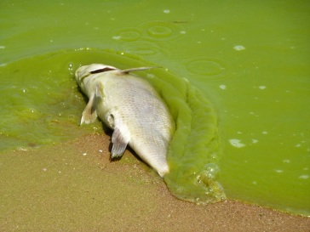
Integrated River Basin Management
Land-water-environmental management
Modeling, monitoring and managing water quality and quantity
Surface and groundwater sources
Multiuse of water for economic-livelihoods-environmental flow sustainability
Stakeholder engagement

Slide 9
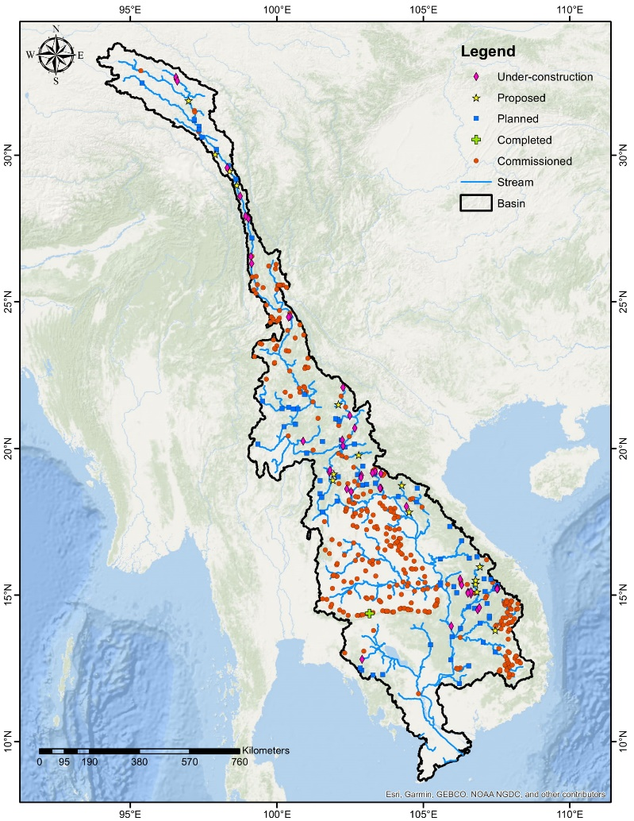
Anthropogenic Footprints
MRB has hydropower potential of approximately 88,000 MW (Stone, 2011).
It remains largely underutilized in the Mekong Basin (Seibert et al 2010).
Irrigation plays an important role in regulating the crop water requirement.
Population increase: 90.6%
Agricultural area increase: 3%
Dams to be built: 456
Source: https://opendevelopmentmekong.net/topics/urban-administration-and-development/

Slide 10
Communities under threat
There is no income in times of crisis—No safety nets but forests, rivers and wetlands –provide food and nutrients.
Impacts are uneven-marginalized communities impacted more (communities displaced by dam projects face food and income shortages)
Positive note- Karen communities in Salween basin --collect rice they cultivate to donate to Covid affected communities.

Slide 11
New developments
Many dam projects has been temporarily halted due to the pandemic.
There is clarity now than ever that large dams destroy rivers and people’s livelihoods and they may have to be scrapped.
Growing recognition for just energy transitions (food-energy-water nexus)

Slide 12
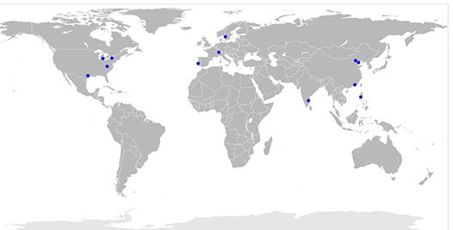
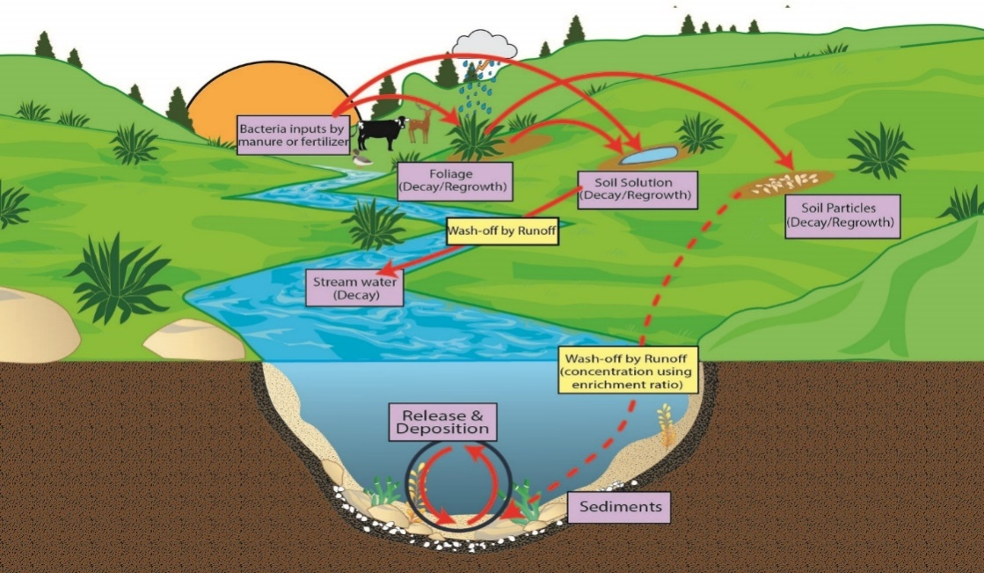
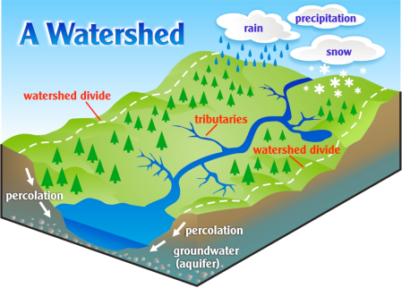
NSF PIRE: Transcontinental study
Simulation of antibiotic resistance in the receiving environments
Assessing the relationships between various environmental (both human and natural) variables and dissemination of antibiotic resistance
(Getty Images, 2015)
Project Team: Drs. Peter Vikesland, Amy Pruden, Venkat Sridhar and other researchers at VT and elsewhere

Slide 13
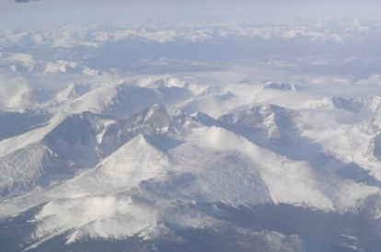
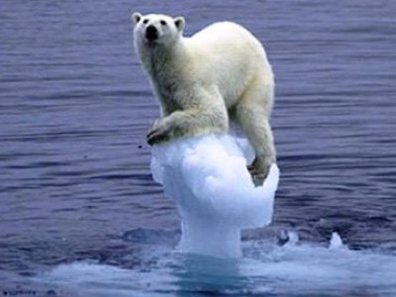
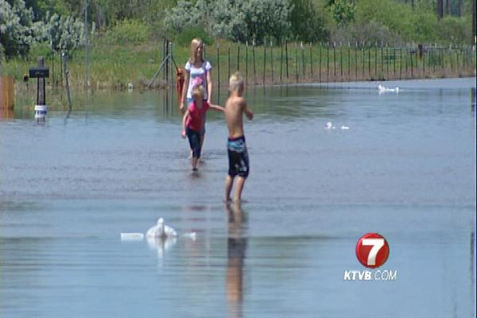
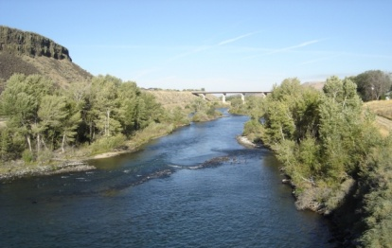
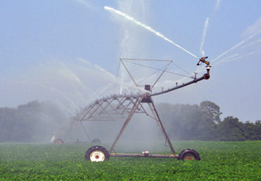
Final Thoughts-Progress and Challenges
Food-energy-water nexus in the context of public health and livelihoods needs better data, models and synthesis-a tool to meet to today’s challenges is possible!!.
Drivers and impacts that stresses the system can be quantified at a local scale now!!.
However ……
Supply assessments are advancing but estimates on the demand that increases with time requires better understanding (human dimensions, and external stressors-population, global pandemic, land use and land cover and climate change)
Space (3D)-Time (1D) data at High Res is urgently required for monitoring, modeling and managing the impacts of managed systems and the extreme events (floods, drought, etc., )

