Slide 1
U.S.-Jordanian University Cooperation Network (UCN) Webinar Series
The Impact of COVID-19 on Higher Education:
AABU experience
Prof. Adnan Atoum
President
15 DECEMBER 2020

Slide 2
Content
General info
Faculties and Programs
E-learning before and after Covid-19.
E-learning indicators
Transformation era, current and future plans
Challenges

Slide 3
General info
Al al-Bayt University is located on the outskirts of the city of Mafraq, 65 Kilometers to the north-east (about 45 minutes drive) of the capital Amman, Jordan.
The university has integrated academic facilities, student housing, and social services on one site.
the University started to receive the first group of students on October 1, 1994.

Slide 4
Faculties and Institutes
(Scientific Faculties/Institutes):
Information Technology
Basic Sciences
Engineering
Earth and Environmental Sciences
Nursing
Aviation Sciences
(Arts & Humanities, Faculties/Institutes):
Educational Sciences
Arts and Humanities
Law
Islamic Studies, Shari'a
Political Sciences
Economic and administrative sciences

Slide 5
AABU in Figures
No. Alumni | 63841
Females: Males | 57%: 43%
Undergraduates | 16870
Graduate Programs | 3493
Non-Jordanians | 1000
Staff-Academic | 433+
Staff-administrative | 869
20363
5%

Slide 6
New Programs (2020-2021)
BA/BSC: 45 HD: 4 MA/MSC: 36 PHD: 2
Master Degree In Community Health Nursing
Bachelor Degree In Information Systems Security
Bachelor Degree In Digital Marketing
High Diploma In Arabic For Non-native Speakers
Bachelor degree in applied geography.

Slide 7
Research Priorities As According To UCN
ICT and Innovation
Renewable energy, Arid regions and water management
Refugees
Multi-disciplinary research

Slide 8
Online Teaching: Pre-Covid-19
Few of university’s essential courses were automated and provided fully online over our platform (5-7 courses each semester)
Some courses’ exams were automated (20-25 courses each semester)
A small unit to manage online exams was established.
notable skills gap for using technology in traditional education among faculty members and students.

Slide 9
During Early Covid-19
AABU has prepared a Training plan to provide the needed capacity building for faculty members on how to use E-learning and communication tools before the lockdown.
Faculty members were directed to prepare the content needed for the E-learning process and the offered courses during each semester.
Several committees were formed to monitor the progress of E-learning.

Slide 10
Training process
Focal point for each faculty/ institute was nominated
Training content was prepared by experts at AABU. Using different types (video, Audio…)
Focal points were trained to be able to use online tools and platforms
Training skills were transferred to all faculty members by focal points (ToT)
“Training series”

Slide 13
Monitoring and quality assurance committees
Crisis management and emergency committee (safety and health)
E-Learning
committee
E-Learning Quality Assurance committee
Technical committee to manage online exams

Slide 14
E-Learning platforms

Slide 15
Some Indicators

Slide 16
Lectures (Fall 2020/2021)
(88%)
(63%)
(81%)
(59%)
(41%)
(Virtual labs)

Slide 17
Fall 2020/2021

Slide 18
Courses per each online teaching tool
(100%)

Slide 19
Quality Assurance plan: Main Aspects
Technical support for Staff
Capacity Building
Course portfolio
Academic content
Provide awareness about supporting tools
Recorded lectures
Technical support for students
Interactive teaching
E-assessment tools for students.
Administrative support
General published guidelines
Supporting tools
Nominating focal points and coordinators
Clear Goals
Monitoring and Evaluation
Students’ Feedback

Slide 20
Online Satisfaction surveys
Students’ satisfaction about e-learning at AABU (content, internet speed,feedback..etc)
Spring:54%
Fall: 56%
Faculty members’ satisfaction about
e-learning at AABU (procedures, rules..etc)
Spring: 83%
Fall: 70%

Slide 21
Transformation era
Well-equipped studio for recording lectures
New computer labs in online learning center (400 Pcs) + 300 Pcs in language center.
New clouding services to Moodle
Re-engineered 6 class rooms to ensure social distancing.
One stop office for students (registration and financial affairs)
6 hotline numbers for students
Provide students with free pre-paid internet cards.
Provide Urgent financial support for in-need students.
Follow Safe and health protocol /procedures on the campus.
Prepare online teaching instructions.
Prepare new work plans with minim working ratios.
3 Years plan for transforming into a technology-based learning instruction.

Slide 22
Challenges
Moving toward technology based learning (After Covid19).
Internet infrastructure (University/Faculty/Students).
Continuous training to faculty members on interactive online teaching in-campus.
More legislative modifications (bylaws and instructions).
Internet speed/ connection in remote areas.
More quality assurance measures (Qualities Vs. Quantitative Norms).
Students cheating on exams

Slide 23
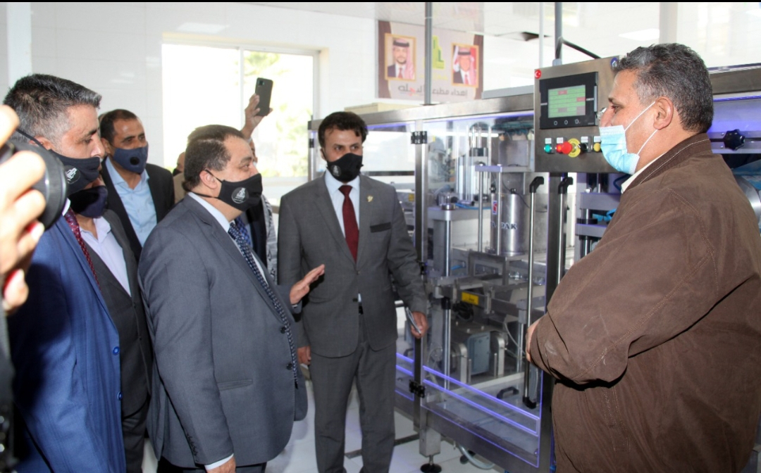
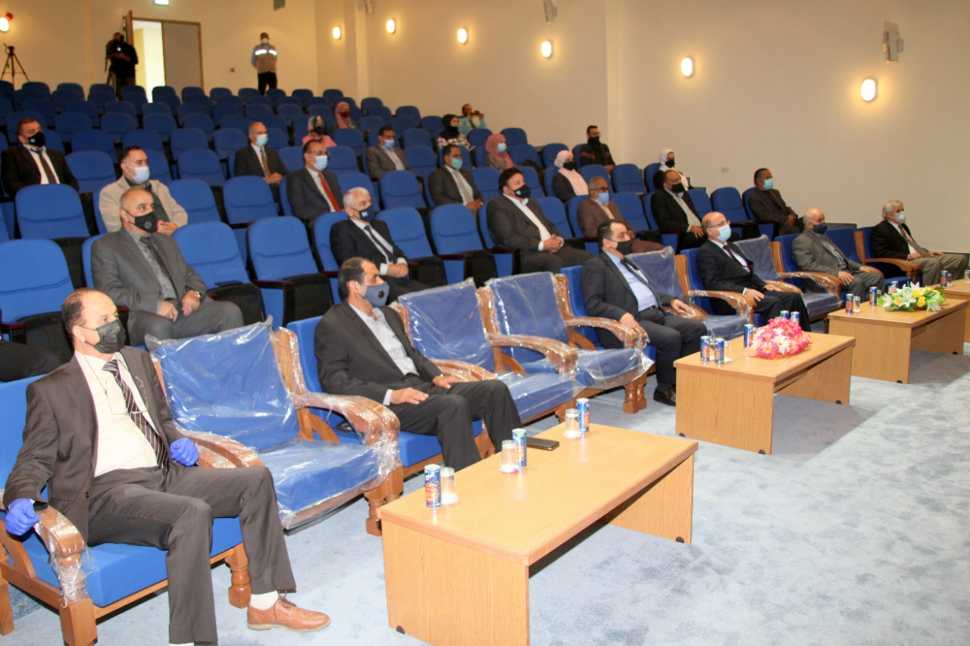
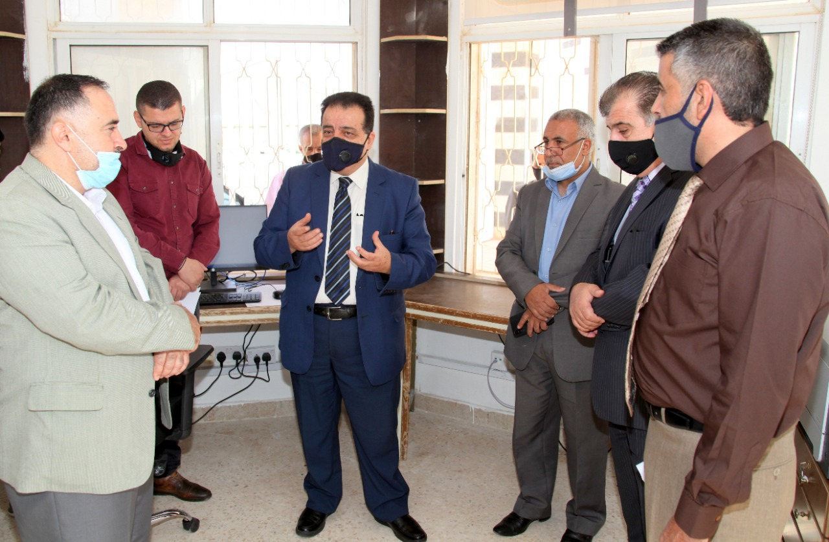
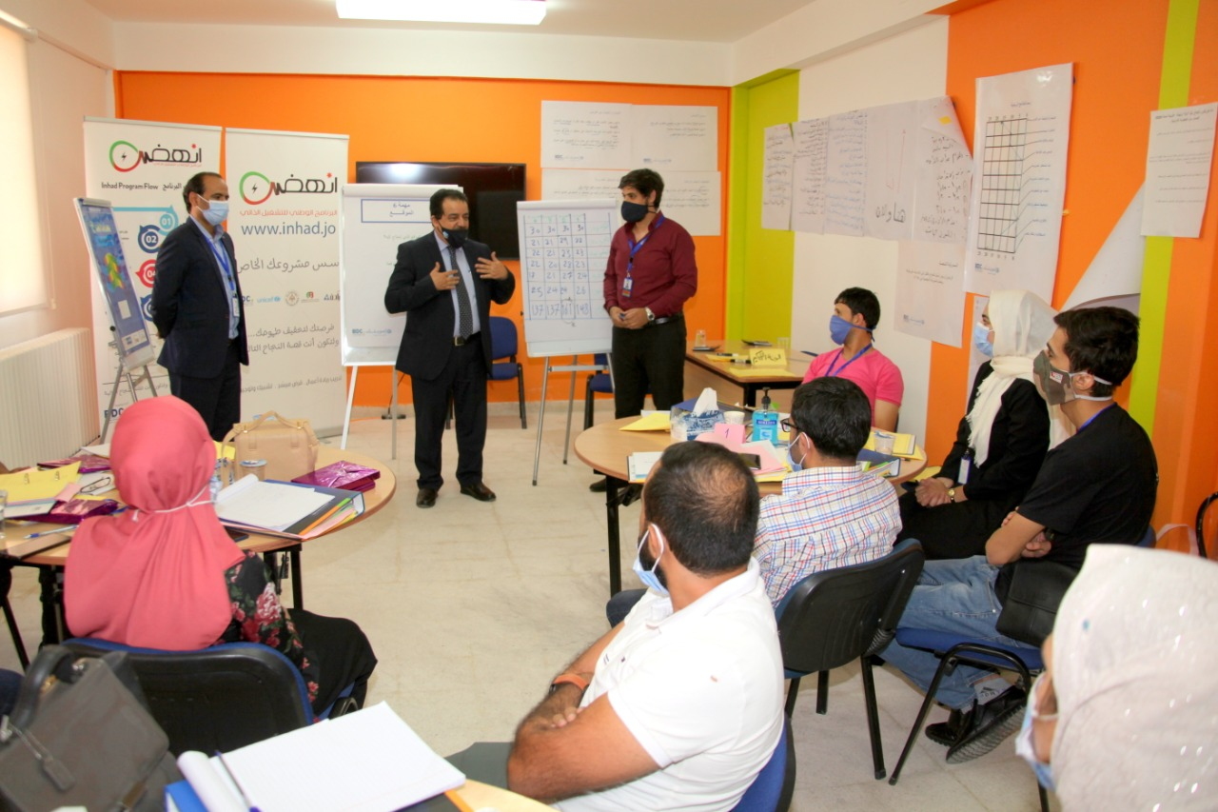
Thank you Q & A

