Slide 1
Linking Tertiary Education to the Labor Market
US - Jordanian UCN Webinar series: #2
Andreas Blom & Mariam Nusrat

Slide 2
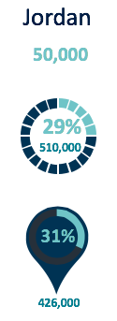
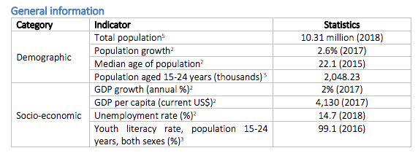
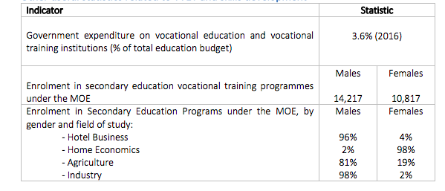
The Time is Now
The time is now to prepare the Jordanian youth for the future of work.
Demographic dividend: Jordanian society is one of the youngest in the world – people under 24 constitute 54% of the population and median age is 22.8.
Notes:
Demographic data: https://www.indexmundi.com/jordan/demographics_profile.html
Demographic dividend

Slide 3
Current Challenges
Gaps in Tertiary Education Ecosystem
Weak private sector coordination
Limited availability of flexible, quality and relevant training options & (micro credits)
Limited focus on generic employability skills (reliability, communication, pro-activeness)
Need for greater emphasis on transition to work process – job search and job search skills
Lack of practical hands-on training/ OTJ
Limited capacity of training providers to absorb growing demand
Lack of monitoring and measurement of outcomes
Limited competition and innovation in training
Notes:
Talking points:
Skills mismatches abound in labor market: Need to effectively match the supply of skills with the demand for skills. The quality is highly variable and the accumulation of skills is dampened by emigration of many of the most talented.
Youth are not prepared for the changing nature and future of work: There is a need to focus on delivering 21st Century Skills to students and trainees across all levels

Slide 4
Tertiary Education & COVID19
A Challenge & An Opportunity
The COVID19 pandemic is inflicting a heavy toll on young workers, destroying their employment and undermining their career prospects.
COVID19 crises also represents an opportunity for change and building back better.
PROTECTING JOBS to safeguard income and preserve human capital.
GLOBAL IMPACTS
One in six young people (17%) stopped working altogether;
Two out of five young people (42%) reported a reduction in their income.
REBUILDING BETTER SYSTEMS FOR THE FUTURE by removing binding constraints, addressing gender issues and strengthening core systems for service delivery.
JORDAN SPECIFIC IMPACTS
42 % of Jordanian enterprises can pay salaries for less than one month, another 42 per cent for less than three months. Affected micro and small businesses cannot pay any salaries.
PROTECTING POOR AND VULNERABLE PEOPLE by scaling up social safety nets and safeguarding nutrition and learning. Jordan has mobilized technology-enabled distance learning as the centerpiece of the education sector response to COVID-19.
Notes:
Sources:
Source: Global Survey on Youth and COVID-19 conducted by partners of the Global Initiative on Decent Jobs for Youth between April and May 2020.
Source: Rapid assessment on the impact of COVID-19 on enterprises in Jordan. In April 2020, ILO and UNDP conducted a sample survey of 1,190 enterprises
https://www.ilo.org/wcmsp5/groups/public/---arabstates/---ro-beirut/documents/publication/wcms_749136.pdf
https://www.ilo.org/wcmsp5/groups/public/---ed_emp/documents/publication/wcms_753026.pdf

Slide 5
World Bank’s Role
Enhanced Support to Skills Development Initiatives
Skills development programs to enhance youth employability and labor market participation
Ending poverty and boosting shared prosperity: A lack of focus on building skills reflects a loss of opportunity to enter quality jobs with decent income earning potential – critical to improving livelihoods and contributing to the Bank’s twin goals of (i) eradicating poverty and (ii) promoting shared prosperity, especially for the bottom 40%.

Slide 6
Current World Bank Engagement
Synergies & Opportunities to leverage momentum
Skilling Up Mashreq Initiative
Provides a template for private sector partnerships around training curriculum and industry certifications
SUM activities scaled under YTJ project & Educ PforR
Jordan YTJ Project - Youth Technology & Jobs Project ($200m): Focus on digital skills
SUM is an umbrella initiative aimed at establishing partnership models with global and regional private sector digital skills players (Financed through Dutch Prospects TF )
SUM partnerships:
Code.org & Edraak for localization of free open source online coding courses
Microsoft for skilling initiative for digital skills training and industry certification targeting 1000 students
Al-Ghurair Foundation for digital skills training for refugees
Hsoub for Digital trainings for refugees to leverage gig economy
Digital Skills council
Digital skills competitive fund
Digital skills curriculum in public schools
Jordan Education PforR Project ($300m): Strengthening the education pipeline.
Blended learning models
SEL: Socio-emotional learning
Digital assessments

Slide 7
Menu of Options
A System-Wide Approach for Effective Skills Development
World Bank is uniquely positioned to respond in an effective and timely manner towards providing support to GoJ in preparing its youth for the future of work.
To respond to the changing nature of work, skills development initiatives need to:
Fully reflect modern industry practices
Focus on competency-based training and certification methods
Provide youth with robust practical experience.
Lay a foundation for addressing systemic challenges in skills development ecosystem

Slide 8
Menu of Options
Tools for Effective Skills Development
Quality Training Provision
Focus on skills demanded for the future of work
Job Matching & Tracking Systems
Building institutional capacity for effective M&E
Focus on systems for tracking of employment outcomes of graduates
Capacity building for HE and TVET institutes
Private Sector Collaboration
Apprenticeships/OTJ
Competitive funds for short term, flexible trainings
Provide support to graduates for job search
Industry certifications/ competence based micro-credits

Slide 9
Private Sector Engagement
Creating a Collaborative Ecosystem for Skills Development
Models for Private Sector Collaboration
Competitive funds for PPPs for skills development:
Performance-based contracts with private and public training providers stimulate innovation and competition in catering to market demand for skills.
Industry Certification:
Incorporation of industry certifications/micro-credits can help educators ensure their programs are modular, up-to-date and aligned with industry standards.
Apprenticeship schemes :
Properly designed, apprenticeship schemes can allow for effective matching of demand for and supply of workers and can lead to full-time positions for students.
(refer to Annex slide on India PPP models for examples)
Notes:
Currently six National Skills Councils are active in Jordan: Tourism and Hospitality (T&H), Information and Communications Technology (ICT), Logistics, Water and Energy, Leather and Textile, and Cosmetics & Chemicals.

Slide 10
World Bank’s Experience with Private Sector
Lessons Learned

Slide 11
Gender Sensitive Skills Development
Enhancing Female Labor Force Participation
Designing Programs with a Gender Lens
Design and implementation of outreach and awareness-raising activities to identify and motivate targeted female beneficiaries to register for trainings and to support applicants with the application process.
Barriers to Employment for Young Women
Training curriculum developed with a gender lens, such as including female role models, to ensure training courses and learning resources are inclusive.
Address barriers to access for women for leveraging training and employment opportunities with a focus on role of social constructs and societal perceptions around labor force participation

Slide 12
The Way Forward
What’s Next
Partnerships
Scale Up, Scale Fast
Capacity building
Resource Mobilization
Universities & private sector
Time is now
TVET institutes need capacity building
Build back better
Channel financing
Covid19 momentum

Slide 13
THANK YOU

