Slide 1
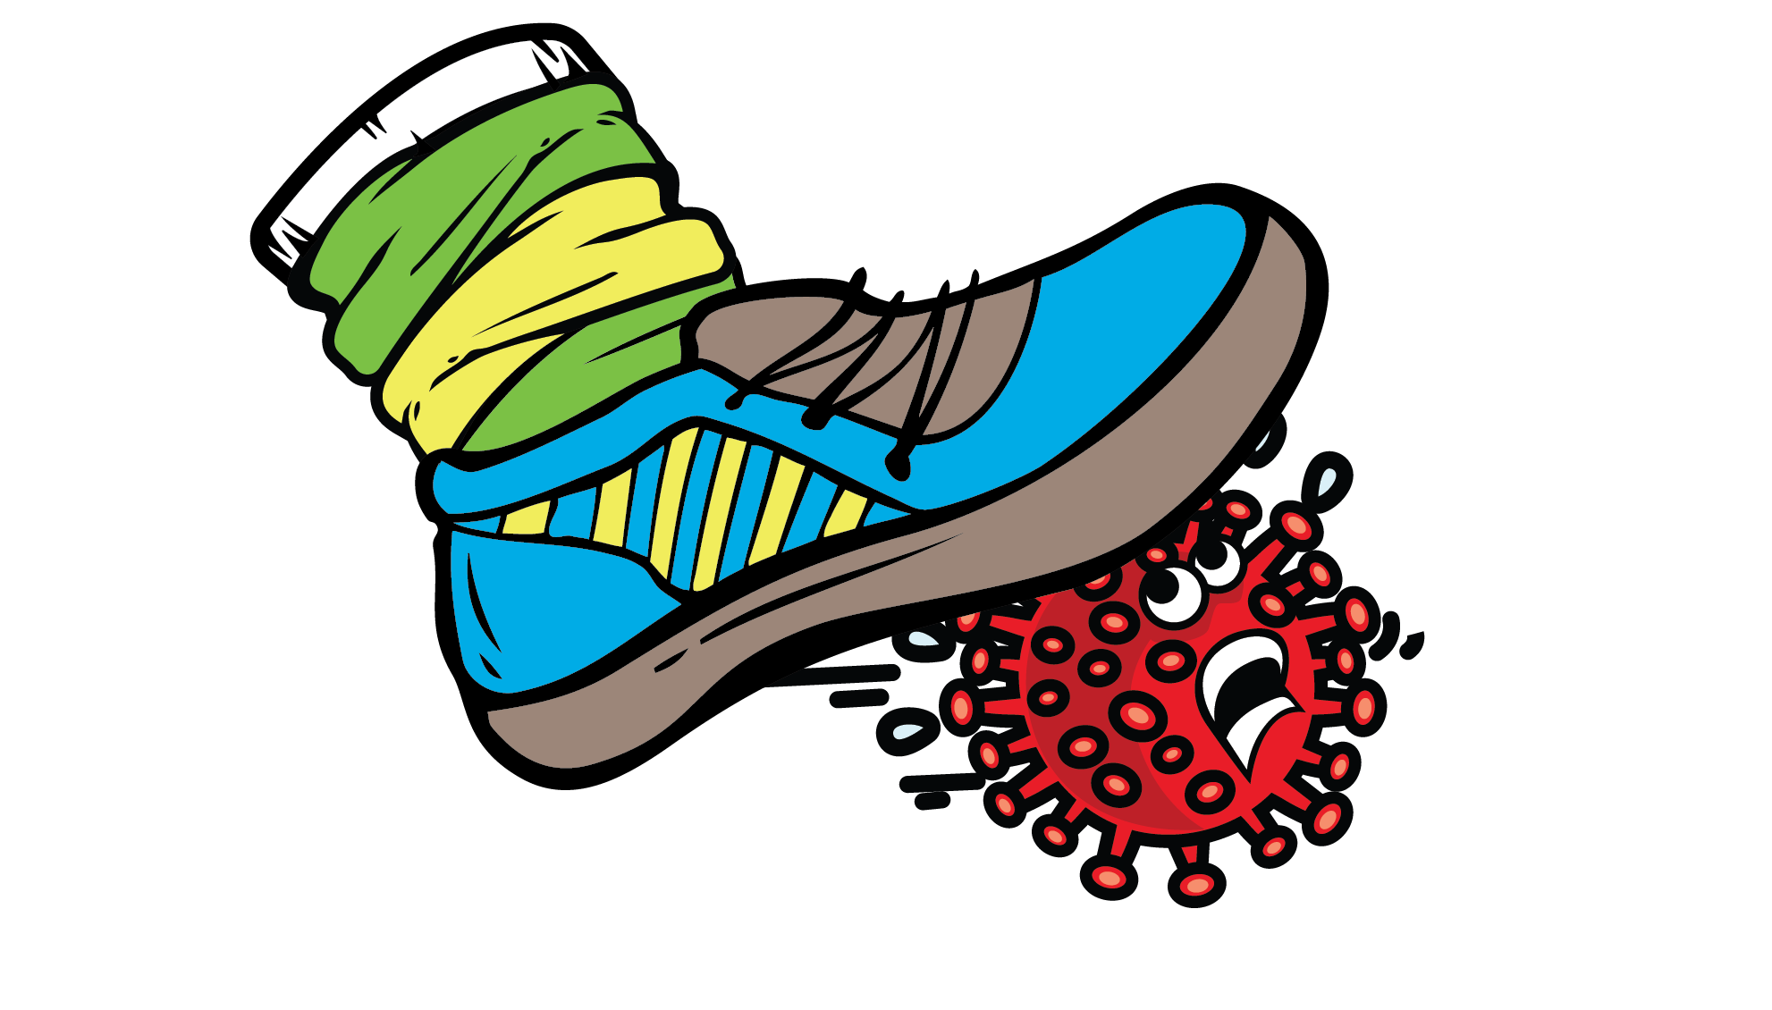
The COVID-19 Crushers: a peer-to-peer education initiative in the New River Valley

Slide 2
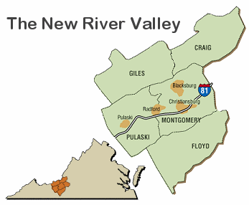
BACKGROUND
Blacksburg
Blacksburg is a town located in the New River Valley, a region in Southwest Virginia
Blacksburg is dominated economically and demographically by Virginia Tech
Approximately half of the population in Blacksburg are students

Slide 3
BLACKSBURG AND THE COVID-19 PANDEMIC
March 7, 2020- First case of COVID-19 in Virginia
March 12, 2020- State of emergency in the Commonwealth of Virginia
March 27, 2020- First positive case of COVID-19 in Blacksburg is confirmed
March 7- Spring Break begins at Virginia Tech
March 23, 2020- after spring break has been extended, classes go online.
Aug 24, 2020- Start of classes; hybrid instruction
Notes:
Source: https://wittman.house.gov/coronavirus/virginia-timeline.htm
Source: http://www.collegiatetimes.com/news/first-positive-case-of-covid-19-in-blacksburg-confirmed/article_c297c622-7056-11ea-9861-2f06e1230613.html
Estimated that only 10% of students living on campus returned after spring break (only 950 students out of 9,500 returned to campus an estimate of 40% (11,000 people) of students living off campus remained
https://roanoke.com/news/education/virginia-tech-makes-new-offer-to-entice-campus-bound-students-to-leave/article_f4e072ab-dc83-5b44-8518-f9bd4da97777.html
https://www.wfxrtv.com/news/health/coronavirus/virginia-tech-students-return-to-class-21-cases-of-covid-19-confirmed/

Slide 5
FROM THIS CAME THE NEED TO CREATE A PEER-T0-PEER EDUCATION INITIATIVE TARGETED TO VIRGINIA TECH STUDENTS

Slide 6
The COVID-19 CRUSHERS
The New River Valley Public Health Task Force wanted to provide peer-to-peer outreach to both students and residents
Students provide boots on the ground education in a “non-threatening” way
The COVID-19 Crushers- a student led initiative – end of August 2020.
Funded by the Town of Blacksburg and working closely with the New River Health District and the Master of Public Health Program at Virginia Tech

Slide 7
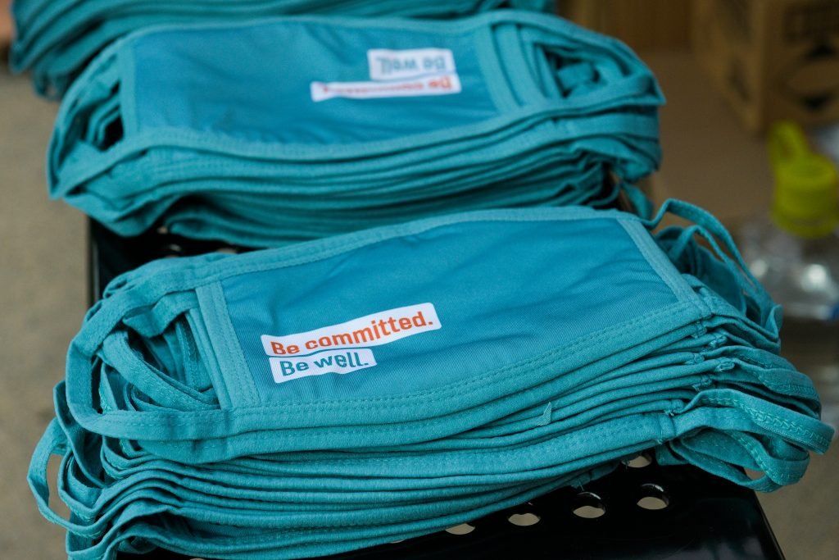
Activities done by the COVID-19 Crushers
Provided information on health, prevention, services to the community
Gave out incentives for engagement
Masks, hand-sanitizer, gift cards, gum, candy, etc.
Weekly events in downtown Blacksburg from Aug- Nov 2020
Drive-thru Flu Shot clinics in 5 different locations through the New River Valley
Election Day support
Community contests to promote healthy behaviors
Distribution of meals through the Agency on Aging

Slide 8
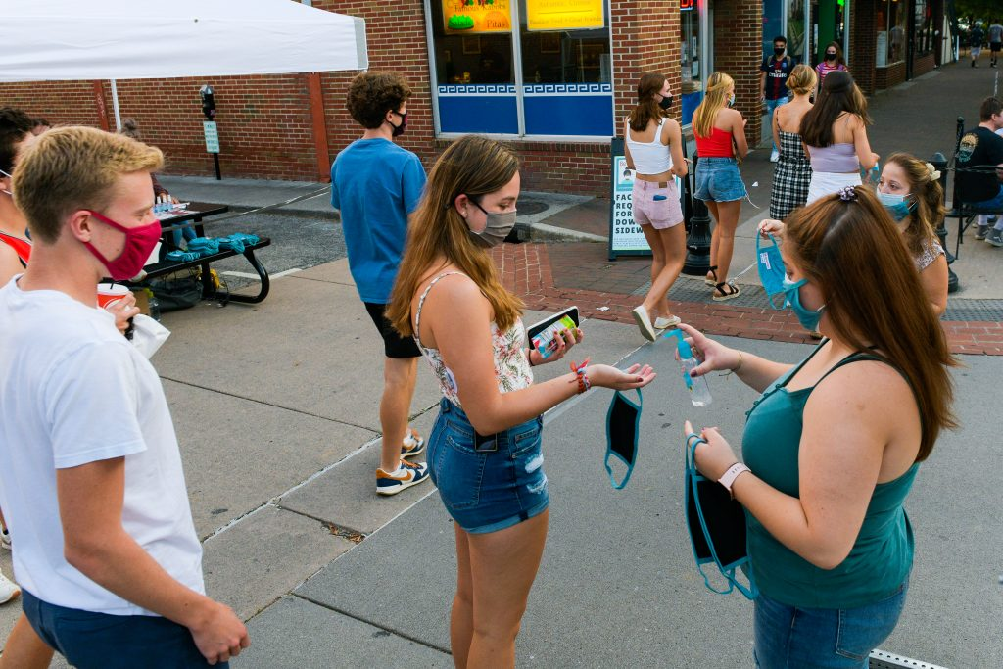
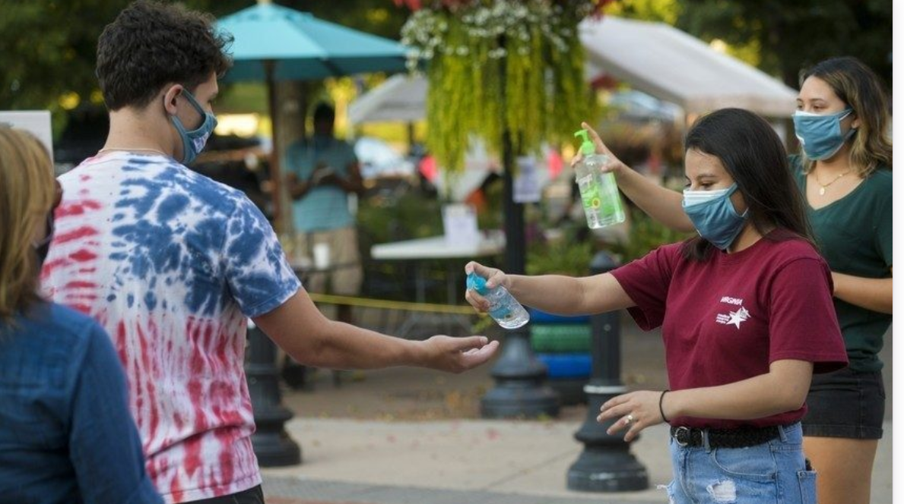
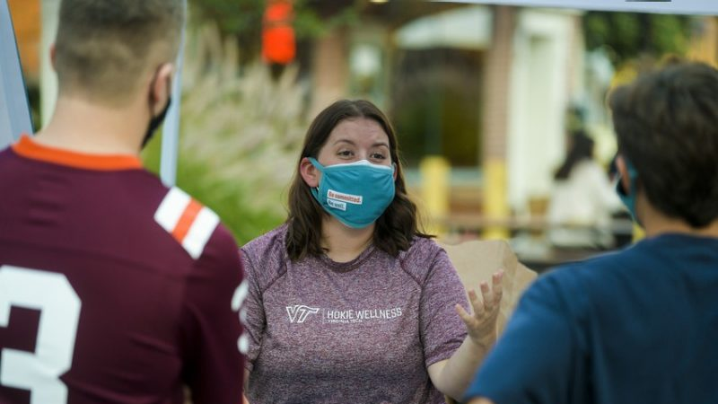
Distribution of hand-sanitizer and outreach material by the COVID-19 Crushers

Slide 9
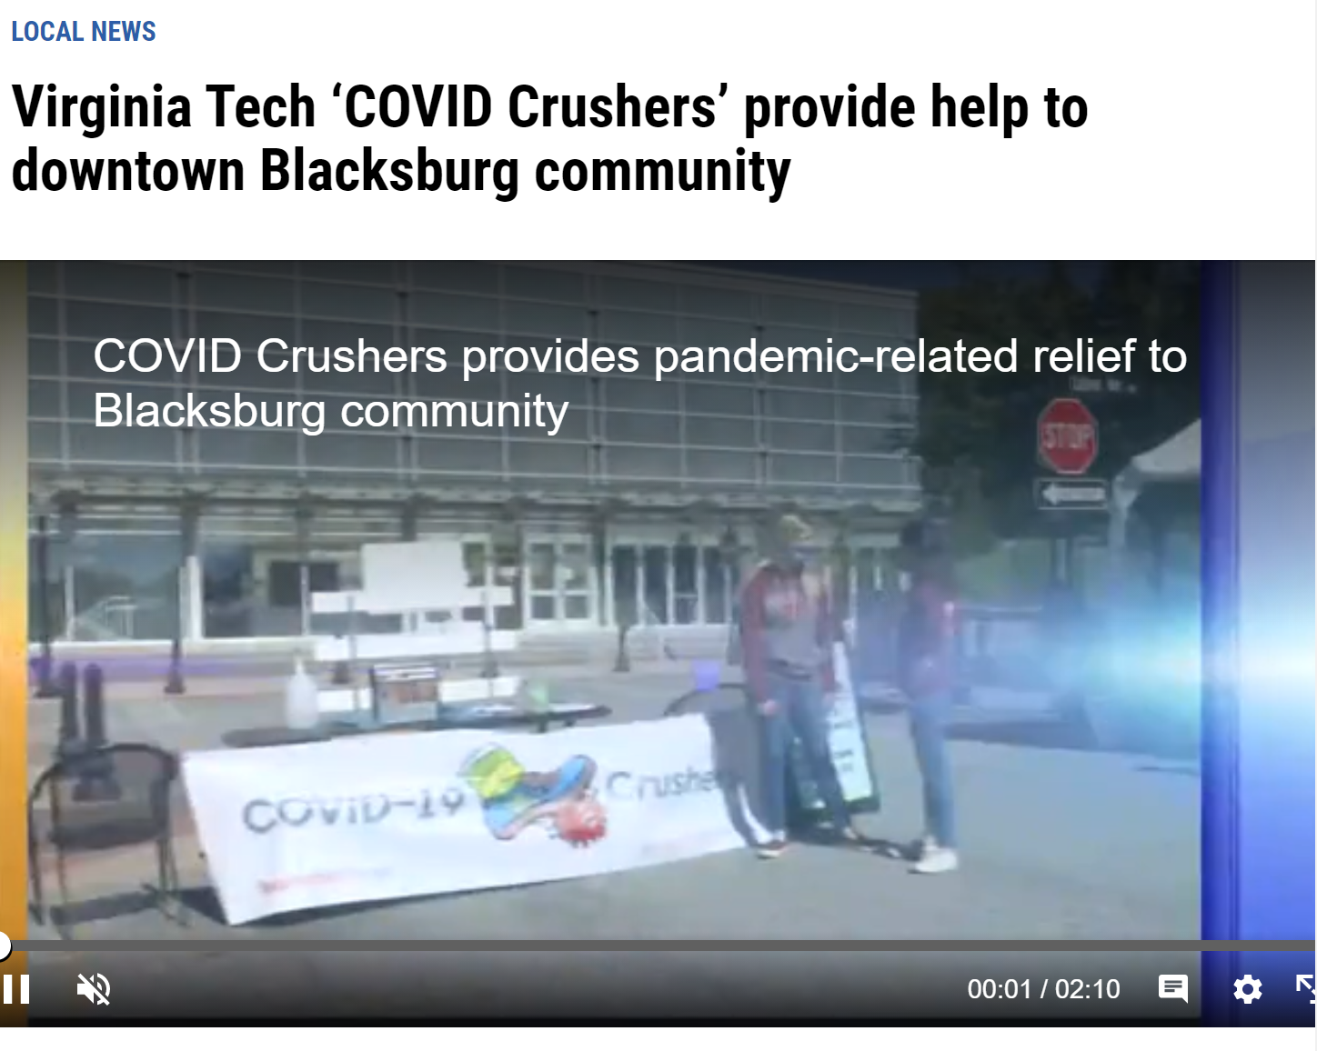
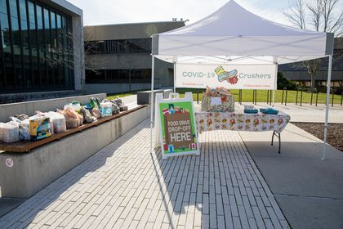
Some results
Positive and welcoming response from Virginia Tech and the New River Valley community members
Distribution of +8,000 masks and engagement with +200 people at each event
Interest from the local media and Virginia Tech News

Slide 10
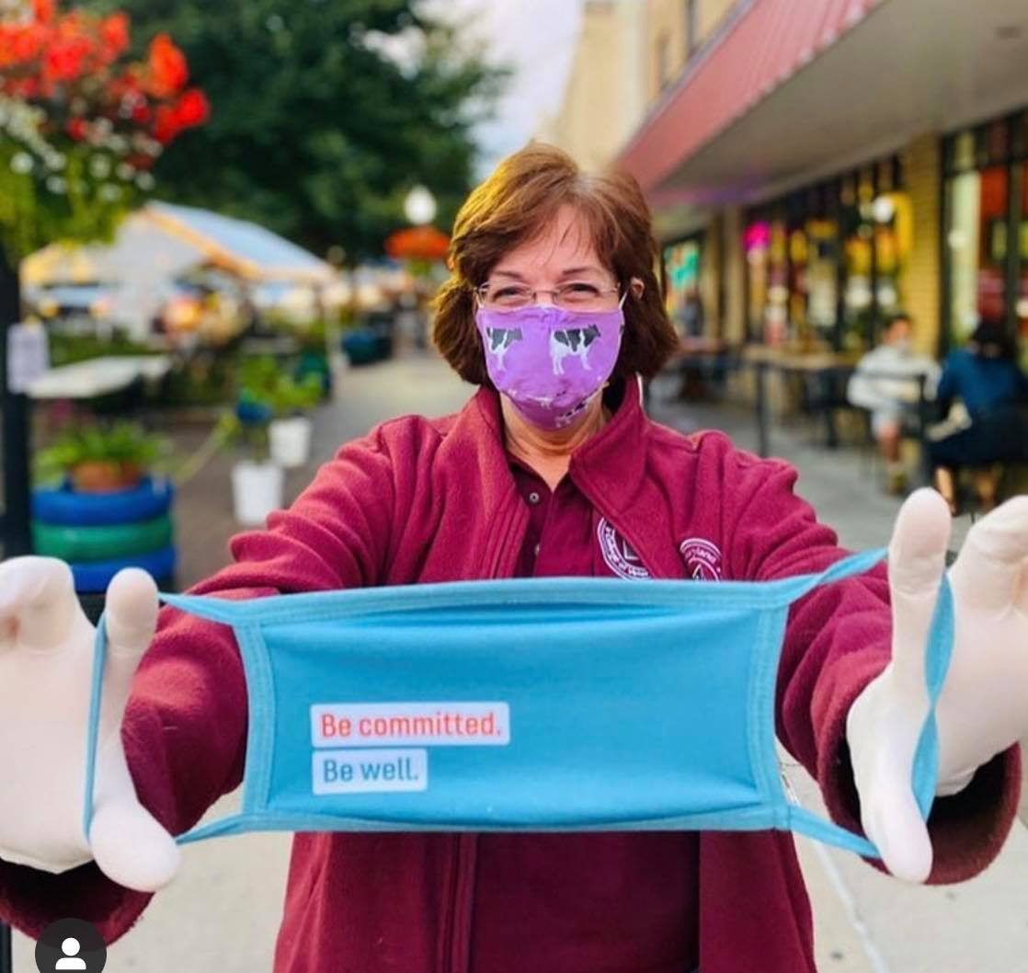
Lessons Learned
Lesson 1: Support from stakeholders and collaborations
Dr. Laura Hungerford, Department Head of Population Health Science at Virginia Tech shows her support by distributing masks, hand-sanitizer, and resources with the COVID-19 Crushers on a Friday night.
Words from Virginia Tech’s president Tim Sands
Notes:
Support from stakeholders, in our case the health department, the town of Blacksburg, the Blacksburg police, the university, faculty in our department and other departments was highly important COMMUNITY MEMBERS
Collaboration with other departments (i.e., graphic designers, researchers, students, was highly important, local organizations, health care professionals, police)
Gave us credibility

Slide 12
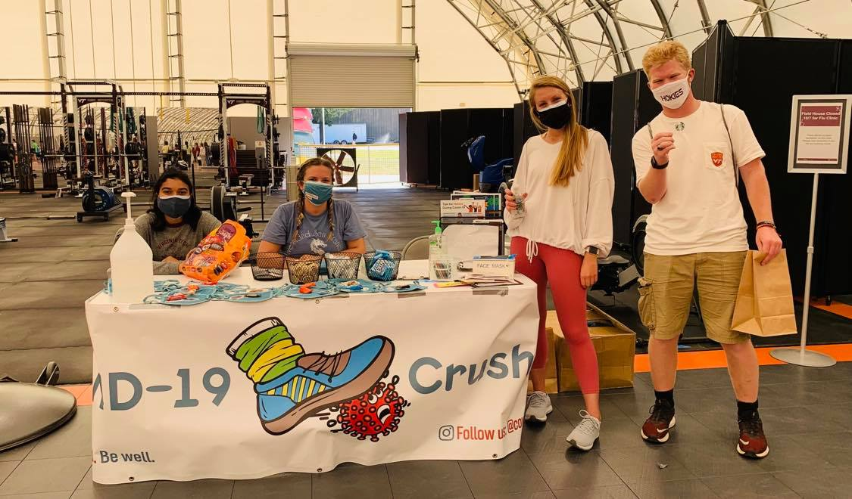
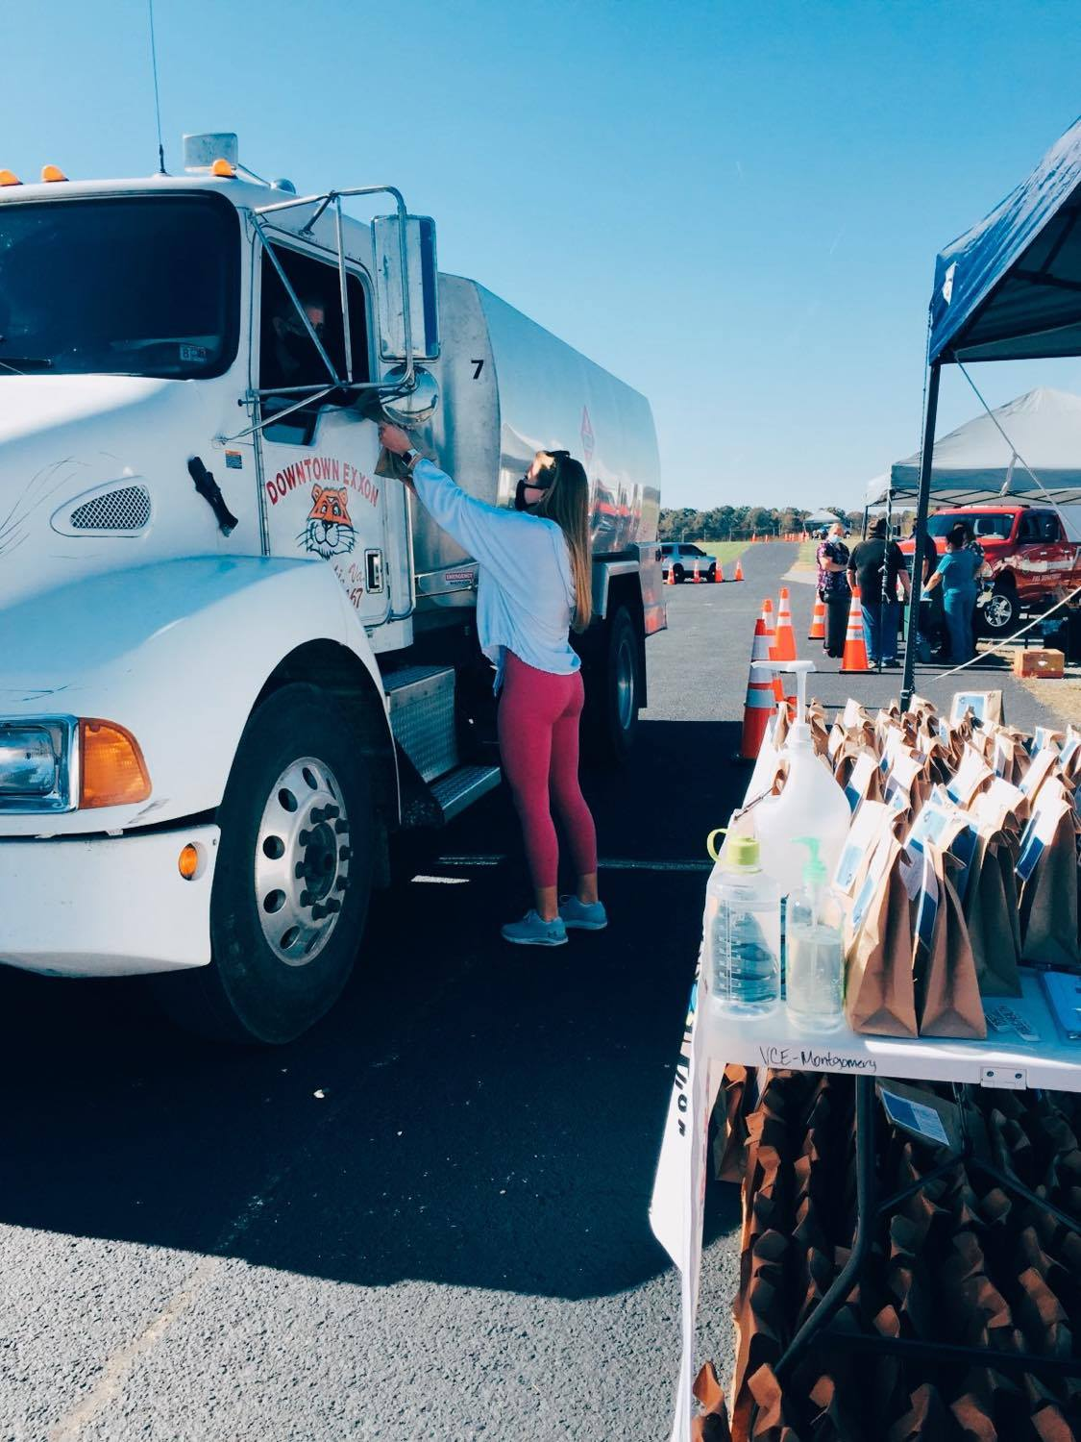
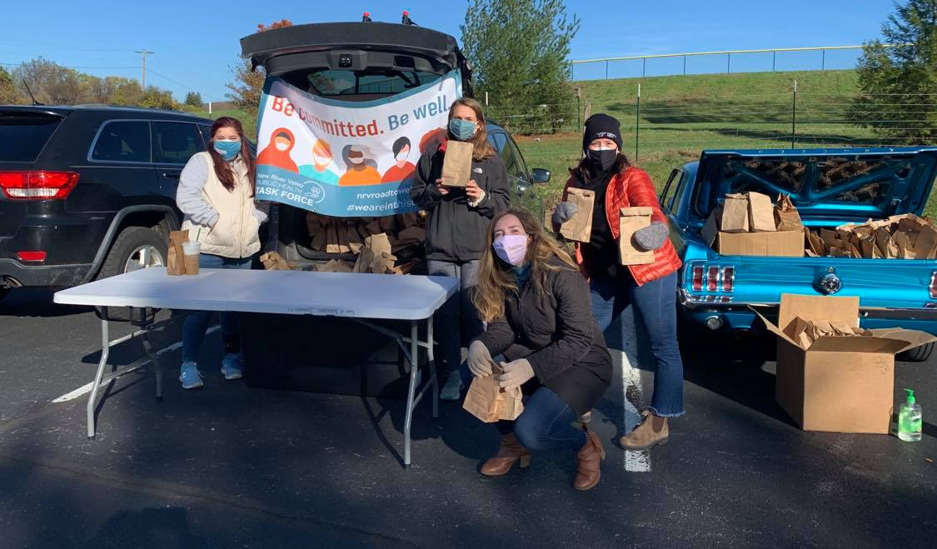
Lesson 2: Power of Adaptability

Slide 13
Lesson 3: Positive and unifying messages
Notes:
We created positive messaging that instead of telling people what they couldn’t do told of the activities they could do safely
We encouraged the community

Slide 14
Conclusion
With challenges, come opportunities- students can be leaders and make a difference in their communities
The pandemic allowed us to learn through and be better prepared for the next pandemic
Future steps:
Help with the distribution of the vaccine?
Share our experience with others
Continue with health education iniatives

Slide 15
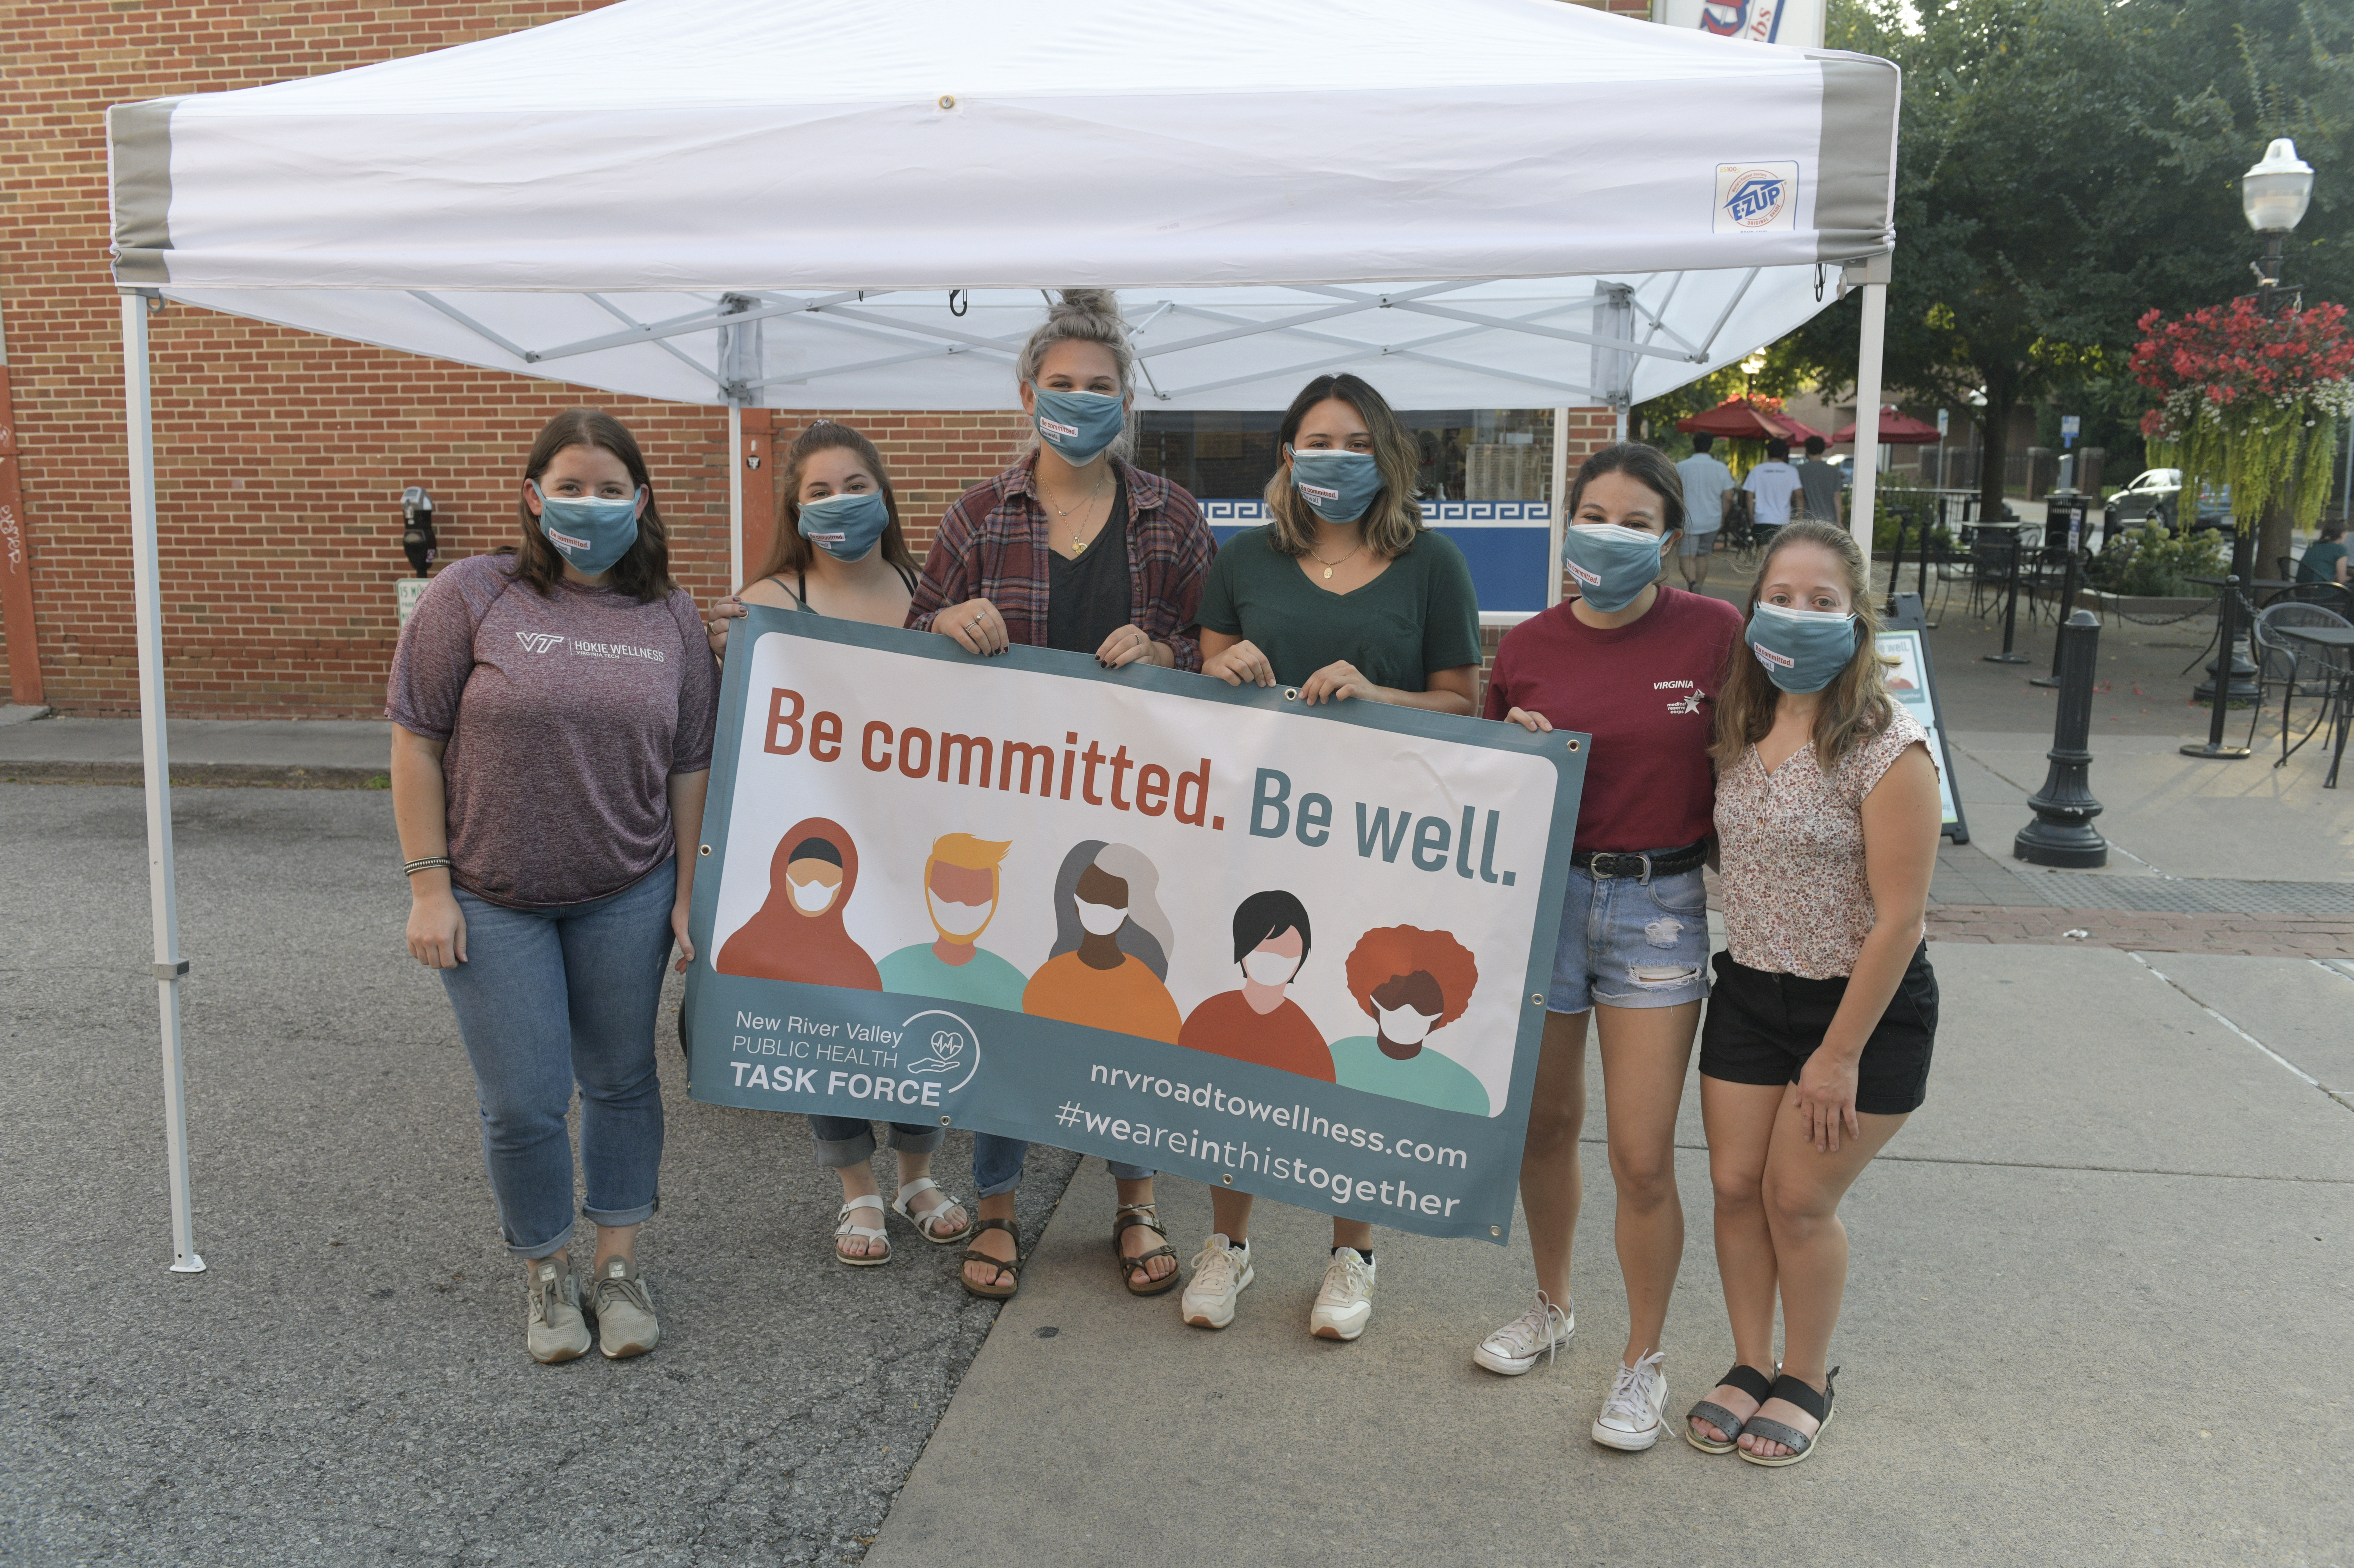
Thank you!
Contact: Fernanda Gutierrez- fernandag@vt.edu

