Slide 1
Internationalization of Higher Education: Case of the University of Jordan
Dr. Hadeel Yaseen - Director – International Affairs Unit

Slide 2
Overview
Internationalization of HE – Global Trends
UoJ Internationalization Strategy
Impact of COVID-19 on Internationalization
Opportunities & Challenges for Internationalization

Slide 3
Internationalization of HE – Global Trends
A relatively new but broad and varied phenomenon.
Internationalization has become a major opportunity and a serious challenge for universities worldwide.
Internationalization has evolved from a marginal activity to a key aspect of the reform agenda
Driven by a dynamic combination of political, economic, socio-cultural and academic rationales and stakeholders
The idea of internationalization is now a key objective in the strategic plans of most universities and colleges around the world
Growing importance of internationalization at all levels
The positive aspects of internationalization include improved academic quality, internationally oriented students and staff, national and international citizenship for students and staff, enriching international practical experience, opportunity to study in a foreign language and Increased possibilities in finding a job at home or abroad.

Slide 4
UoJ Internationalization Strategy
Internationalization is one of the pillars of UJ’s 2017-2022 Strategic Plan.
Forging national, regional, and international strategic partnerships is one of the six strategic priorities of UJ that serve its mission of providing students with fulfilling learning experiences and conducting knowledge-producing research.
UJ’s strategic plan complies with the strategic objectives of the National Strategy for Human Resource Development 2016 – 2025 which include raising the standards of HE research, teaching and learning to those expected from the best modern universities; incentivizing and encouraging universities to take greater responsibility for making significant contributions to national economic and social goals and to enable the adoption of international best practices in teaching and learning that will support improved access and quality.
UOJ designed its internationalization strategy to fully prepare and cope effectively with future challenges, and we have consequently allocated dedicated staff and other resources to meet the needs in this regard. The International Affairs Unit (IAU) was empowered in order to implement the new internationalization structure.

Slide 5
UoJ Strategic Objectives & Initiatives
UOJ Strategic Objectives:
To develop effective local, Arab and international strategic partnerships.
To forge relations with external bodies that support scientific research and capacity building.
To offer joint graduate programs in partnership with international universities and international institutions.
To exchange experiences and knowledge globally.
To establish a global information system for the documentation and classification of Arabic publications.
To maximize benefit from international grant programs.
Internationalization Abroad
Student Degree Mobility
Student Credit Mobility
Student short term Mobility
Staff Mobility
Program mobility
Internationalization at Home
Campus internationalization (e.g. Aqaba)
Internationalization of the Curriculum
Joint Programs
Intercultural and international competences and learning outcomes

Slide 6
Active Agreements: 160

Slide 8
UOJ SWOT Analysis
Weaknesses | Strength
• Insufficient infrastructure (for teaching, research and service). • High percentage of university budget is derived from tuition fees. • Low budget for research and international student scholarships. | • Excellent quality of graduates. • Highly employability rate of graduates. • Nice campus and strategic location. • Motivating work environment. • Good quality of international and local teaching staff. • Appealing and competitive academic programmes. • National ranking system for quality assurance.
Threats | Opportunities
• Limited government & private sector financial support. • Limited applied scientific research by private sector enterprises. • Unstable political situation in the region. • Impact of Covid-19 on UOJ Internationalization efforts. | • Consolidating partnership with American, European and international funding programs. • Enhancing internationalization profile. • Increase prospects of post-graduate scholarships. • Engage faculty in quality research activities. • Develop students‟ quality admission criteria.

Slide 9
The impact of COVID-19 on Internationalization
The Crisis Has Affected:
Continuity of learning.
International Mobility.
Research mobility exchanges will be postponed to later in 2021.
Safety and legal status of international students.
Students’ perception of the value of studying abroad for their degree.
The meaning of ‘partnership’ has been redefined: partnerships will no longer be based mostly on mobility.
Students are missing out on:
International exposure.
Input into foreign job markets and networking.
Welcome days and induction weeks will be held in online format.

Slide 10
Opportunities For Internationalization
Universities should consider a focus on the development of innovative interventions, including:
Recognizing digital mobility at national and institutional levels has the potential to increase accessibility for real.
Joint staff trainings across the network are seen as a valuable opportunity.
Curriculum internationalization.
Short-term virtual exchanges; semester or year virtual mobilities.
Increasing and speeding up research collaborations.
Sharing resources.
Engaging researchers to connect online with their peers.
Inclusion of a broad range of university staff in internationalization activities; Virtual Conferences and Webinars.
Mainstreaming Open Science.

Slide 11
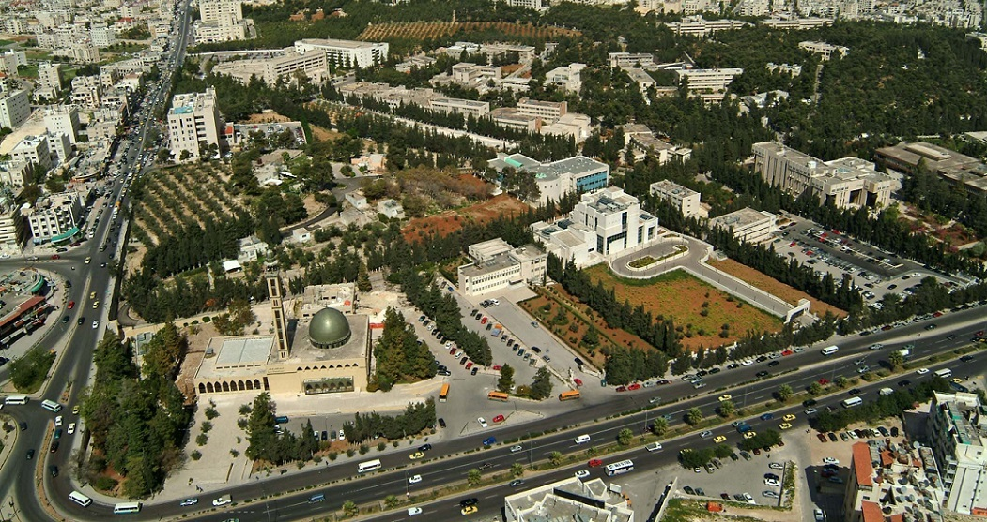
Thank you!
Dr. Hadeel Yaseen
Email:
Phone:
Institute:
H.Yaseen@ju.edu.jo
+962797599929
The University of Jordan

