Slide 1


Urgency, Community, Economy, Joy: the Many Faces of Virginia Tech’s COVID-19 Response
US - Jordanian UCN Webinar series
15 December 2020
Matthew Hull, PhD
Virginia Tech, ICTAS
NanoSafe, Inc.
mahull@vt.edu
Notes:
Right place, right time: how sustainable nanotechnology prepared us to battle CoVID-19 and future pandemics
M. Hull
Abstract
As the world shut down when CoVID-19 reached pandemic proportions and aerosol transmission routes became evident, researchers skilled in the environmental health and safety (EHS) of aerosolized nanoparticles went to work. Expertise, resources, and frameworks developed to mitigate nanotechnology EHS risks suddenly became essential in the battle against an unseen enemy with nanoscale dimensions. This presentation uses multiple case studies developed since March 2020 to describe some of these nanotechnology EHS resources and how they were adapted and deployed to protect frontline healthcare workers, the general public, student

Slide 2
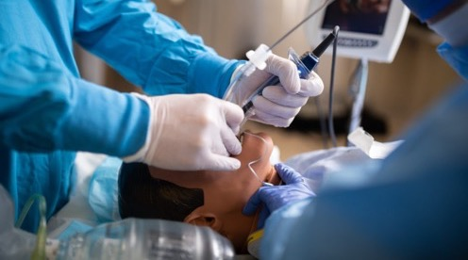
URGENCY
PPE for high-risk healthcare procedures
Notes:
APF = a measure of the degree of protection offered by the respirator the greater the APF the greater the protection offered)
Exposure during doffing (removal) is major concern.

Slide 3
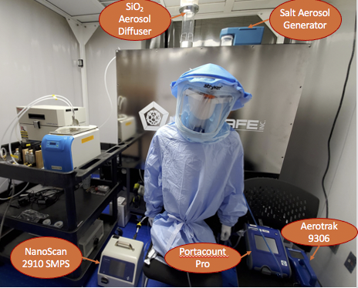
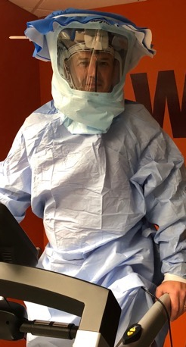
Powered Air Purifying Respirator (PAPR)

Slide 4
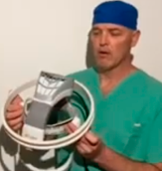

Scale-up and dissemination as emergency backup PAPR
Carilion
Approved as back up
30+ kits
Other Health Systems
Roanoke, VA
Charlotte, NC
Austin, TX
Chicago, IL
Georgia

Slide 5
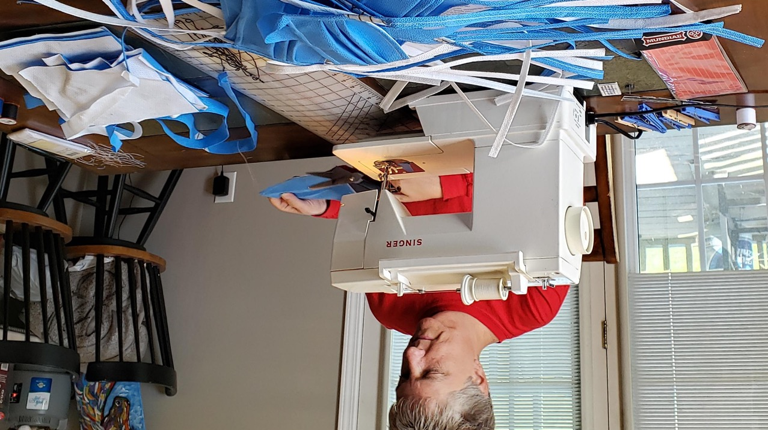
COMMUNITY
mask sewing initiative for first responders, health workers

Slide 6
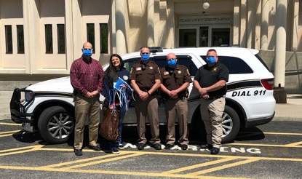
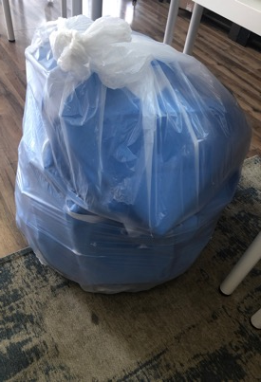
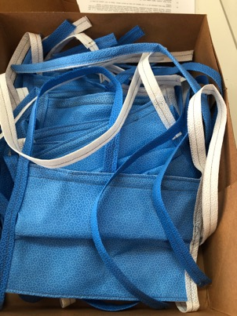
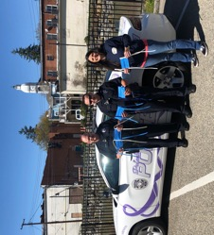
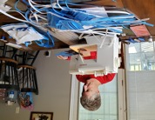
From PAPR development to masks for first responders, health workers
Same surplus hospital materials used for PAPR

Slide 7
ECONOMY
a tool to help small businesses recover from COVID-19

Slide 8
From Nano to CoVID-19
A simple framework for small business safety
Nano: 1-100 nm, aerosol/surface threat
SARS-CoV-2: 125 nm, aerosol/surface threat/infectious

Slide 9

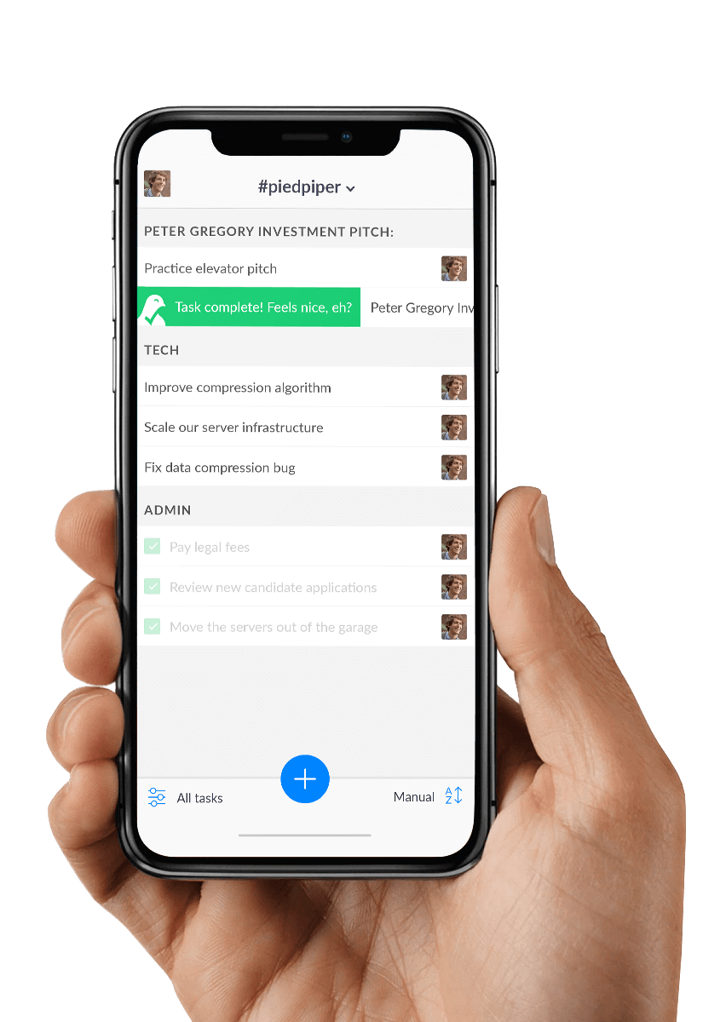
Help small business owners manage
COVID-19 risks. Save jobs.
PHRE
Public Health Readiness Evaluation Tool
Let’s see how you’re doing.
Help small businesses assess their readiness to operate by translating guidance into simple yes/no questions. Option to share score with others.
Notes:
“Tool to support public-health”
“speed to market” mobile application focused on small business sustainability and adaptation to COVID-19.”

Slide 10
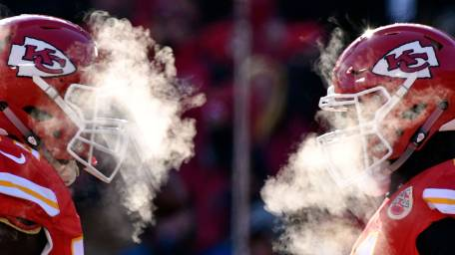
JOY
faceshields for a beloved American pastime

Slide 11
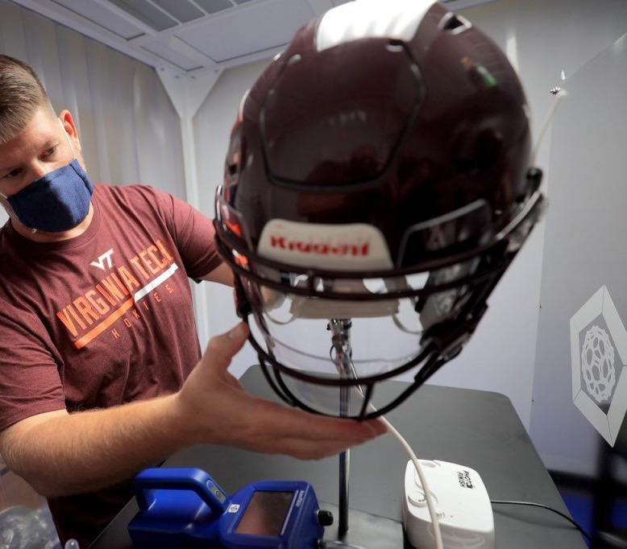

On-field
protection
Lab testing: inward/outward penetration testing

Slide 12
Choukran
Matthew Hull, PhD
Virginia Tech, ICTAS
NanoSafe, Inc.
mahull@vt.edu

