Slide 1
Linking Tertiary Education to Labor Market
Mohannad Aljarrah, PhD, PDEng
Director, Center of Excellence for Innovative Projects
Director, UNICEF WASH Innovation HUB
Associate Professor
Department of Chemical Engineering
Jordan University of Science and Technology

Slide 2
Outline
General approach to issue of linking tertiary education to the labor market
The center of excellence at JUST
Projects and case studies

Slide 3
Introduction
The Issue of linking the tertiary education system to the labor market can be considered through a simple supply and demand framework
London School of Economics
Is there now ‘over-supply’ of graduates? Field specific?
Is there evidence of ‘over-qualification’ or skill mismatch?
Are students studying the ‘right type’ of subjects at tertiary-level?
The balance between employer provided training and education provided in institutes of tertiary education?
Is there a shortage of science and technology graduates in particular?
How does type of institution matter for labor market prospects?

Slide 4
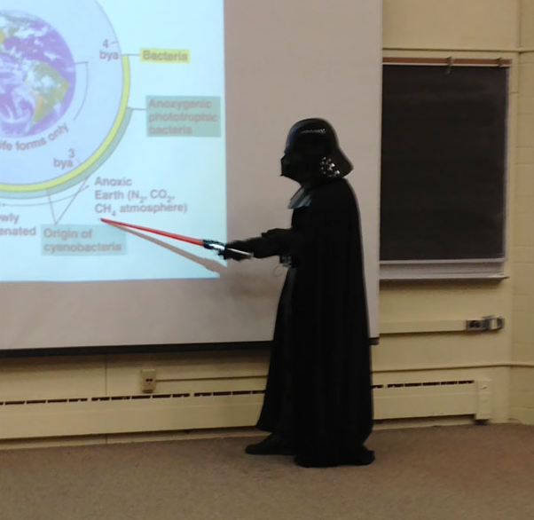
General Approach
Bridging the gap between the education system and the labor market
Specialized Centers and extracurricular training
Changes to way we teach the curriculum
Changes to the curriculum
3
2
1
Problem solving/project based
Example: Design course, graduation projects, internships, etc
Continuous improvement process based on feedback form labor market
Example: ABET
Center of Excellence for Innovative Projects

Slide 5
The output of the tertiary education system is not only the graduates but also the research
Advancement to basic sciences
Applied research
Design reports
Technology trends
Patents
…

Slide 6
Should we trust the labor market with the quality of our educational system??
Are we forcing universities to be run as corporates where our product (graduates) must meet the requirement of the customer?
What about basic science?
Are we going to miss having the next Albert Einstein or the next Nikola Tesla?

Slide 7
Center of Excellence for Innovative Projects at JUST
Model Innovation Center for Jordanian Universities

Slide 8
Center’s Services
TTO
Incubator
Objective:
Protect the IP rights of JUST employees, students, and partners in ideas, projects, products, and services.
Sub-objectives:
Train university staff on IP services
Raise the awareness for IP rights
Protect ideas via patenting, etc.
Statistics:
12 patents granted in the last 2 years
35 applications under processing
These numbers were zeros 3 years ago
Objective:
Spinoff startup companies
Incubation Process:
Seed funding
Training and qualifying
Statistics:
~20 incubated projects
~25 under processing
1 spinoff

Slide 9
Projects
Elegant: EU funded project
Employing or improving employment opportunities for students of the College of Computer Technology and Information from graduates or those about to graduate through training, study tours, networking, etc.
Tajdeed: Center/private company partnership
6 months training program to improve employability of university graduates
AppsFactory:
Internship program for IT student to develop real life applications
Innovation groups: CEIP initiative
Provide extra-curricular training in 3D printing, IOT, ethical hacking, drones and problem solving.

Slide 10
Thank You

