Slide 1
Creating Global Classrooms through Virtual Exchange
Paloma Rodriguez,
Director of Office of Global Learning
Paloma Rodriguez
Director, Office of Global Learning

Slide 2
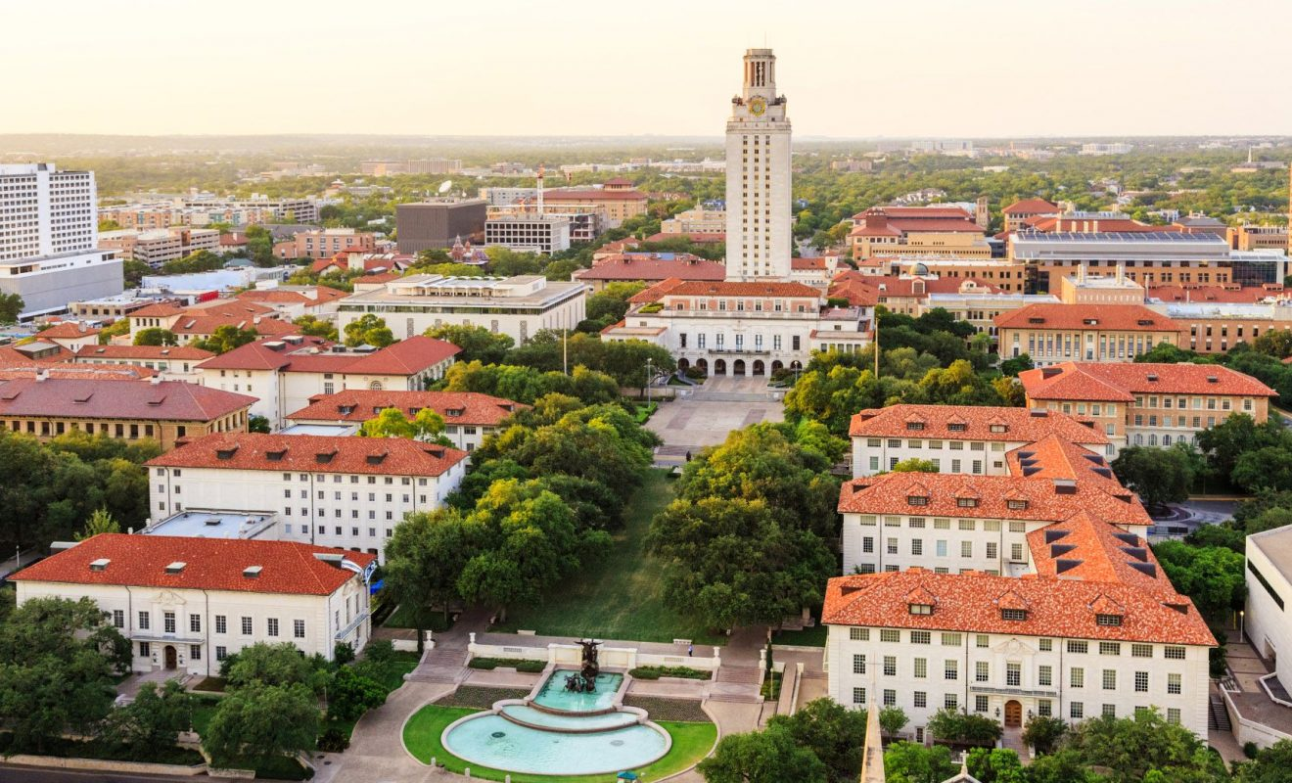
Priority Activities US Higher Ed Institutions Mapping Internationalization on US Campuses 2017, American Council on Education

Slide 3
National Survey of Student Engagement (NSSE) & ACE Mapping Internationalization
Jillian Kinzie, Indiana University, National Survey of Student Engagement
Robin Helms & Lucia Brajkovic, American Council on Education’s Center for Internationalization and Global Engagement
https://aiea.memberclicks.net/assets/docs/Conference_Materials/2019/Session_Materials/NSSE%20Mapping_Global%20Learning%20AIEA%202019%20Kinzie%2C%20Helms.pdf

Slide 4
Faculty Professional Development Programs
Research
Global Fellows
Teaching on Campus
Global Learning Institute
Virtual Exchange
Teaching Abroad
Study Abroad Leadership Program
Certificate of Global Teaching & Learning- Center for Teaching Excellence
https://internationalcenter.ufl.edu/faculty-engagement/international-teaching/global-teaching-home/global-teaching-learning-certificate

Slide 5
Overview
What is Virtual Exchange (VE)?
Examples of VE Courses
Benefits
Virtual Exchange Around the World

Slide 6
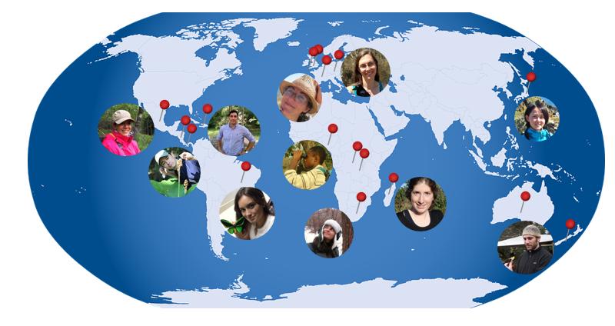
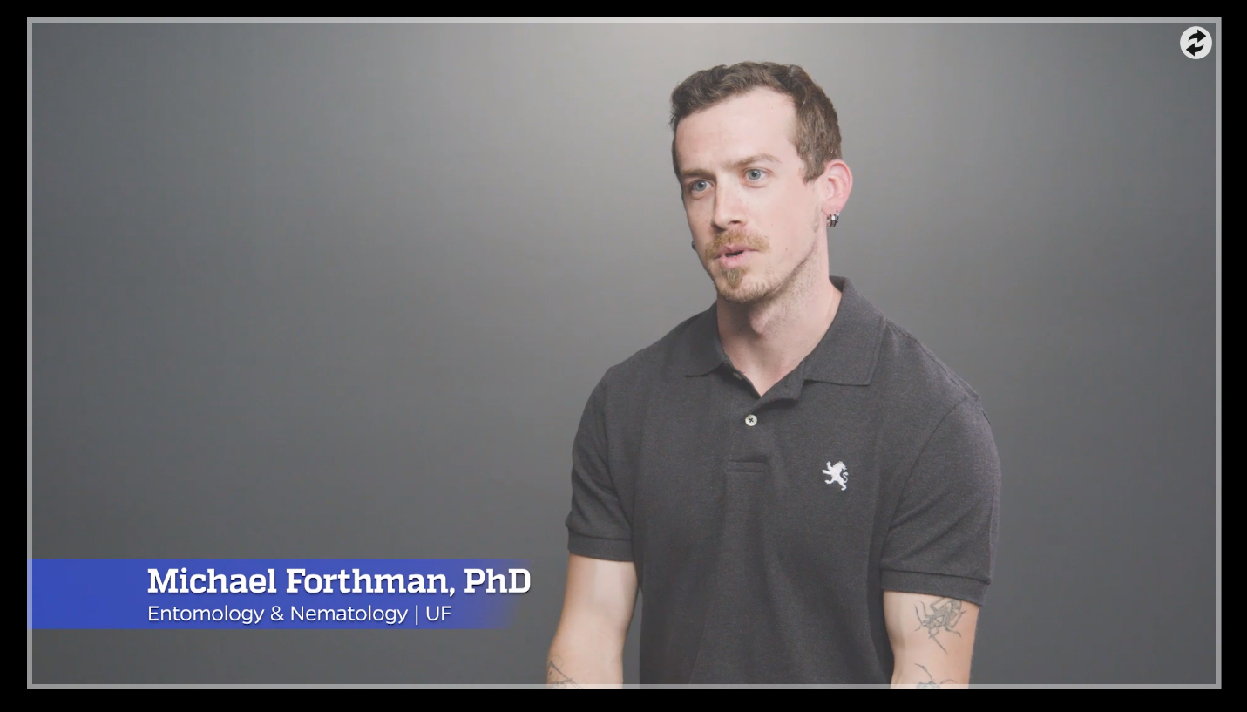
Envisioning the Possibilities
Virtual Exchange Project:
Interview with international researchers
Ginnie Greenway & Michael Forthman
ENY 2890 Insect Research & Scientific engagement
https://mediasite.video.ufl.edu/Mediasite/Play/95a43cb7fea8400395ebc2fc1ec8d1491d
Notes:
Other examples: invited educators discussing educational systems, sustainable development non-profit practitioner discussions on careers

Slide 7
ENY 2890 Insect Research & Scientific engagement
Interview with
international researchers
Blog by lab members currently doing international fieldwork
Guest speakers
What are the benefits and challenges of conducting science across borders?
Reflection

Slide 8
Interview with international researcher
Activity Type
Guest speaker- small group
Synchronous
Outside of Class

Slide 9
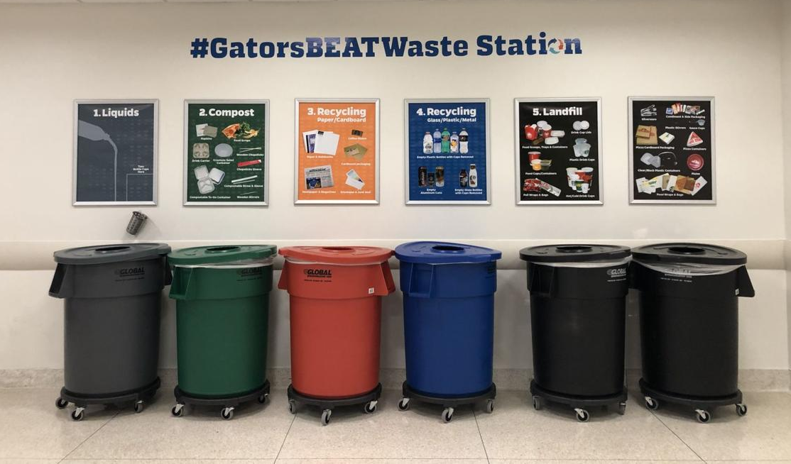
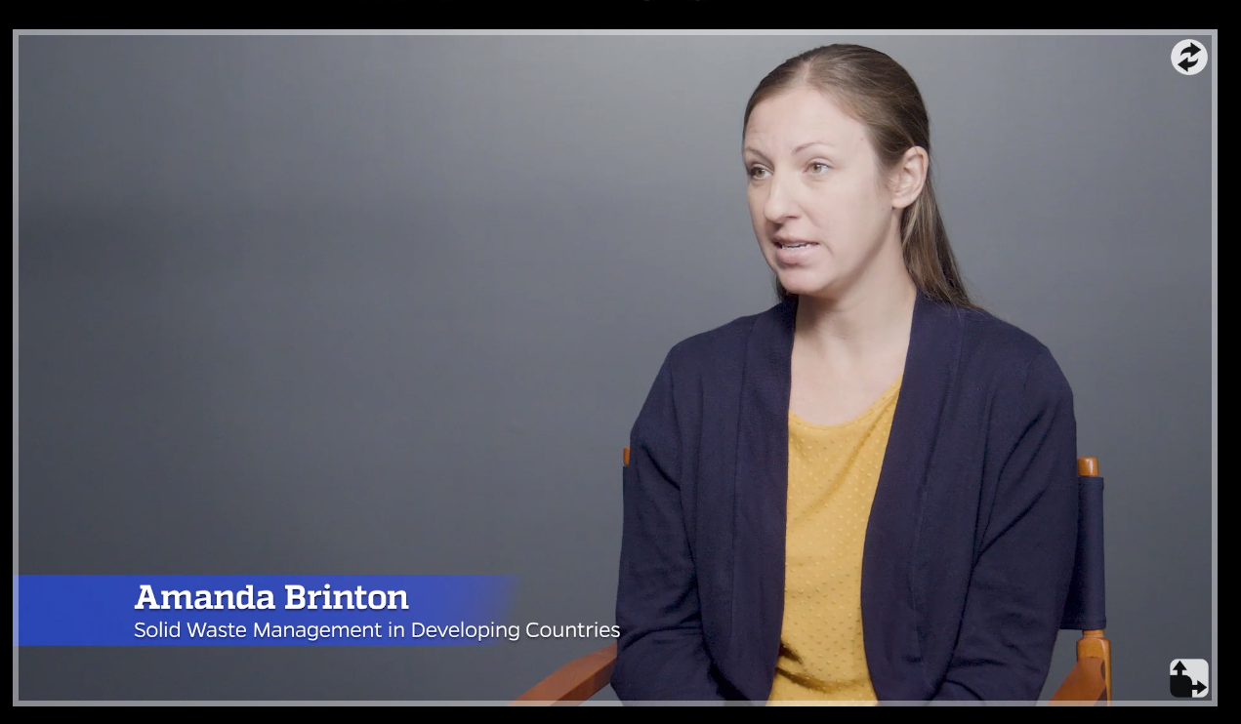
Envisioning the Possibilities
Virtual Exchange Project
Amanda Brinton
ENY 2890 Solid Waste Management in Developing Countries
Group Project: Behavioral Change Plan
https://mediasite.video.ufl.edu/Mediasite/Play/25eafaaa02f9420698a31c22892ed3261d
Partnership: University of Florida- Universidad de los Andes, Colombia

Slide 10
Behavioral Change Plan
Activity Type
Peer to Peer
Synchronous
Outside of Class

Slide 11
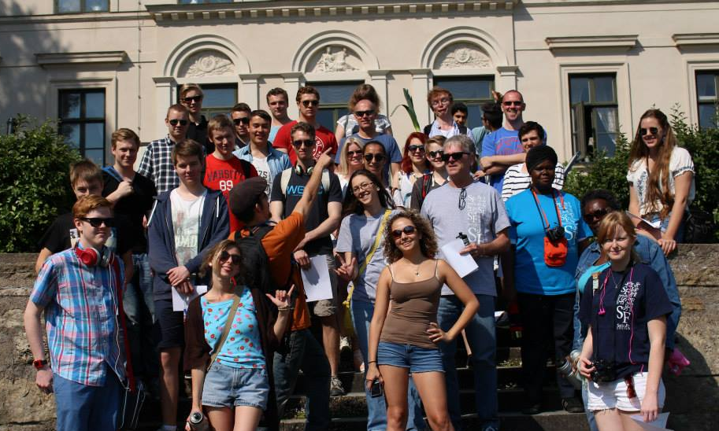
Envisioning the Possibilities
Virtual Exchange Project:
Marriage and Family: Compare & Contrast, Guest Lectures
Santa Fe College, FL- Orebro, Sweden

Slide 12
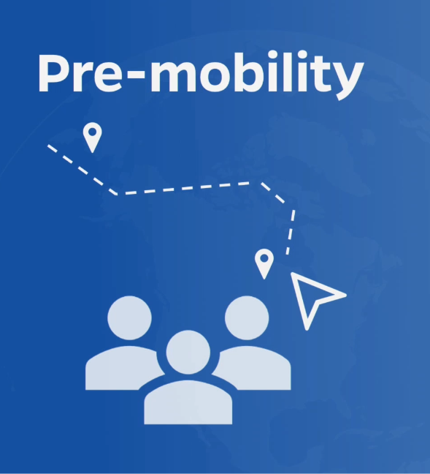
Activity Type
Marriage and Family:
Compare & Contrast, Guest Lectures
Peer to Peer
Synchronous
In Class
Pre- study abroad

Slide 13
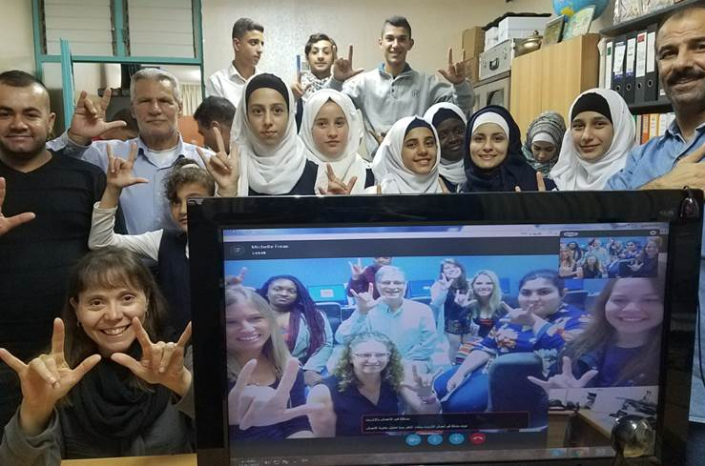
Envisioning the Possibilities
Michelle Freas, American Sign Language
Project: Bilingual Sign Language Dictionary
Partnership: Santa Fe College (FL) - Al-Amal School for the Deaf in West Bank

Slide 14
Bilingual Sign Language Dictionary
Activity Type
Peer to Peer
Synchronous
In Class
Virtual Service Learning

Slide 15
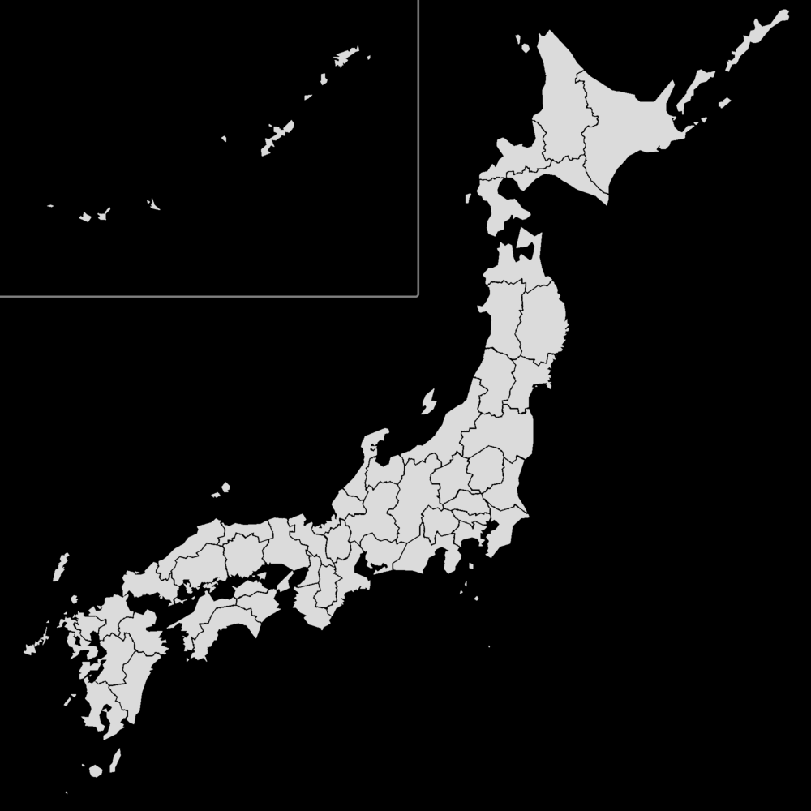
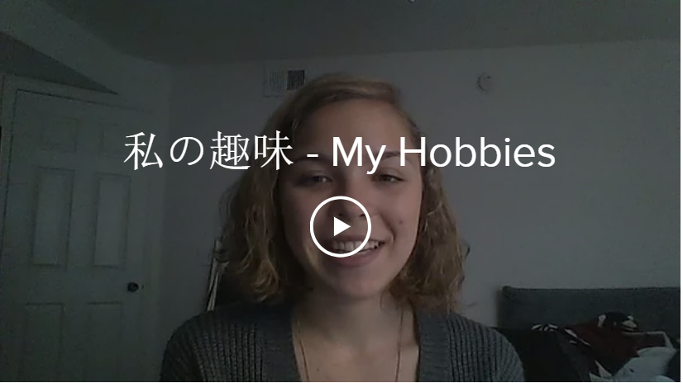
Envisioning the Possibilities
https://rachelgeshay.wixsite.com/rachelgeshay/language-learning
Virtual Exchange Project:
Japanese Language Practice
University of Florida- Japan

Slide 16
Japanese Language Practice
Activity Type
Peer to Peer
Asynchronous
Outside of Class

Slide 17
Virtual Exchange
Why and Why now?
1
Leverages Availability of Virtual Communications
Aligned with Student
Digital literacy
Increased
Faculty Expertise
Restricted Mobility
2
Strengthens Internationalization
Complements curriculum internationalization
Partnerships
Complements mobility
Adds new mode of partnership
Gateway to study abroad
Access
Intercultural Competence
Employability
3
Improves Student Learning
All students can participate
Affordable
Peer to peer interactions
In-depth global views
Virtual collaboration
In international teams
www.free-powerpoint-templates-design.com

Slide 18
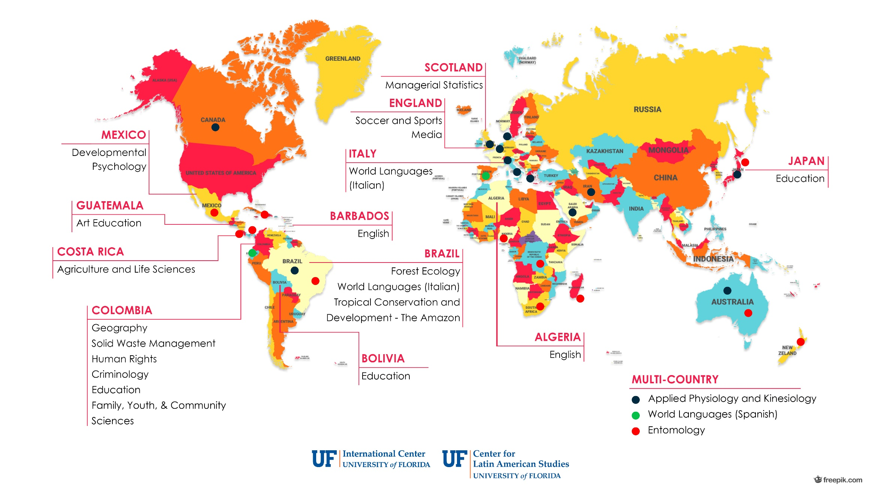
VE at UF: Global Classrooms

Slide 19
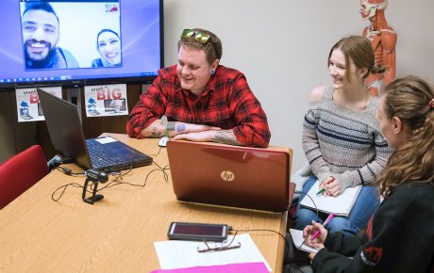
VE in the U.S./ Middle East
https://www.stevensinitiative.org/
Virtual Exchange Coalition (2011)
https://youtu.be/ehyOWMgV7e4
Global Nomads
Soliya
iEarn
Webinars
Grants
Manuals
(2015)

Slide 20
VE in the US
http://coil.suny.edu/
Courses
Partner Network
Professional Development
Annual Conference (Now merged with Europe and other groups)
(2008, NEH)
Notes:
This flagship programme is established under a contract with the Education, Audiovisual and Culture Executive Agency, financed by the European Union’s budget, and it is implemented by a consortium composed of Search for Common Ground, Anna Lindh Foundation, UNIMED, Sharing Perspectives Foundation, Soliya, UNICollaboration, Kiron Open Higher Education, and Migration Matters.

Slide 21
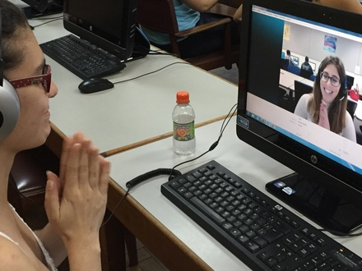
VE in Europe
VE in Latin America
https://www.unicollaboration.org/ (2014)
Conferences
EU Educational Policy
Professional Development
VE Journal
Partner Fairs
Teletandem Brazil 2006, UNESP
*Language focus
https://europa.eu/youth/erasmusvirtual_en
Notes:
This flagship programme is established under a contract with the Education, Audiovisual and Culture Executive Agency, financed by the European Union’s budget, and it is implemented by a consortium composed of Search for Common Ground, Anna Lindh Foundation, UNIMED, Sharing Perspectives Foundation, Soliya, UNICollaboration, Kiron Open Higher Education, and Migration Matters.

Slide 22
Getting Started
BROWSE
Get some ideas by browsing a catalog of courses
De Paul University
SUNY COIL Center
Unicollaborate Projects
READ
Workshop handout
Faculty Guide to learn about VE (SUNY-COIL)
Notes:
Paloma

Slide 23
Getting Started
TAKE A COURSE
Free Online Self-paced Courses
VE 101- An Introduction
VE 102: A Deep Dive
UF Virtual Exchange Training
5-week online cohort-based training for UF faculty
Training models VE pedagogy, introduces technology tools and exercises, and helps faculty develop their own project
International faculty partners join for free
PARTNER
Find an international partner (UF International Center can provide help with partnering)

Slide 24
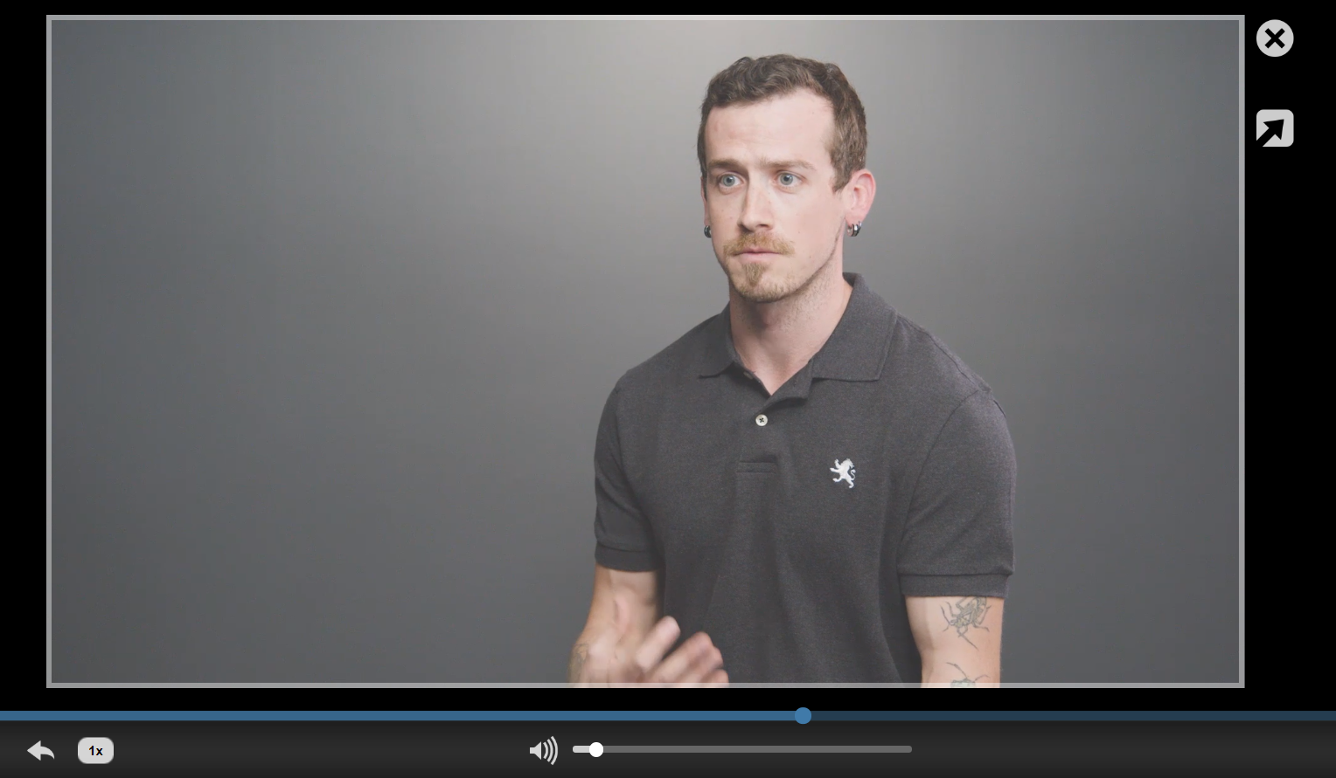
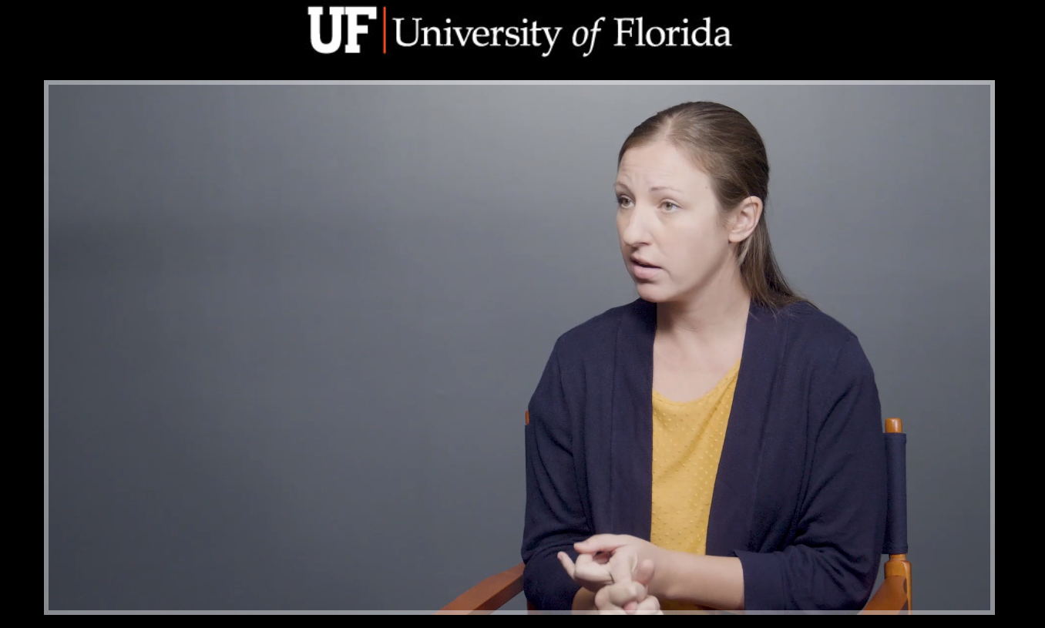
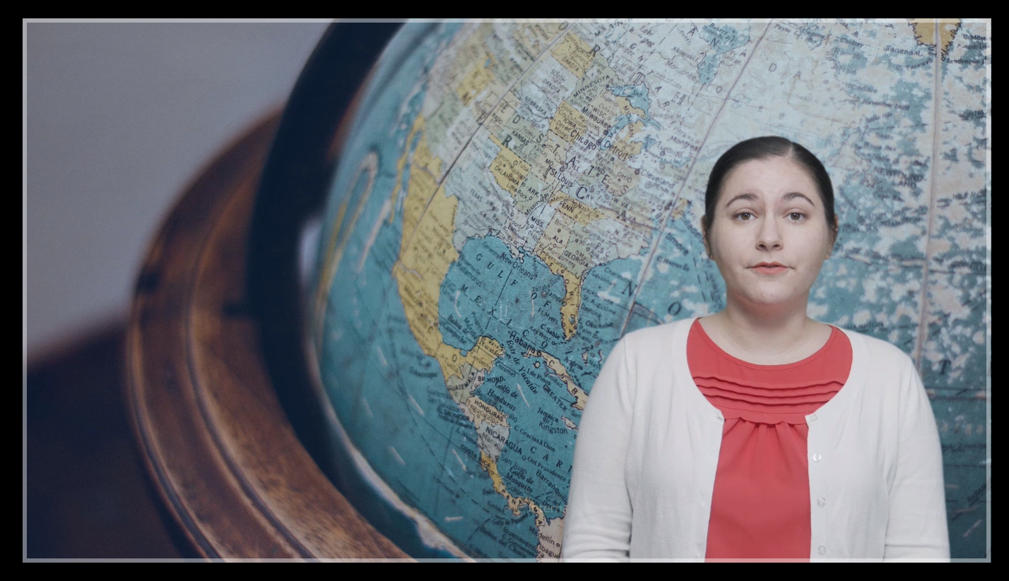
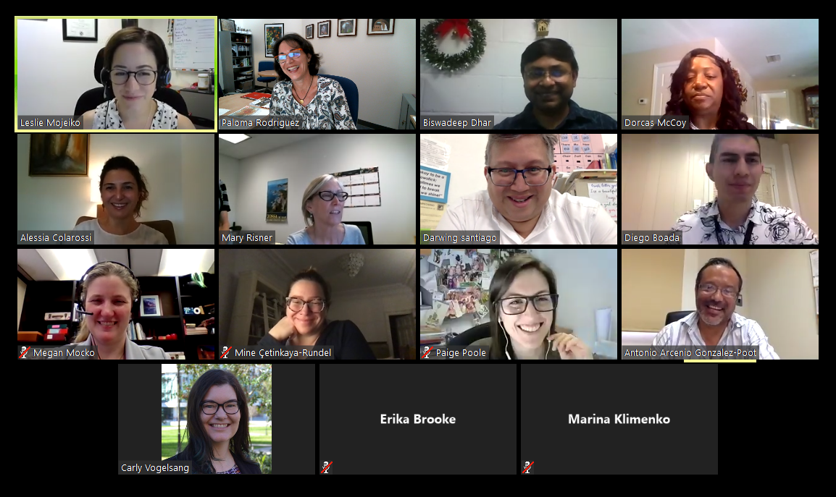
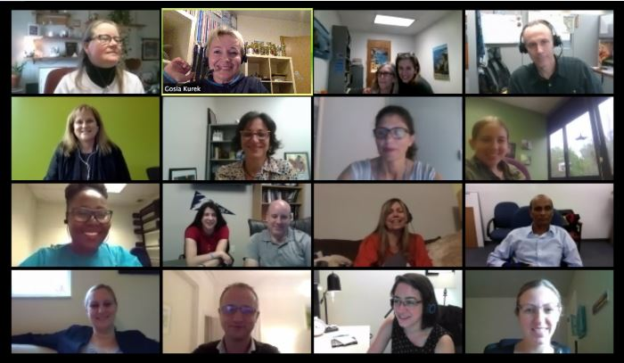
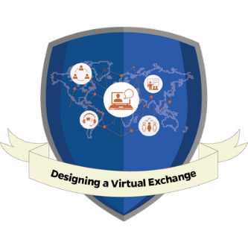
UF INTERNATIONAL CENTER
UF Professional Development Trainings & Courses
Designing a Virtual Exchange
Online course available in spring and fall
Training free for international partners
In collaboration with Center for Latin American Studies and CITT

Slide 25
Thanks!
Any questions?
UF Virtual Exchange Website
Paloma Rodriguez
prodriguez@ufic.ufl.edu
https://internationalcenter.ufl.edu/faculty-engagement/international-teaching/introduction-virtual-exchange

