Slide 1
Carpe Diem: Seizing the Opportunities Afforded by the Challenges of 2020
THERESA JOHANSSON
Director, Global Education

Slide 2
INSTITUTIONAL PARTNERSHIPS
STUDY ABROAD
GLOBAL SAFETY
UNDERGRADUATE STUDENT SUPPORT
FACULTY SUPPORT

Slide 3
The Forced Pandemic Pivot
Global Safety
Student recall
Policy revisions
Cancelation decisions
Virtualization
Faculty-led programs
Bilateral exchange
Evaluation of non-VT virtual programs internships

Slide 4
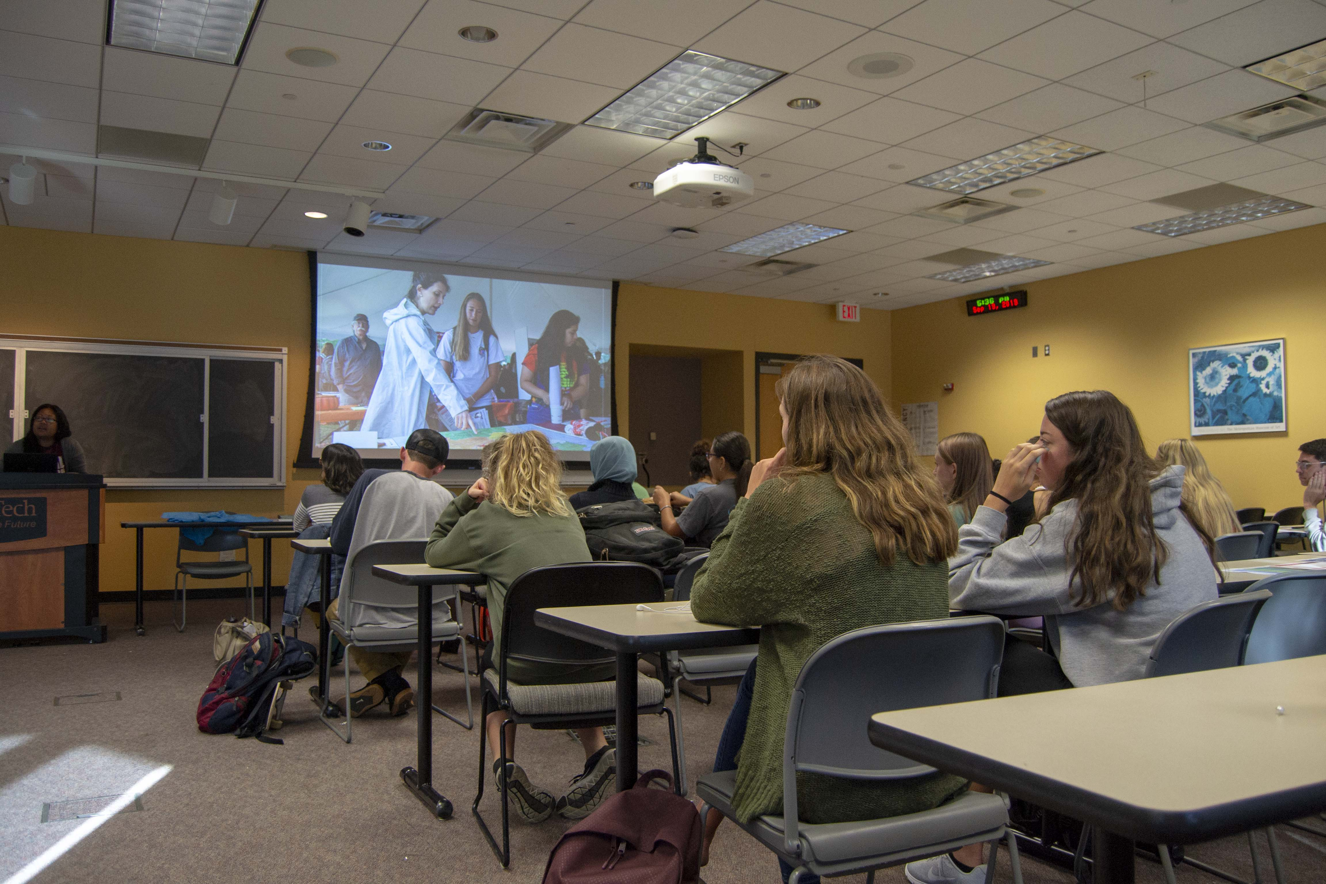
New Immediate Priorities
Students
Academic continuity
Virtual abroad content
Language learning
Intercultural skills development
Virtual tours
Faculty
Home course internationalization
Language learning
Intercultural skills development

Slide 5
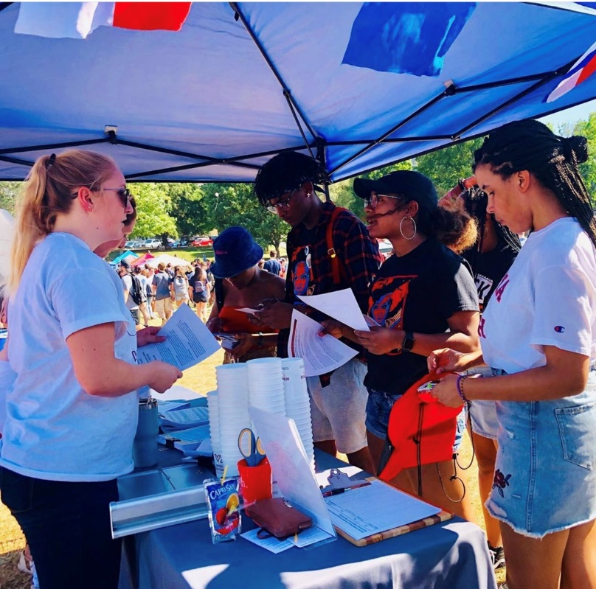
New Big Picture Priorities:
The Broader Sense of Global Education
Hub for faculty connections
to resources
to like-minded colleagues
to idoneous institutional partners in other countries
Intercultural learning center
Primary actor in the university’s inclusion, diversity, and access efforts

Slide 6
Internationalization on the home (or virtual) campus
The Global@Home Webinar
Overview of resources
Showcasing VT faculty activities and expertise in course internationalization
Overview of partner institutions worldwide
Close-up of the Purdue CILMAR HubICL and the SUNY COIL Center

Slide 7
The Global@Home Toolkit
Video spotlights of VT faculty initiatives
External global teaching & learning resources
List of research on virtual exchange and high-impact practices in online learning
Seats of Virginia Tech expertise in online learning, international and intercultural affairs, diversity & inclusion
Outcomes and assessment resources
Links to external sources of funding

Slide 8
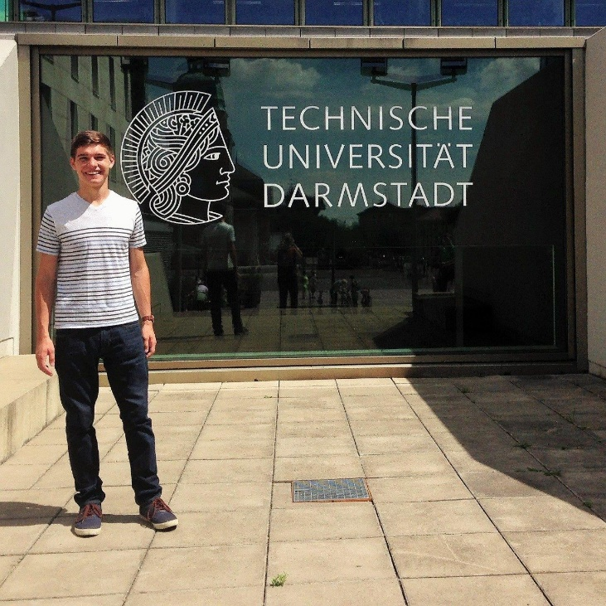
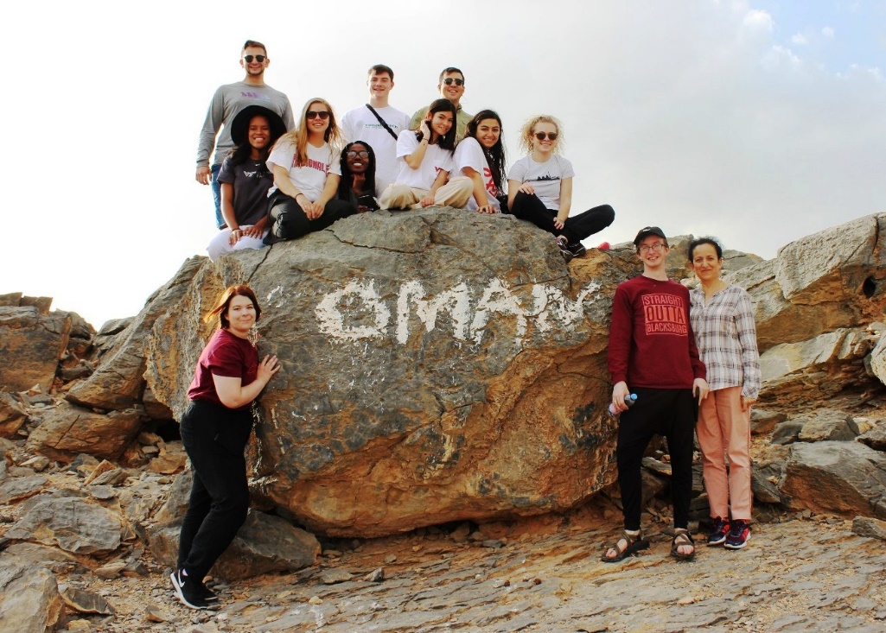
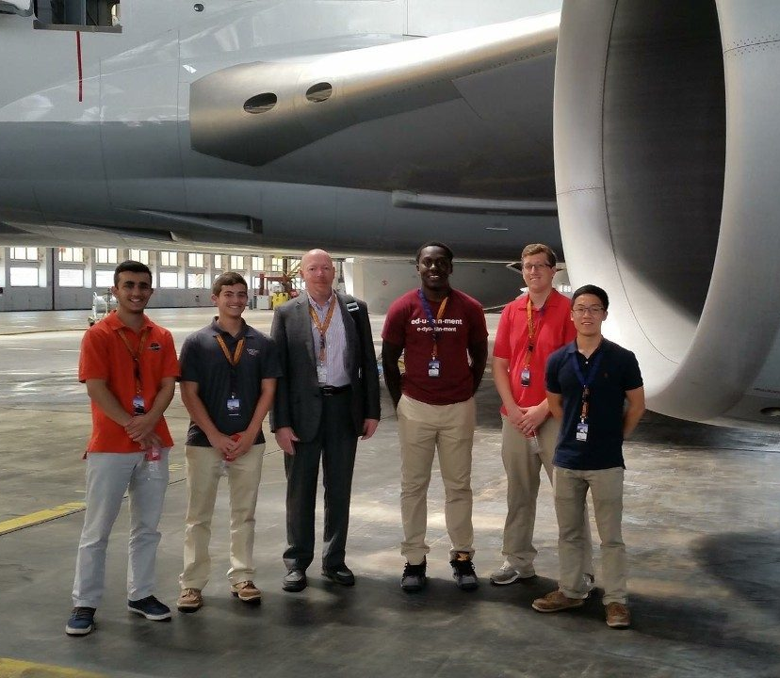
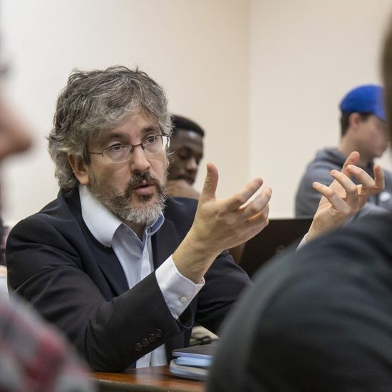
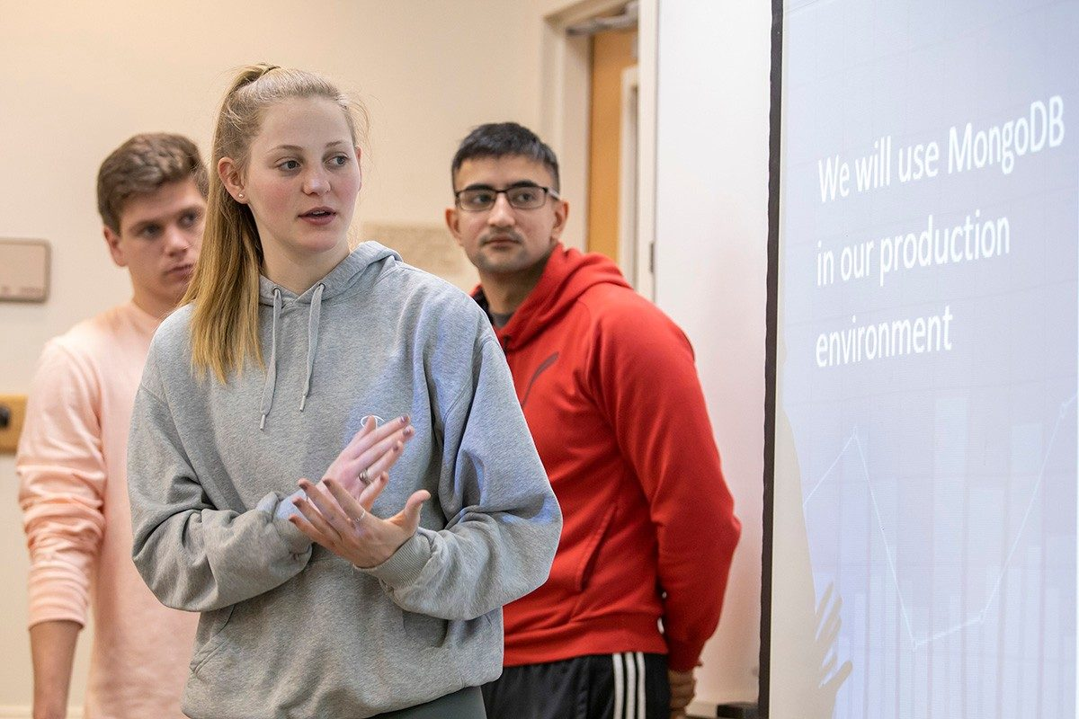
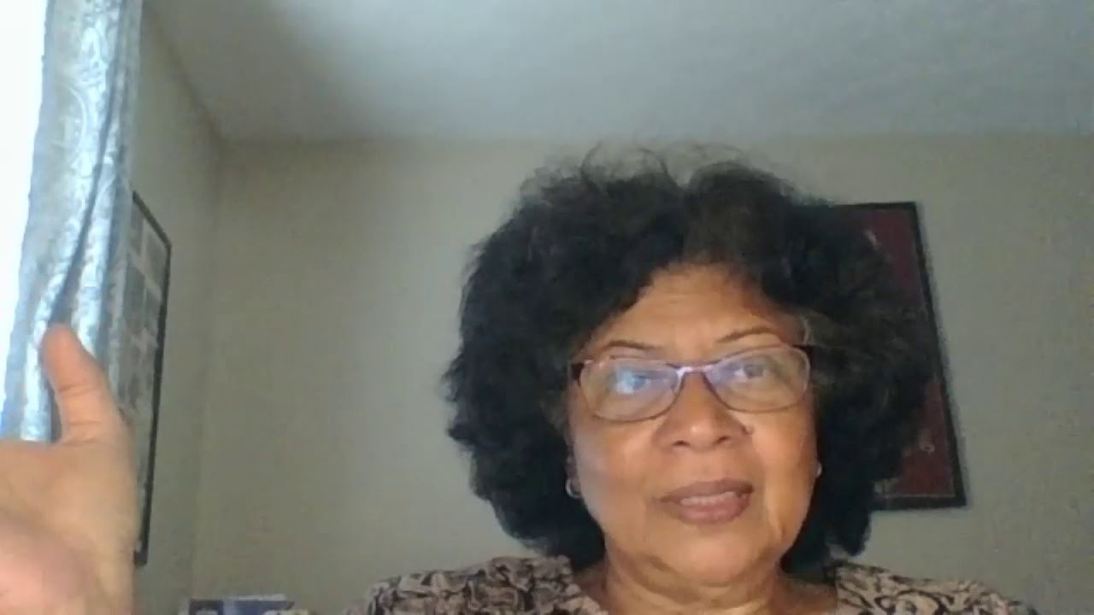
Faculty spotlights/examples
Virginia Tech BIT - Singapore Management University business capstone course
Suchitra Samanta, Women and Gender Studies - Curriculum Globalization Grantee
Virginia Tech - Universidad San Francisco de Quito COIL course in veterinary pathology
Faculty mentorship of students participating in virtual internships in London
US-MENA Virtual Exchange Program:
Electrical and Computer Engineering Capstone Design Project - Solutions to Global Challenges
VT Arabic in Oman…or not!
Virginia Tech – TU Darmstadt Global Engineering Competence

Slide 9
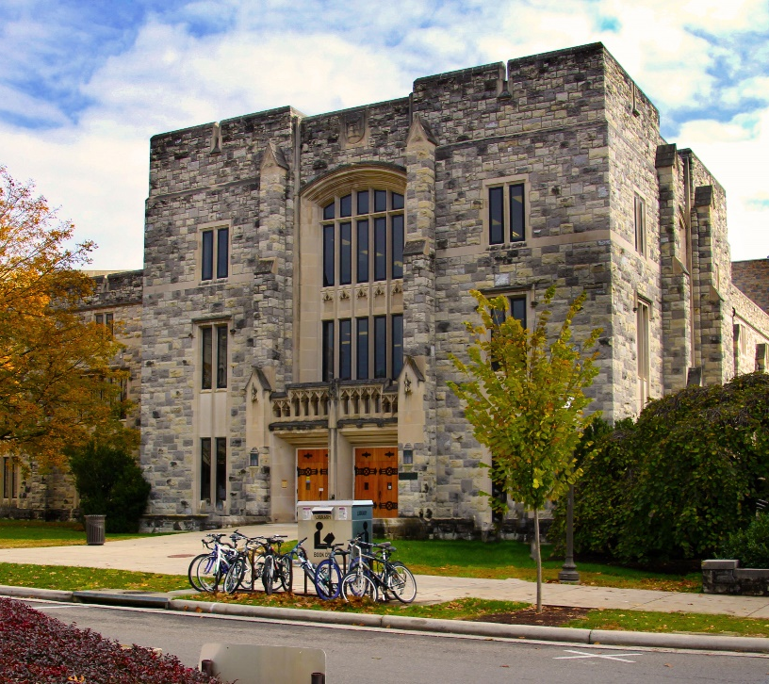
Home University Expertise in Distanced Engagement
TLOS - Technology-enhanced Learning and Online Strategies
Center for Excellence in Teaching and Learning
Office of Inclusion and Diversity
Outreach and International Affairs (CIRED, CPE, Virginia Centers)
Living Learning Communities and Cultural Centers
University libraries

Slide 10
Funding
University
Departmental & disciplinary
Central
Office of Sponsored Programs
Governmental
Department of State
Bureau of Educational and Cultural Affairs
Stevens Initiative (sponsor)
Department of Education
Institute of International Education (Fulbright, Partners of the Americas)
USAID
National Endowment for the Humanities
National Science Foundation
Non-profit (generalists and specialists)
Corporate funding

Slide 11
Starting Points
Adaptations made for home-campus teaching and research activities
Existing transnational faculty relationships
University’s portfolio of international partners

Slide 12
All the Silver Linings
Access and Equity considerations
Inclusion and Diversity
Freedom of “movement”
New momentum and faculty interest
Heightened institutional commitment
Impetus for resource collection

Slide 13
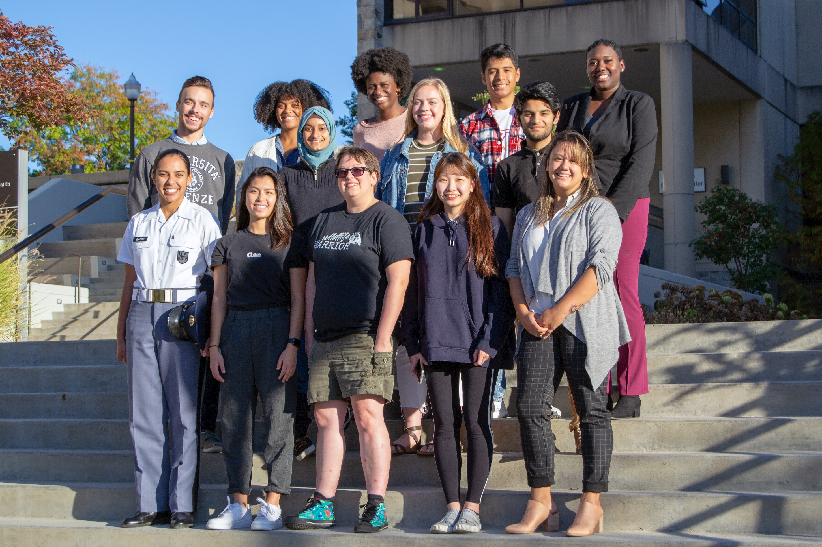
Moving Forward
Expand the resource archives and toolkit
Cement relations with offices across campus
Develop further faculty training and workshops
Continue partner mapping
Create incentive grants
Tell the stories

Slide 14
Thank you!
Theresa Johansson
theresaj@vt.edu

