Slide 1
U.S Jordanian University Coorperation (UCN)
History and Evolution: what’s next?
Patricia Parera, Associate Director for Partnerships

Slide 2
UCN HISTORY
Established with funding from the U.S. Embassy, Amman, Jordan Public Affairs Section (2018).
Charter signed by 10 universities in Jordan and 9 in USA.
Two active Secretariats at University of Jordan and Virginia Tech.
Membership open to universities that share the mission, objectives and scope of work of the current members.
Still work to do…

Slide 3
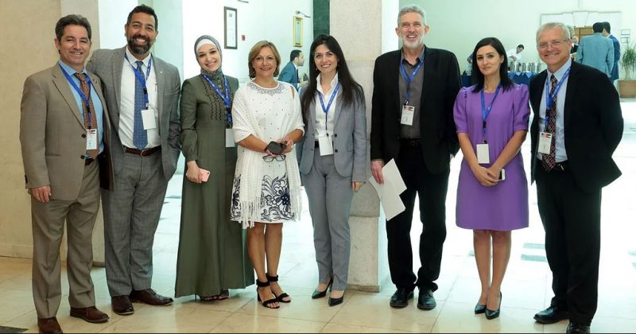

Slide 4
UCN Mission
To strengthen strategic and long-term collaboration between the United States and Jordanian universities to advance:
Joint research
Expand academic exchanges
Strengthen the quality of higher education, and encourage joint capacity building and professional development
Promote mutual understanding
Contribute to public diplomacy

Slide 5
Efforts and initiatives since 2018
1. Conference on Innovative & Transformational Ideas to Improve the Development and Policy Response to Forced Displacement
60 people in attendance
8 proposals presented, (World Bank, DoS, VT faculty and Researchers)
Linkage to the International Refugee Initiative (SPIA)
4. Newsletter
Monthly UCN newsletter sponsored by Virginia Tech and the U.S. Embassy Amman
3 Editions (March, April, and October 2020)
March – 1,750 opens
April- 507 opens
October- 3,998 opens
2. International conference & workshop on Building Capacity for International University Cooperation and Research Collaboration
Jordan (24-26 June 2019)– US Embassy in Jordan, UJ and North Carolina State University: Capacity building
3. Websites
Created and operational at University of Jordan (UoJ) Secretariat & Virginia Tech Language and Culture Institute (VT-LCI)

Slide 6
Efforts and initiatives since 2018
5. Efforts at the North-Carolina State University (NCSU) : Scholarship on Developing Cultural Competency to UCN Jordanian schools for up to 3 undergraduate students in any field to enroll in one of NCSU non-credit certificate courses.
6. Joint proposal submissions:
UW-Madison CALS (College of Agricultural and Life Sciences) Global submitted a proposal to the NSF International Research Experiences for Students (IRES) Program, together with JUST and Yarmouk U, for a two-year summer school on the food-energy-water nexus, and how all those areas are being impacted by climate change.
Virginia Tech/UW-Madison/Cambridge Education: PRESTIJ
7. Efforts at Yarmouk University (YU):
Purdue and YU faculty exchange.
Wisconsin-Madison/YU faculty exchange funded by Fulbright Commission.
3 visits from Purdue faculty to YU.
YU and Purdue are about to launch a fellowship program.
YU will announce a scholarship in industrial engineering and/or mechanical engineering and the candidates will be directed to apply to Purdue or any other UCN member in the U.S.
YU received a grant from the U.S. Embassy, Amman to fund an online GRE platform.

Slide 7
UCN Contributions
Platform: the UCN serves as a platform, not only to coordinate and introduce people to different opportunities, but also to align and harmonize communication flows.
Database: by creating a database, members can have access to funding and research opportunities, circulate conferences, agendas, suggestions, look for mobility opportunities, etc.
Networks facilitate access to knowledge resources

Slide 8
Challenges and Opportunities
Participating in the UCN helps universities enhance knowledge to develop sustainable, long-term institutional partnerships.
The UCN helps build robust relations to develop internationalization processes.
UCN provides an excellent channel to know more about possible funding opportunities and facilitate the process of finding more US partners.
Enhance cooperation by establishing an annual/semi-annual strategic plan for conferences & other activities according to priority areas.
Encourage, improve research and writing skills to be able to publish in international Journals.
Focus on mobility programs (faculty/students/administrators).

Slide 9
What is next?
The UCN team/Secretariat is using institutional resources to operationalize the network by hosting meetings, sharing communications tools, supplying survey tools, designing and maintaining websites; publishing newsletters, etc.
The UCN Secretariats are giving more than what they receive. These first years have entailed building a community rather than their own institutional growth.
The UCN team needs to motivate, keep things on track, as well as guide and mentor others to promote inclusion.
The network’s success is built around members who make contributions and stick to their commitments.

Slide 10
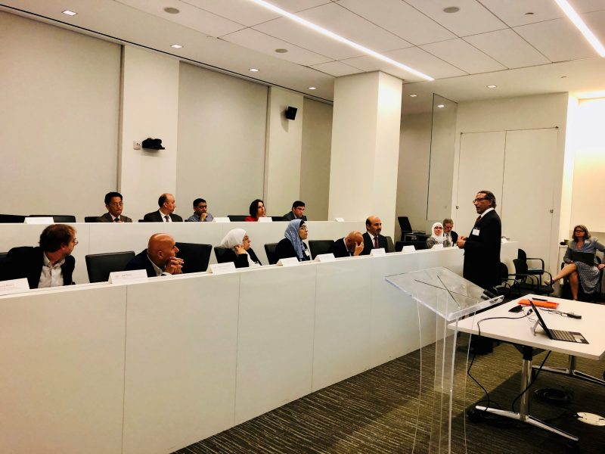
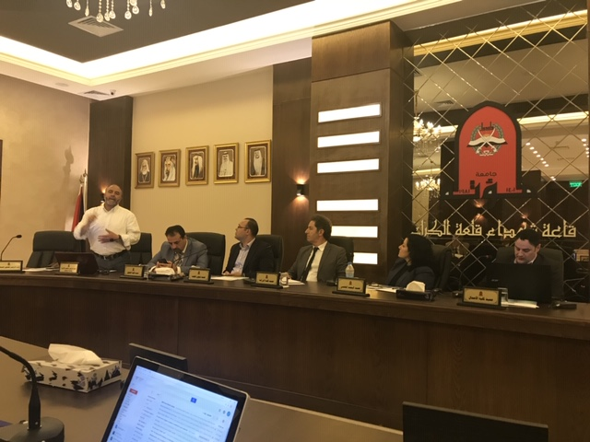

Slide 11
Ideally the UCN should:
Move away from a competitive framework to a collaborative one: the Power of Collective Action
The Secretariats need financial resources to operate
Identify funding opportunities with the help of all UCN members and apply to proposals according to relevancy of each institution
Promote and conduct collaborative research involving other thought leaders in the community.
Keep abreast of the latest developments and trends around the world
Gain global visibility and international recognition for our work

Slide 12
Thank You!
Any questions?
Patricia Parera, Associate Director for Partnerships / U.S. UCN Secretariat
Email: patric7@vt.edu

